Slide 1

PRESIDENT BOOT CAMP
Preparation and Knowledge is the Key
PDG Fred Conger • October 3rd, 2026

Slide 2
Bookmark These URLs:
Important Web Sites
https://lionsdistrict2x1.org
https://www.lionsclubs.org
https://texaslions.org
https://lionsuniversity.org

Slide 3
GENERAL INFORMATION

Slide 4
Lions Clubs International
Our Motto - We Serve
Our Mission - Our mission is to empower Lions clubs, volunteers and partners to improve health and well-being, strengthen communities, and support those in need through humanitarian service, and grants that impact lives globally, and encourage peace and international understanding.
Understand that your club is one of over 50,000 clubs joined together in the “Association of Lions Clubs” known as Lions Clubs International (LCI).
Your club is one club of our District, our Multiple District (MD-2)(TEXAS), and our Constitutional Area 1 and all LCI.
Participation in District events strengthens your club.

Slide 5
LCI’s Standard Club Structure
https://lionsdistrict2x1.org DA-MCS_en.pdf
Is your club missing any of these positions?
Membership Chair, Service Chair, 1st VP, LCIF Coordinator (IPP)?
Try to fill them and get the position trained. They are IMPORTANT to your club’s success!
Contact your District’s GLT, GMT, or GST for help.
Duties of Officers and Board of Directors are found in LA-2 pages 18-23

Slide 6
Lions Clubs International Goals
Increase Membership –
  Club’s Membership Chair/Committee + Members
Provide More Service –
  Club’s Service Chair/Committee + Members
Develop New Leaders –
  Club’s First Vice President (Club Leadership Chair)
Support LCIF’s grants and service –
  Club’s Immediate Past President or Elected LCIF Coordinator

Slide 7
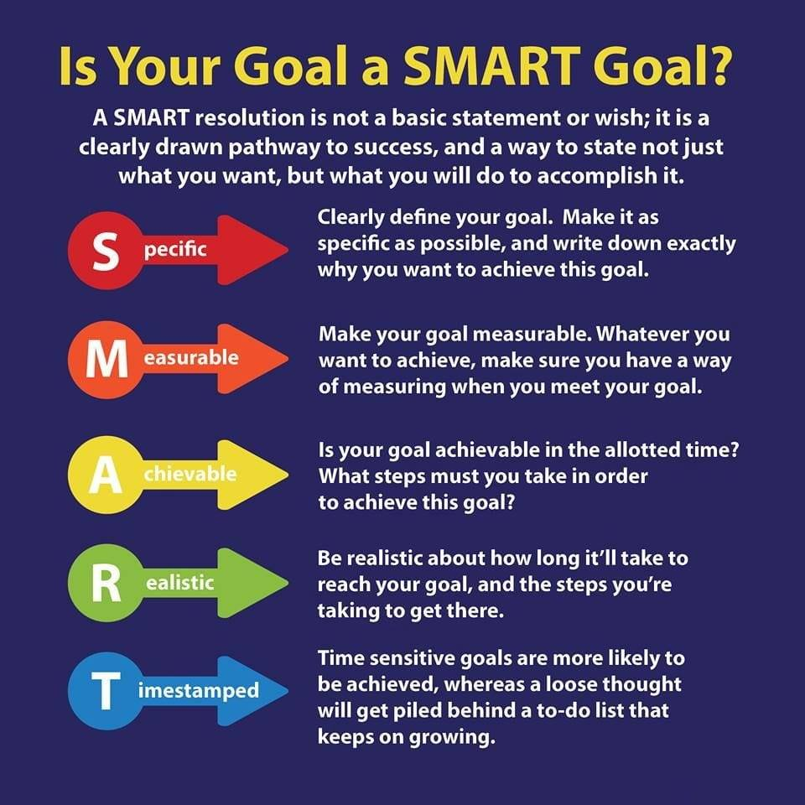
Setting Club Goals
Club Goals
Club Goals should not be only the President’s goals. They should be developed together with the entire Board of Directors and measured periodically by the Club’s Global Action Team.
Membership Growth Goal(s)
Amount of club Service Goal(s)
Officer and Lion training Goal(s)
Club support of LCIF Goal(s)
Any Custom club goals
INSERT PHOTO

Slide 8
Club Action Plans
Failure to Plan is a Plan to Fail.
Action Plans must include …
  Type of Goal (Service, Membership, Leadership, LCIF, or Custom)
  A Clearly defined Goal Statements
  What Action Steps are required to reach the goal?
  Who is responsible for each action step?
  What are the required resources for each action step?
  A Date to Begin for each action step
  A Due Date for each action step

Slide 9
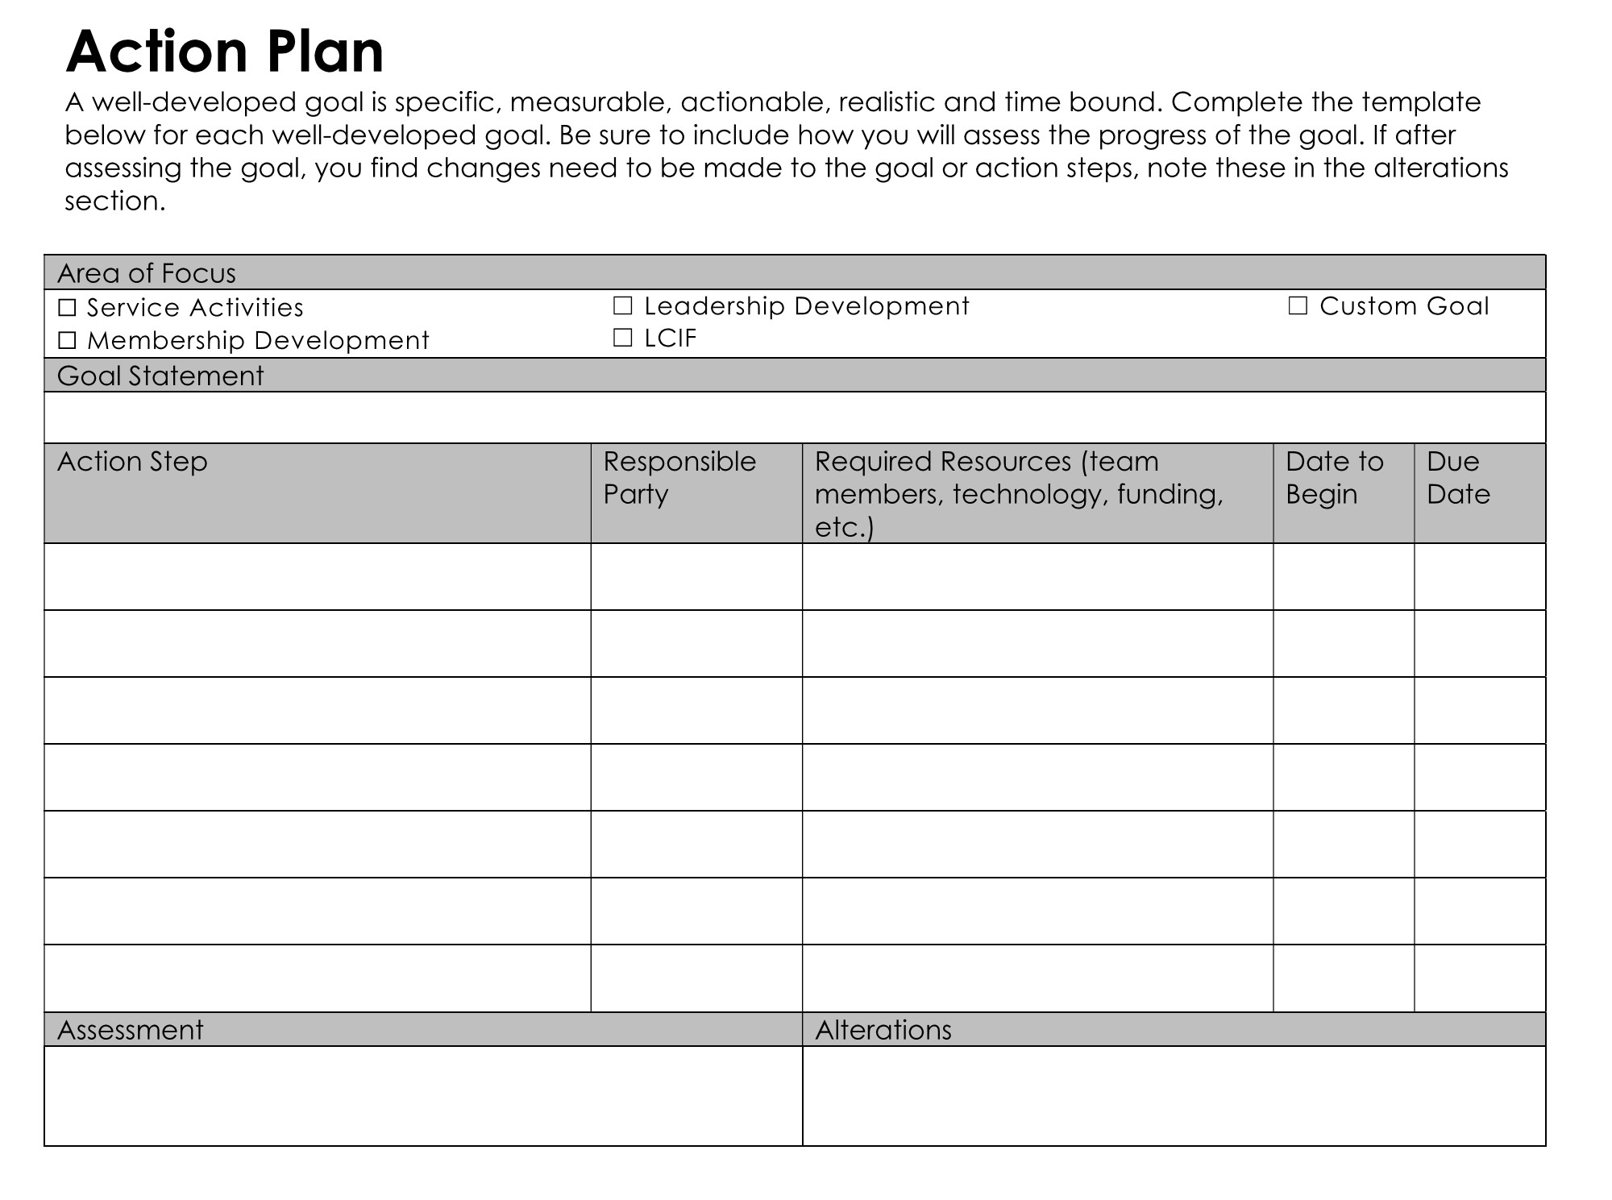
Club Action Plan Form

Slide 10
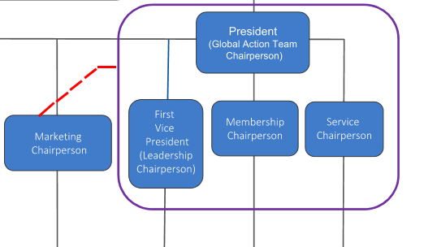
Club Global Action Team
Club Officers Leading the Global Action Team.
I would also include the LCIF Coordinator (IPP)
GAT Duties are to monitor Goal and Action Plan progress and keep them on track.

Slide 11
KEY INFORMATION

Slide 12
Preparation & Knowledge – Learn all that you can!
Club Officer & Lion Resources:
District Club Officer Training (District GLT)
LCI’s Member Resource Center
LCI’s Learn (In the Portal)
Texas Lions Leadership Forums
USA/Canada Lions Leadership Forums
Previous Club President(s)
AND if they are available….
Emerging Lions Leadership Institutes
Regional Lions Leadership Institutes

Slide 13
PRESIDENT BASICS - Agendas
DO
DON’T
• Always have a prepared meeting agenda
• Ensure all topics and items are included especially at your board meetings.
• Send to the members before the meeting
  Have printed copies for handouts
  Club Secretary can use to take notes
• Know your meeting location/room and have the needed technology available, setup and checked out.
• Arrive at your meeting(s) unprepared!
• Arrive late or at the last minute.
• Take it for granted that everything will work.

Slide 14
PRESIDENT BASICS - Meetings
DO
DON’T
• Have interesting and informational programs. Very important!!!
• Remember, You are the club CEO not the dictator. The Board makes the club’s decisions. You chair the meetings and set the agenda. You are, however, the club’s LEADER. Set an energized, positive tone.
• Start your meetings on time and end on time! Respect your member’s time.
• Allow your meeting to run overtime.
• Go down rabbit holes or allow a program to go on too long.

Slide 15
PRESIDENT BASICS - Meetings
DO
DON’T
• Welcome your members and especially any guests! Ensure everyone is welcome!
• Recognize your club member’s efforts during the meeting! Hold a year end Awards & Installation of Officers Banquet
• An acknowledgement, a simple certificate, or small token works wonders.
• Table topics or issues for a later meeting if taking too much time or are not ready for an informed decision.
• Overlook member achievements both in Lion and outside of Lions.
• Go down rabbit holes on non-agenda items or allow a program presenter to run on too long at the expense of your allotted meeting time.

Slide 16
PRESIDENT BASICS - General
• Make sure your officers are ready to report at meetings. Check in with them periodically. Communication is IMPORTANT.
• Make sure your meeting room is set up and ready and that everything works.
• Make certain that your Treasurer is sending timely member dues statements, collecting their dues, and paying the club’s bills. Any problems must be addressed ASAP. Clubs have 90 days to pay their LCI dues or they go on Suspension!
• Stay in touch with your club Secretary regarding any club correspondence and distributing timely meeting minutes.
• Fun social time is important to member satisfaction.
• Doing Quality Service Projects is why members joined your club. “We Serve”
• Have meaningful new member Inductions and offer a timely New Member Orientation program for them.

Slide 17
So, Future Club Presidents!
• Learn all that your can and be prepared for your turn as club Leader.
• Don’t feel intimidated by the office. You can do this!
• Your club will support you. After all they elected you!
• Have fun but put in the work and time.
• Being club President is a great experience.
• And it also qualifies you to become a District Zone Chairperson.

Slide 18
Questions??

Slide 19
“Remember,
There Is No Shortage of Training Material and Support.”
Need help or encouragement? Contact me or your District’s GLT.

Slide 20


EXIT TICKET
Name 1 training that you plan to attend and encourage others to attend this Lion year.
LION LEADERSHIP

Slide 21
THANK YOU
Texas Lions Leadership Forum

