Slide 1


2-X1 Charities, Inc.
Lion District 2-X1 501c3 Foundation
Supported Charities
IPDG Kedar Timalsina
President
2026-2027 Lion Year
District 2-X1 GLT - PDG Fred Conger
September 4, 2026

Slide 2
We Serve
As Lions We Serve
Our Communities
Our District 2-X1
Our State - Texas (MD-2)
Our Nation
The World

Slide 3
Lions Serve Through
Local Hands-On Service
Local Charity Donations
Our District/State Dues
(Includes $21/Year for Texas Lions Camp Fund)
District 2-X1 Supported Charities Donations
Optional 100% Charities Contributions
Purchases of Club Member Awards
2. Lions Clubs International Foundation
Club and Personal Donations
Melvin Jones Fellowships
(LCIF’s overhead covered by the Fund’s Interest)

Slide 4
10 - District 2-X1 Supported Charities
1. Texas Lions Camp
2. Lions Sight & Tissue Foundation
3. Texas Lions Foundation
4. Lions Clubs Int’l Foundation
5. Julien C. Hyer Youth Camp
6. Leader Dogs for the Blind
7. World Services for the Blind
8. Texas Lions Eyeglass Recycling Center
9. Texas Lions Museum
10. 2-X1 Charities, Inc.
https://lionsdistrict2x1.org/charities/

Slide 5
District 2-X1 Supported Charities
So, How can we support these 10 district approved charities?
100% Club Donations
Individual Lion Contributions
Club Donations (Awards)

Slide 6
100% Club Contribution Amounts
* Per club member based on July 1st membership.
Texas Lions Camp $10 * Required for 100%
Lions Sight & Tissue Foundation $2 * Required for 100%
Texas Lions Foundation $2 *Select 5 of remaining 8 charities for 100%
Lions Clubs Int’l Foundation $5 But why not pick all 10?
Julien C. Hyer Youth Camp $2
Leader Dogs for the Blind $2
World Services for the Blind $2
Texas Lions Eyeglass Recycling Center $3
Texas Lions Museum $2
2-X1 Charities, Inc. $2
Total: $32 * 100% contribution is Optional

Slide 7

100% Club Donations
A club’s 100% contributions may be paid from:
the club’s administrative account from member dues or …
from the club’s project/charities account using money raised from the public since these entities are each 501c3 charities.
Note: This money is NOT a part of the club’s District/MD-2 dues.
Clubs receive a notice which is NOT an invoice. February time frame. Contributions are optional but encouraged to support our district charities.
Example: 2000 District 2-X1 Lions x $30 = $60,000 in charity support.

Slide 8


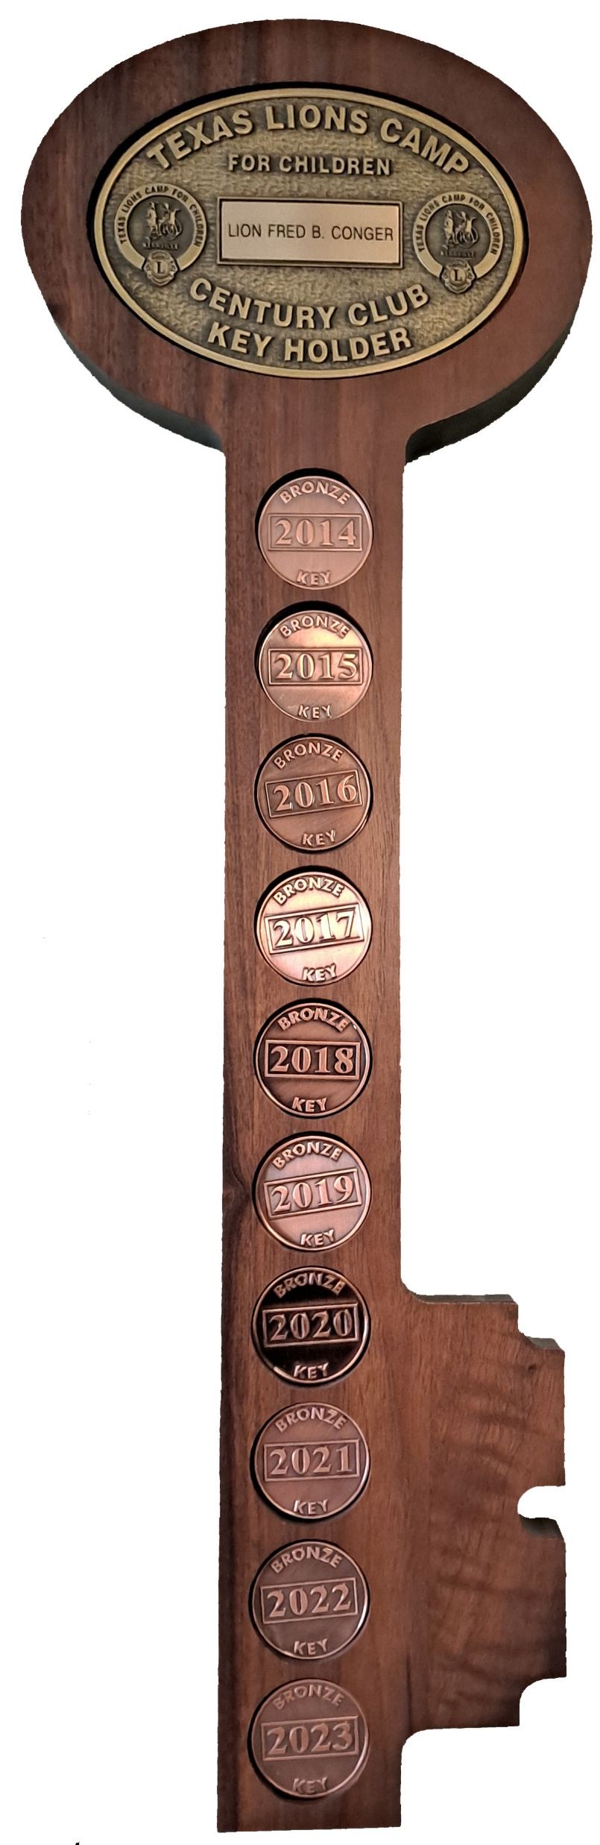
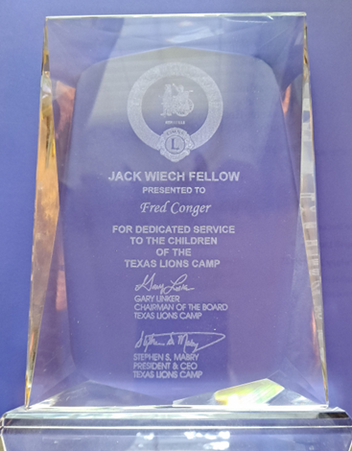
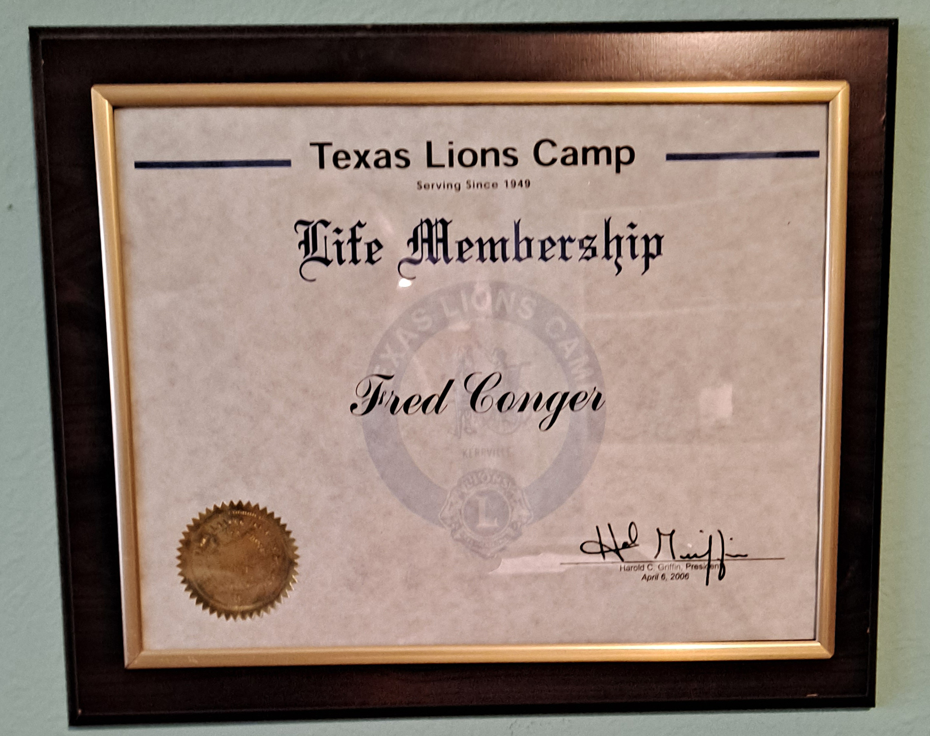
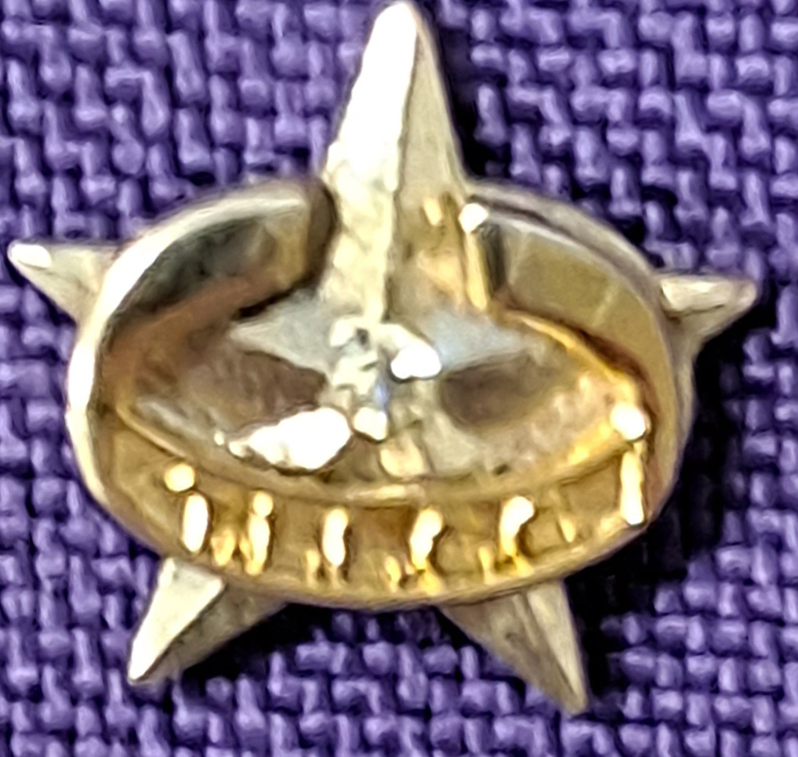
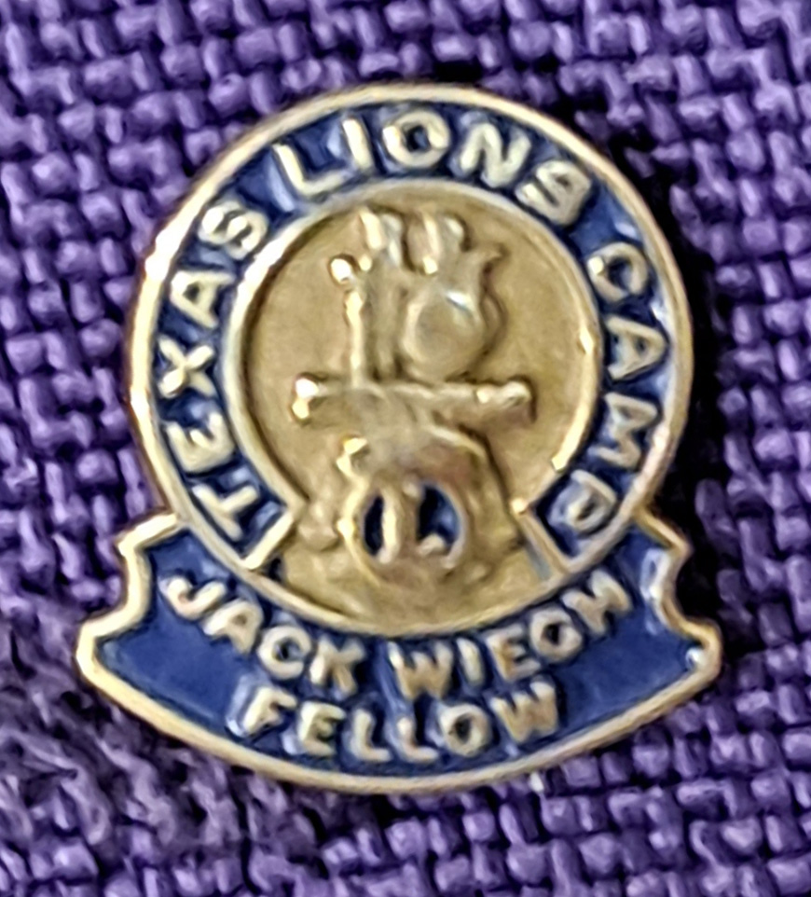
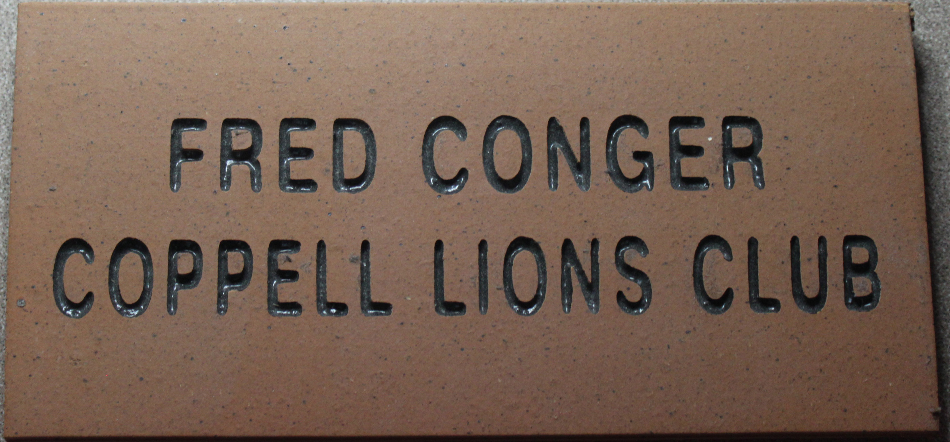
Texas Lions Camp is a residential summer camp for children with physical disabilities, type 1 diabetes and cancer. Children with special medical conditions from all over the State of Texas can attend free of charge.
Texas Lions Camp
4100 San Antonio Hwy, Kerrville, TX 78028
lionscamp.com
Camp video
83,000 Campers Served
12,500 Summer Staff Members
1500 Volunteers last Year
21,000 Texas Lions Support this camp with …
100% Club donations, and
life memberships $100 + $25 for plaque,
Century Club Key memberships $100/year, $250/year, $500/year, $1000/year, $5000/year,
Endowment bricks $250, and
Jack Wiech Fellowships $1000

Slide 9
The Lions Sight and Tissue Foundation of District 2-X1 Inc. (LS&TF) has been serving the citizens of the Dallas area from it’s beginning in 1956 as an eye bank devoted to cataract surgery and cornea transplantation to its current purpose as a resource for the people in District 2-X1 (which includes the Counties of Dallas, Ellis, Hunt, Rockwall, Kaufman & parts of Collin) to receive eyeglasses as well as medical assistance for vision issues.
The impact of this service on the lives of these children and adults is profound. Without glasses, children are less likely to succeed in school, leading to drop-outs, gang involvement, and potential incarceration. Vision problems are 3 times as likely in Juvenile Detention Centers as in the general population. For adults, having a pair of glasses can mean the difference in getting a job or becoming a drain on society’s resources. The sense of pride in becoming self-sufficient can change their lives.
LS&TF is a Lions Club District 2-X1 Charity. As a 501(c)(3), all contributions made are tax deductible under law. We welcome all donations and would be glad to discuss our work with any group or individual who is interested. Only through the generous donations of Lions Clubs, Foundations, Corporations and individuals can the important work of the LS&TF continue to help the people of District 2-X1.

Slide 10
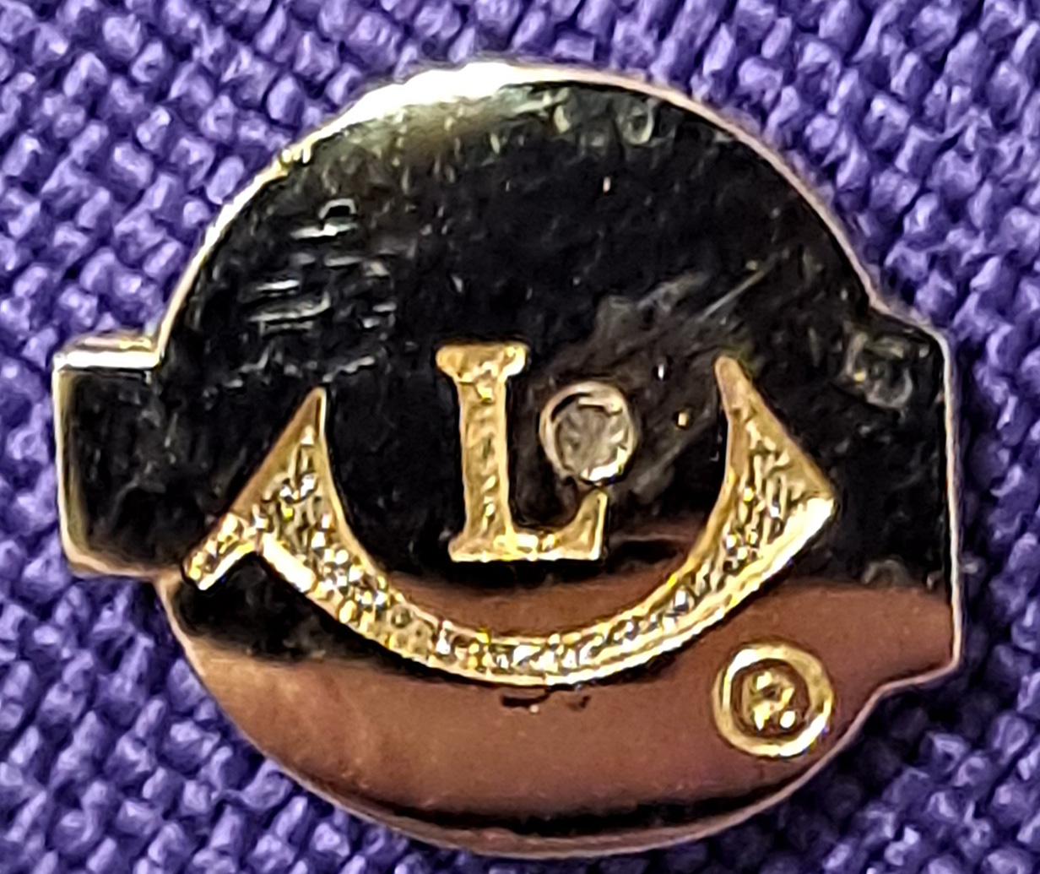
Funded by:
100% Club donations and
$100 – TS&LF Life Membership ($150 with Plaque)
$250 – William S. Harris Memorial Award (Bronze Plaque)
$500 - Pete Anderson Award (Desktop Award)
$750 – Neil Roach Award (Desktop Award)
$1000 – PDG F.X. “Pancho” Luna Award (Bronze Plaque)
Plus, proceeds from Annual
Denim & Diamonds Fundraiser – each June

Slide 11

Texas Lions Foundation
MD-2
Texas Lions Foundation (TLF) is an organization committed to filling humanitarian needs throughout the world. As a public, non-profit, tax-exempt corporation, its purpose is to promote human welfare by careful application of contributed funds.
TLF concentrates its efforts in two areas: humanitarian services and disaster relief. The Foundation strives to support projects that, while falling into one of these two categories, also have long-term and far-reaching effects, and promote the objectives of the Texas Lions Foundation. Overall, the Foundation maintains a strong commitment to helping people achieve their own potential, and to implementing projects that make permanent and positive changes. Projects are favored that provide benefits to as many people as possible.

Slide 12

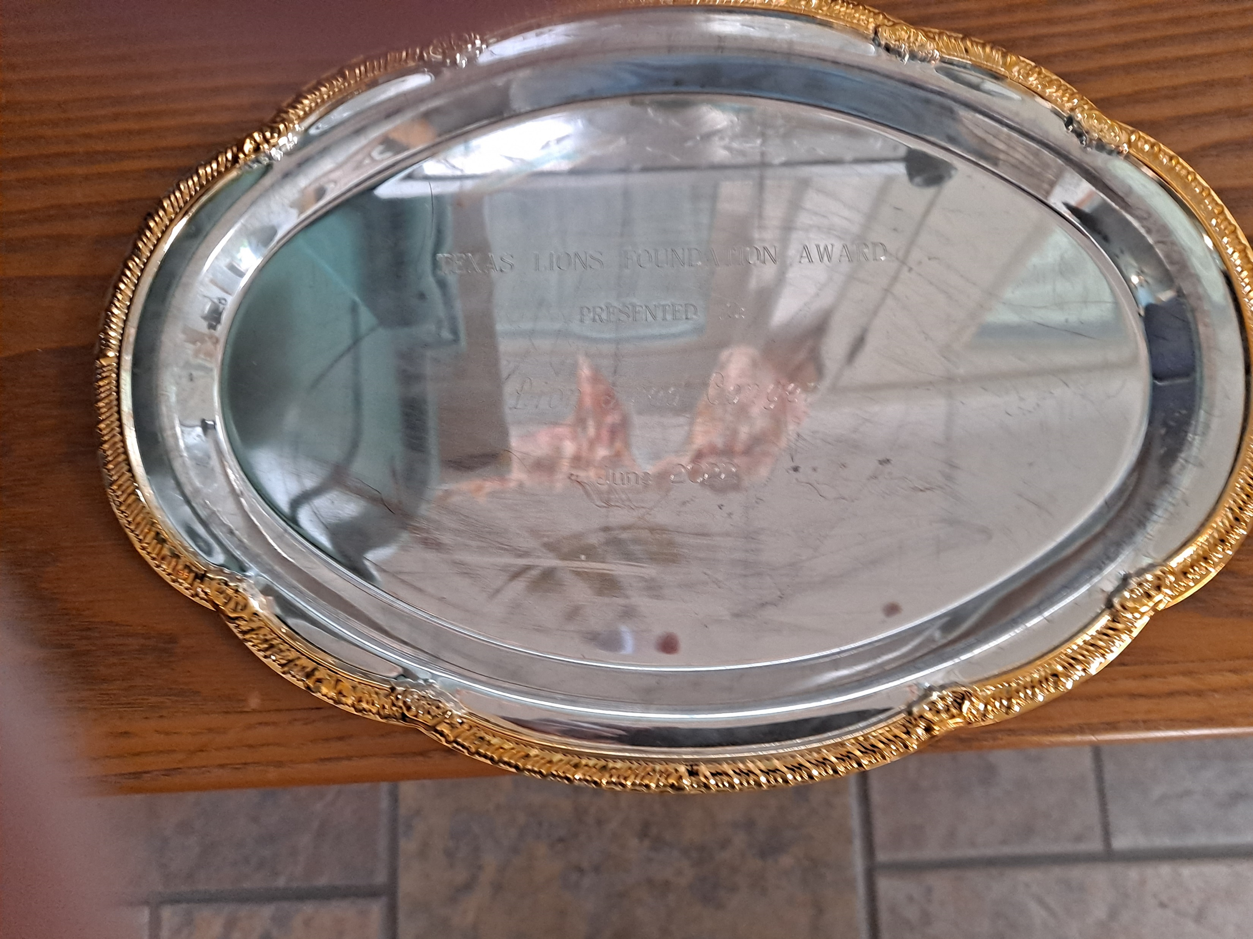
Texas Lions Foundation
MD-2
100% club donations and
$125 - TLF Award (Silver plate engraved)
$500 - TLF Fellow Award (Plaque & lapel Pin)
$500 additional - (pins have a diamond per $500 added)

Slide 13

Lions Clubs International Foundation
Our mission is to empower Lions clubs, volunteers, and partners to improve health and well-being, strengthen communities, and support those in need through humanitarian services and grants that impact lives globally, and encourage peace and international understanding.
Global Causes:
Vision, Hunger, Youth, Disaster Relief, Humanitarian, Diabetes, Environment, Childhood Cancer.

Slide 14
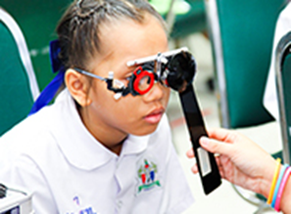

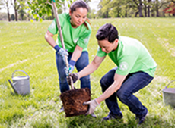
Lions Clubs International Foundation
Global Causes
Vision
LCIF helps Lions prevent avoidable blindness and care for the visually impaired
Hunger
LCIF is on a mission to ensure all community members have access to nutritious foods
Environment
LCIF is dedicated to helping Lions take on large-scale projects that will create a sustainable and healthy future for generations to come.

Slide 15

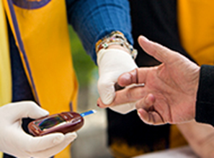
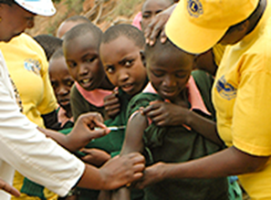
Lions Clubs International Foundation
Global Causes
Childhood Cancer
LCIF is committed to helping cancer patients and their families, and we’re constantly exploring new ways to improve quality of life for these children.
Diabetes
LCIF is fighting to reduce the prevalence of diabetes and improve quality of life for people diagnosed with this disease.
Humanitarian
Lions identify the world’s most crucial needs, and LCIF supports them in their efforts to provide humanitarian aid around the globe.

Slide 16

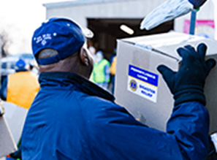
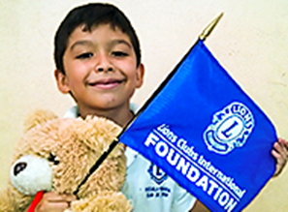
Lions Clubs International Foundation
Global Causes
Disaster Relief
Whenever and wherever disaster strikes, Lions are often among the first to offer aid. LCIF empowers those crucial relief efforts.
Youth
LCIF improves access to quality education, vital health services, and positive youth development for young people around the world.

Slide 17
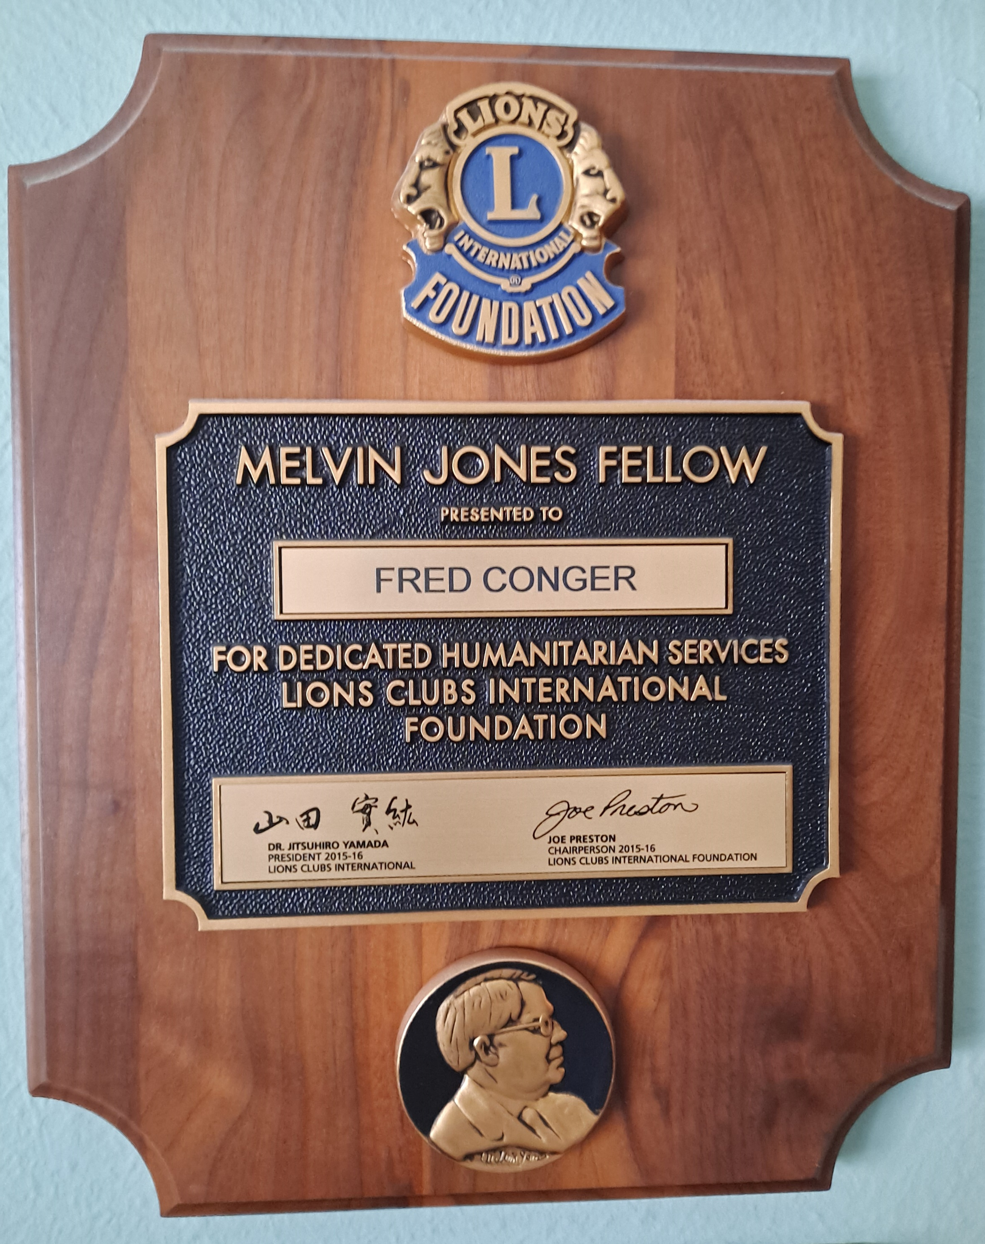
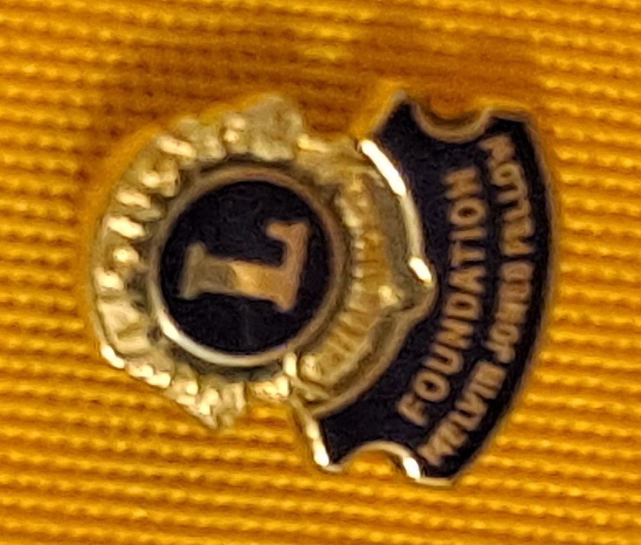
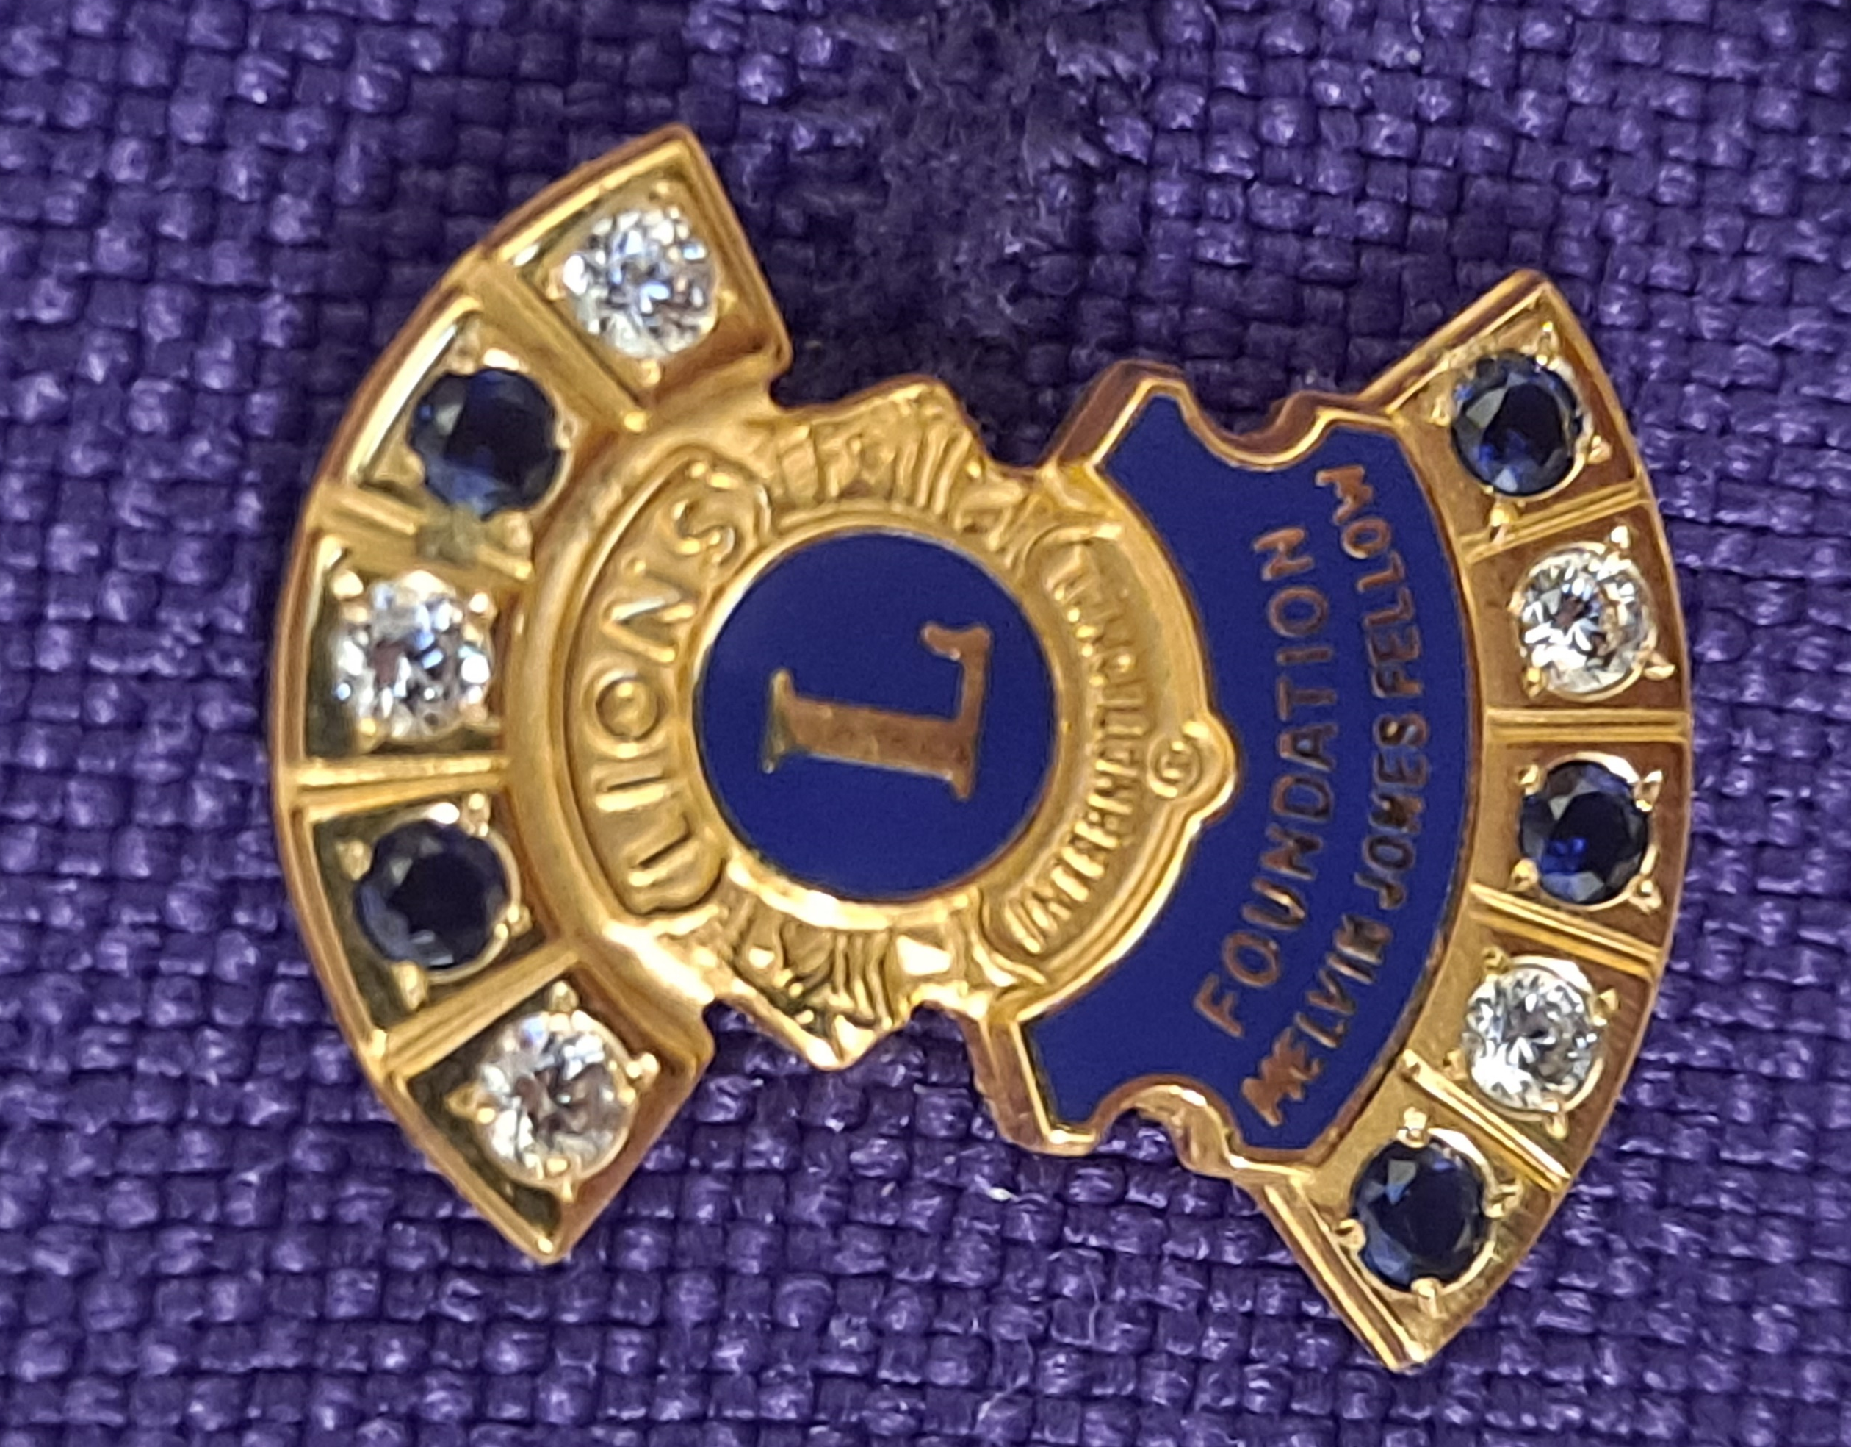
Lions Clubs International Foundation
100% club donations and
Lion Member Donations (counts toward a future MJF)
Club Donations (counts toward a current or future MJF)
Melvin Jones Fellowship
$1000 - MJF Award (Plaque and lapel Pin)
Progressive Melvin Jones awards
(each $1000 level adds 1 up to 10 diamonds then diamonds
are replaced by sapphires up to ten sapphires)

Slide 18

Julien C. Hyer Lions Youth Camp
Districts 2-X1 and 2-E2
The Julien C. Hyer International Youth Camp represents a group of students from countries around the world that participate in a six-week program to expose them to life in Texas through stays in Dallas/Fort Worth, Lake Texoma, San Antonio and Lubbock to promote peace and understanding.
The Julien C. Hyer Lions Youth Camp was organized in 1973 and the first camping session was held in 1974. Each year an average of 30 youths (boys and girls) has visited Texas to attend the Julien Hyer Camp. During this time, the program has changed slightly but the objective “to foster and create a spirit of understanding among the peoples of the world” remains the same. This Camp gives each attending youth the opportunity to learn about other peoples of the world while visiting Texas and the United States of America.
The Camp is named in honor of Past International President Lion Judge Julien C. Hyer (1931/1932) the Founder of the Lions Clubs International Youth Exchange Program.

Slide 19
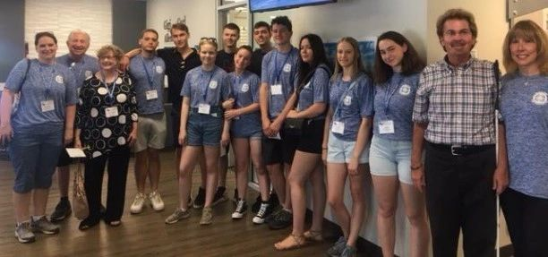
Julien C. Hyer Lions Youth Camp
Districts 2-X1 and 2-E2
100% club donations and
$125 – Life Membership Award (Plaque)
$1000 – Jack Harris Fellowship (Plaque)
$1000 – Jimmy Thompson Fellowship (Plaque)

Slide 20


Leader Dogs for the Blind
Our mission is empowering people who are blind or visually impaired with lifelong skills for safe and independent daily travel.
Leader Dog's programs give people the tools, skills and confidence to travel independently. Our Orientation and Mobility (white cane skills) and Guide Dog programs are for people 16 or older whose daily travel is impacted by vision loss. Teen Summer Camp and Youth Orientation and Mobility are for teens 16 and 17. All our programs are free. If vision loss is holding you back, we can help.
Leader Dog is the answer for thousands of people in critical need of services to regain travel independence. Due to the shortage of state-supplied services, we developed our own Orientation and Mobility program to address the need for people to learn how to safely use a white cane. We believe every person deserves equal opportunity for independent travel, so all our services are provided at no cost.

Slide 21

World Services for the Blind
World Services for the Blind was founded by Roy Kumpe in 1947. With a $10,000 donation from the Little Rock Lions Club, Kumpe began building what would become the most comprehensive rehabilitation center for people who are blind or visually impaired.
The mission of World Services for the Blind is to empower people who are blind or visually impaired in the United States and around the world to achieve sustainable independence. We help individuals reach their goals through life skills and career training. Although each client's tuition and fees are covered by their states, WSB relies on financial contributions for almost everything else, from computers and other classroom technology to furnishings and appliances for dorms.
Since 1947, World Services for the Blind has served over 17,000 blind and visually impaired individuals across the United States and from 60 countries. WSB provides comprehensive life skills training, vocational training, and transitional-aged youth programs on-campus in Little Rock, AR and online through our online Learning Management System.

Slide 22

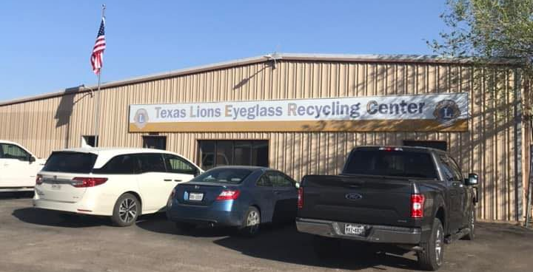
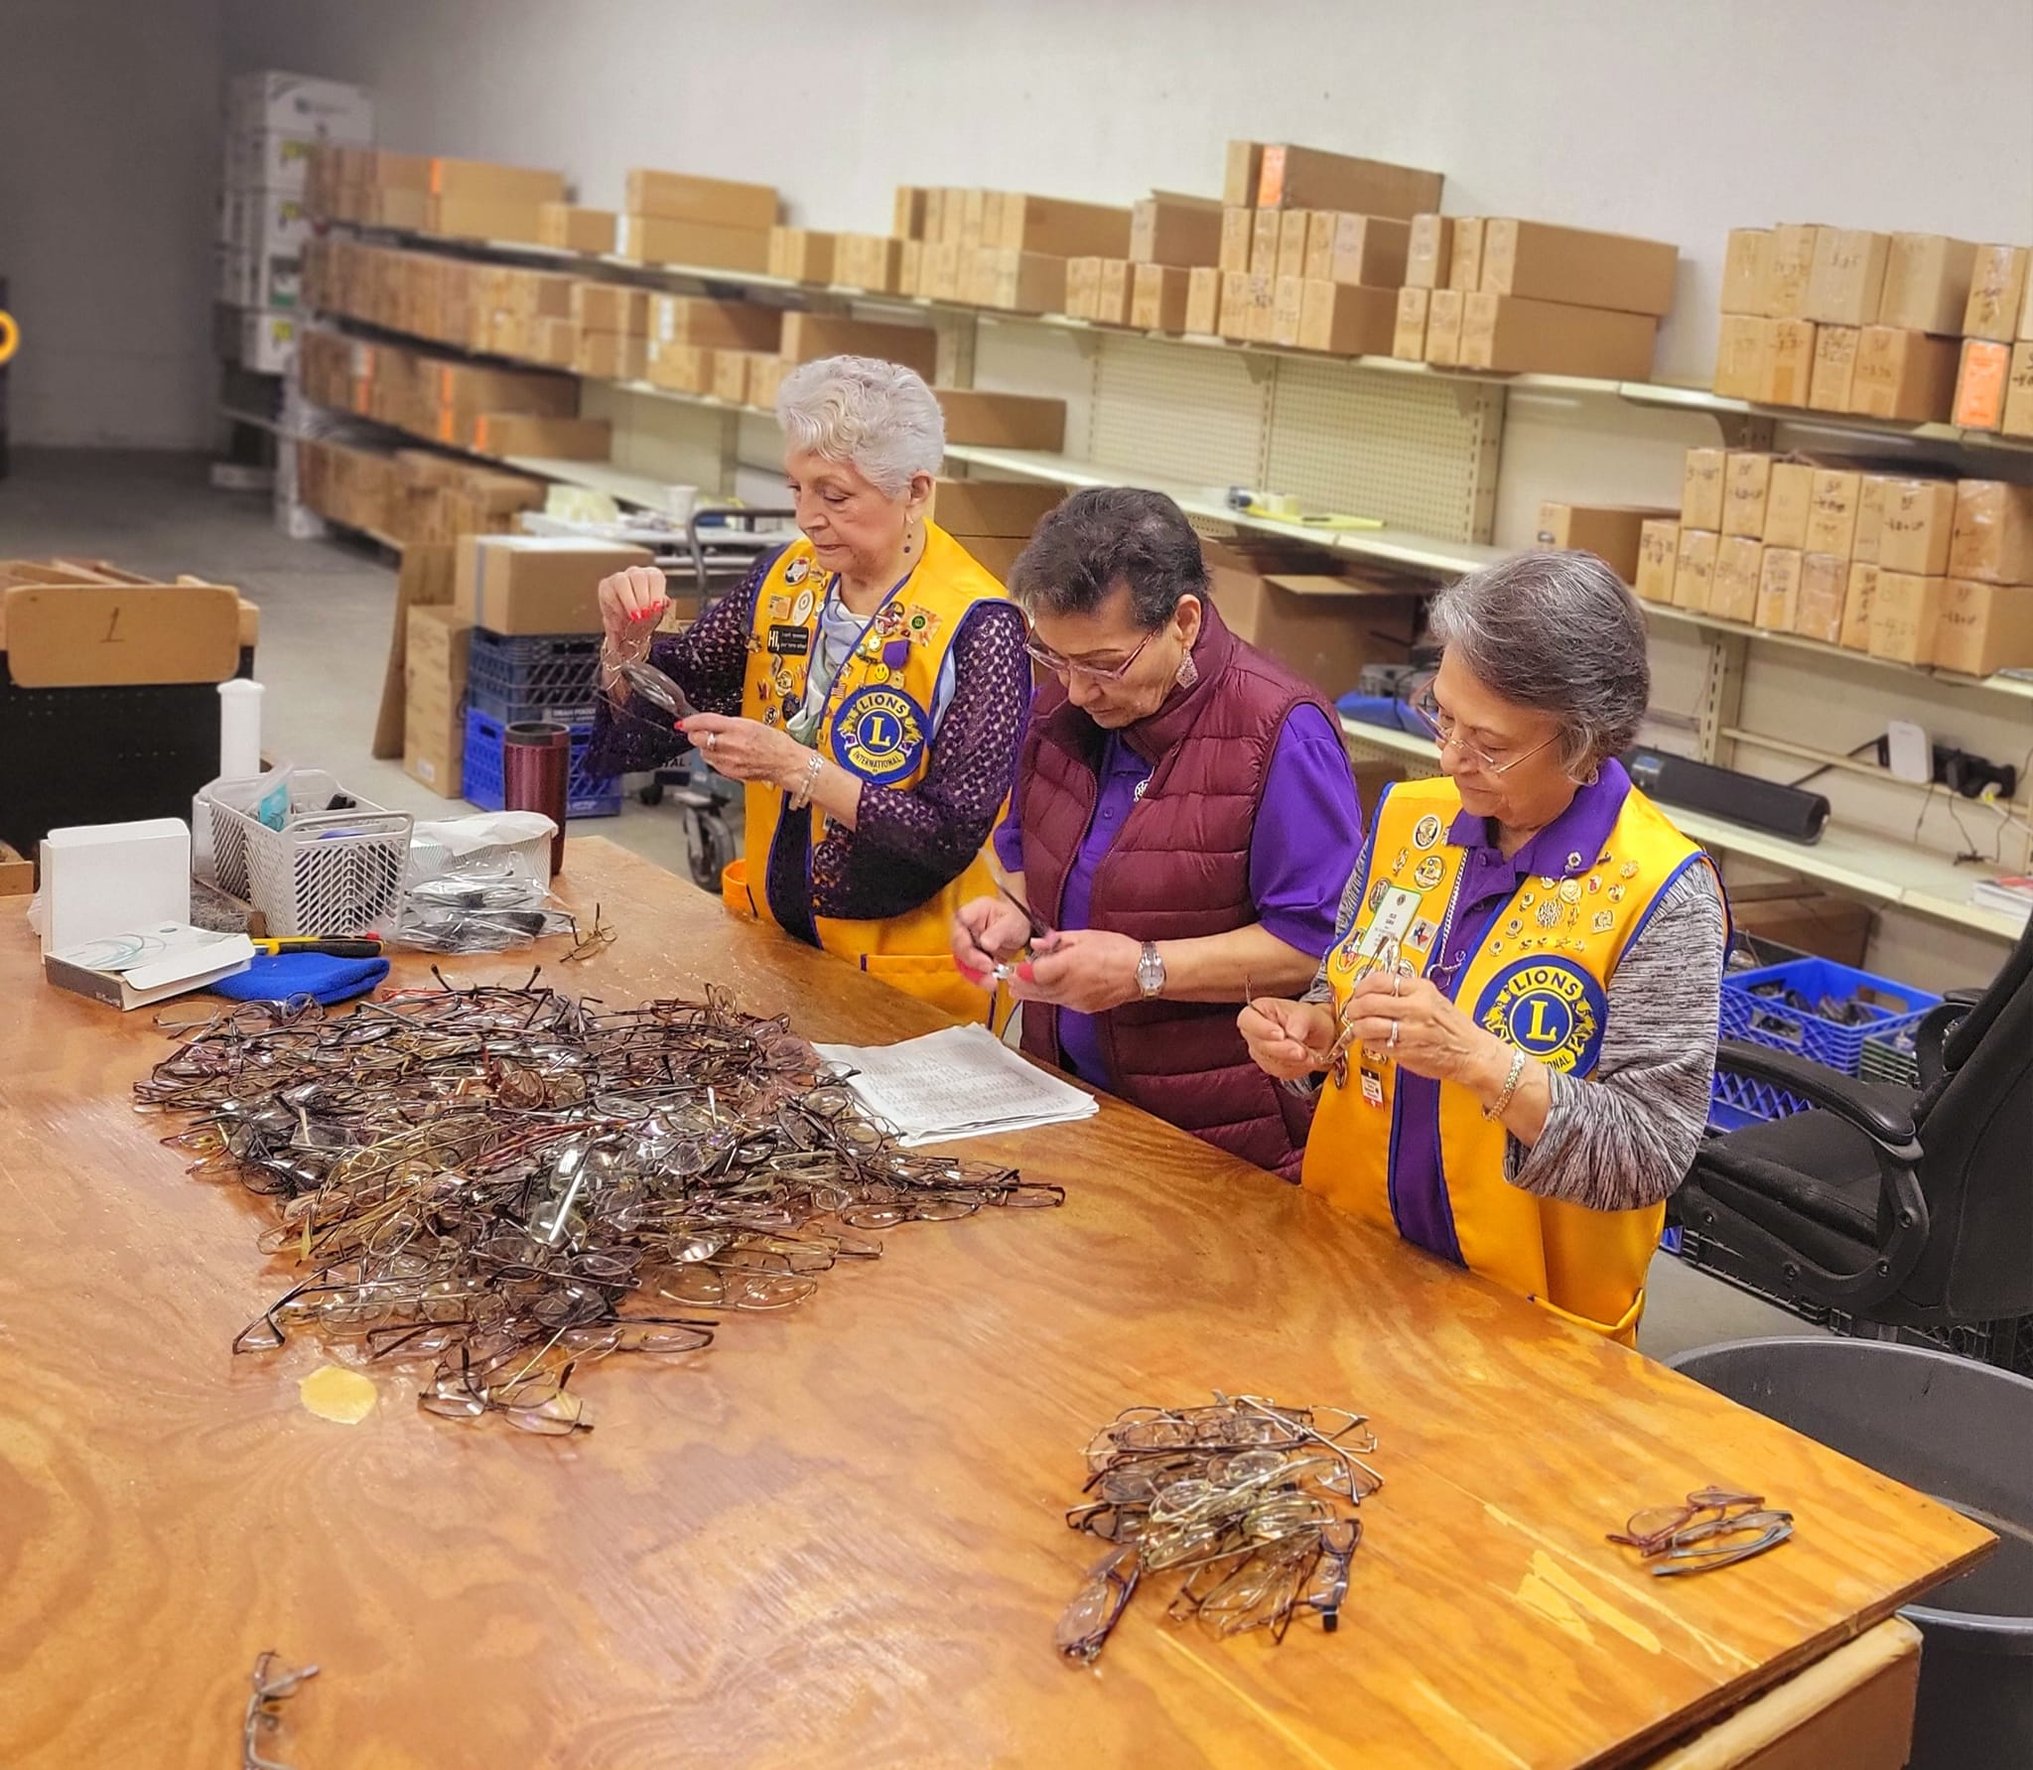

Texas Lions Eyeglass Recycling Center
The TLERC receives, processes and distributes used eyeglasses worldwide to persons without the means and facilities to provide eyecare.
The TLERC, working with Lions Clubs in Texas provides new eyeglasses to the needy children of Texas free of charge.
$250 – Doctor Norman S. Gould Bronze Vision Award (Plaque)
$500 – PID Marshall Cooper Silver Vision Award (Plaque)
$1000 – PDG O. Ike Fitzgerald Gold vision Award (Plaque)

Slide 23
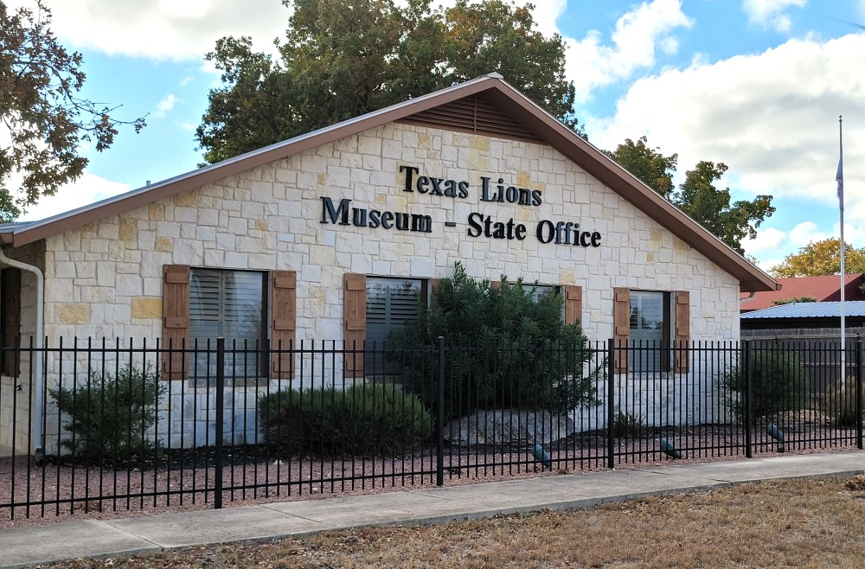
Texas Lions Museum & Office Foundation
$100 – TLM & SO Life Membership (Certificate & Lapel Pin)
$500 – Ebb Grindstaff Fellowship (Plaque and Lapel Pin)
$500 - Cheryl & Mike Butler Fellowship (Plaque and Lapel Pin)

Slide 24
District 2-X1 Charities Inc.
Also Supports
Lions Opportunities for Youth (LOFY)
    Diabetes Awareness Essay Contest Awards
    Drug Awareness Speech Contest Awards
    Outstanding Youth Contest Awards
    LCI Peace Poster Contest Awards
Local Disaster Relief
Provides District SPOT & BLINQ Vision Screening Equipment
Other Special Need Requests
LOFY Funds are supported by:
Duck Derby Race Fundraiser
Polar Plunge Fundraiser
Club Entry Fees

Slide 25

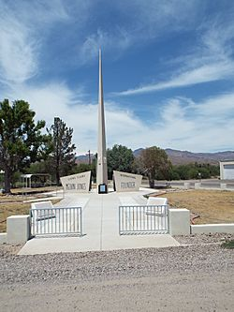
Melvin Jones Lions International Memorial Fellowships
Birthplace of Melvin Jones – Founder of Lions Clubs International
Fort Thomas, AZ
$100, $250, $500 and $1000 Donations are recognized on the Wall of Fame in the Memorial Building.

Slide 26
Lion Non-Charity Awards
Available from
Lions Clubs International Website Store
Club Officer Medals
President’s Appreciation Medals
Lion of the Year Patch & Pin
Club Officer Patches
Past President’s Pin
Club President’s Pin (passed down to next President)
Lions Clubs International Website Store or a Local Awards Store
President Appreciation Plaque
Lion of the Year Plaque

Slide 27
100% Club Contribution Amounts
* Per club member based on July 1st membership.
Texas Lions Camp $10 * Required for 100%
Lions Sight & Tissue Foundation $2 * Required for 100%
Texas Lions Foundation $2 *Select 5 of remaining 8 charities for 100%
Lions Clubs Int’l Foundation $5 But why not pick all 10?
Julien C. Hyer Youth Camp $2
Leader Dogs for the Blind $2
World Services for the Blind $2
Texas Lions Eyeglass Recycling Center $3
Texas Lions Museum $2
2-X1 Charities, Inc. $2
Total: $32 * 100% contribution is Optional

Slide 28

District 2-X1 Supported Charities
Support Your District’s Charities
because …

