Slide 1

Lions International
MD2
District 2X1
2026 Lions University
Region X
Session: Service

Slide 2
Welcome
Thank you for joining us today.
Christy Householter, GST
Richardson Midday Lions Club
crandlehouse@gmail.com
214-926-2374

Slide 3
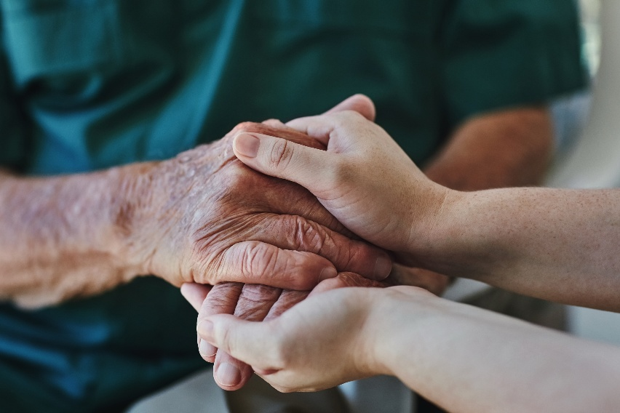
We are serving a world in need. One act of kindness at a time.

Slide 4

Agenda
Service NOW and NEXT YEAR
LA-2Constitution and By-Laws
Section 8-pages 21/22
Service Chairperson
2. Club Service Chair e-book
3. Service Journey
4. Measuring Service Impact
5. Quick Start Service Ideas/100 Ideas
6. District Charity Information
7. Service Q&A
8. Club & Community Needs Assessment
9. Why Service Reporting Matters

Slide 5
Pair Sharing Activity:
Please discuss with a partner the service activity(ies) and/or Signature activity(ies) your club is known for in the community.

Slide 6
AllyouneedtoknowaboutSERVICE
https://lionsdistrict2x1.org/lions-2-x1-university-files/

Slide 7
Service Now and the FUTURE.
2025/2026
3 Weeks of Service (Mental Health,
Hunger, Environment)
DG Kedar Goals
2026/2027
New Weeks of Service Vision (October 8-18)
Youth (Feb 13-21) Environment (May 29-June 6)
DG Vineyard Goals

Slide 8


aa
Lions global causes
Together we tackle 8+ causes, locally and globally. Do you know the “+”?
8
Notes:
Mental Health and Wellbeing

Slide 9
Our global impact at a glance
1.5
million
projects completed
July 2025 through May 2026
Continue to
Make an impact
with us.
290
million
people served
July 2025 through May 2026
51
Million
Volunteer hours
July 2025 through May 2026

Slide 10
1.Club Service Chair/Committee
LCI Club Service Chair Web Page Link
LA-2 Constitution and By-Laws (Standard Club) By-laws Article III – Duties of Officers
Section 8 – page 22 – Service Chairperson

Slide 11
Section 8. SERVICE CHAIRPERSON. The responsibilities for this position shall be as
follows:
(a) Serve as a key member of the club’s Global Action Team as the club Service
Chairperson.

Slide 12
(b) Collaborate with the District Global Service Coordinator, Club LCIF Coordinator, district leaders, members of the club’s service committee and others to develop
and communicate annual service goals and action plans.
Goals and action plans should address current community needs and / or LCI’s global causes, and can be comprised of advocacy and fundraising in addition to direct service to beneficiaries.

Slide 13
(c) Lead the service committee to implement the club’s service action plans in order to achieve the club’s service goals.
(d) Incorporate opportunities for local youth and Leos to engage in all aspects of service activities, including goal setting, implementation, project evaluation and reporting.

Slide 14
(e) Report service activities to Lions Clubs International.
(f) Serve as a club resource on current community needs by monitoring the service activities
of other service clubs, developing community partnerships to expand service, an utilizing tools and resources offered by Lions Clubs International and Lions Clubs
International Foundation.
.

Slide 15
(g) Increase member satisfaction by encouraging participation and engagement in service projects.
(h) Collaborate with the club membership chairperson and other club committees to promote membership opportunities to non-Lions during service projects.

Slide 16
(i) Attend the district governor’s advisory committee meeting of the zone in which this club is located when appropriate.

Slide 17
2.Highlights of Club Service Chairperson e-Book

Slide 18
3.Service Journey

Slide 19
4.Measuring Service Impact

Slide 20
5. Quick Start Service Ideas

Slide 21
6. District Charity Information

Slide 22
7. 100 Simple Service Ideas
https://cdn2.webdamdb.com/md_wPPDXWwYFno12QHN.jpg.pdf?v=1
Quick Start Service Ideas
Find additional global cause service ideas and resources at lionsclubs.org/causes.

Slide 23
8. Club & Community Needs Assessment

Slide 24
9. Why Service Reporting Matters

Slide 25
Benefits for your club
Reporting our service helps us highlight our global achievements.
But it also provides even more value for your club, including:
Celebrating the impact your club is making
Inspiring potential new members to add to your impact
Providing leaders with insight on outcomes to better guide your service
And that’s not all. Clubs that report service become eligible for awards and recognition, including the Kindness Matters Service Award and the Club Excellence Award.
See the other ways reporting service benefits your club in the Why Report Service resource.

Slide 26
How and when to report service
We recommend reporting a service activity in the Lion Portal as soon as possible after you complete your service. The Lion Year ends on June 30, but reports can continue to be entered for that year until July 31.
You can collect the data needed to report an activity with the Service Activity Information resource, which includes a list of our global causes and project types. Training resources and additional information about the Lion Portal can be found on the Lion Portal Updates webpage.

Slide 27
Who can report service
It’s important for your club to know who is responsible for service reporting, so your club receives the benefits. In Lions clubs, service chairpersons are responsible for service reporting, although many clubs choose to have the club secretary or club president report. In Leo clubs, the president, secretary or Leo club advisor can report service. Your club can also appoint an administrator to handle service reporting, or your district can appoint an IT chairperson.
To see all the titles with reporting access, check out the Who Can Report Service resource.

Slide 28

How districts can help clubs report service
Did you know that all districts have a goal to increase the
percentage of their clubs that report service? District leaders can
access reports online that display the number of service activities reported by each club. If you’re a district leader, the following ideas can help your district achieve its reporting goal:
Reach out to club leaders. Ask who is responsible for service reporting and how you can help. Share the benefits of service reporting.
Encourage clubs to elect a service chairperson, who can assume responsibility for reporting service, if that works for the club.
Coach service chairpersons and club secretaries in how to report service by walking them through the steps.
Appoint a district IT chairperson who can directly assist clubs with service activity entry.

Slide 29


Slide 30
Thank you for listening and participating.
Christy Householter, GST
Richardson Midday Lions Club
crandlehouse@gmail.com
214-926-2374

