Slide 1

Global Membership Approach
Plan for your Club’s Success
PDG Vinod Mathur
1

Slide 2

AGENDA
GMA Process- the Need
GMA – the Districts
GMA – the Clubs
The Process
-Build a Team
- Buld a Vision
- Build a Plan
- Build Success
Conclusions
2

Slide 3


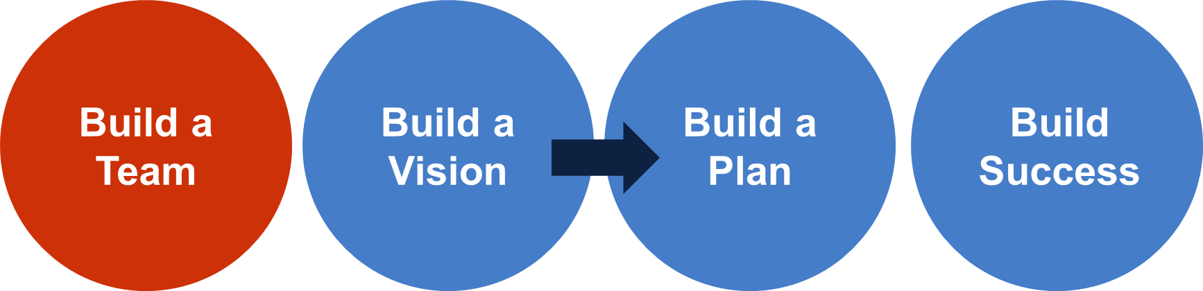
GLOBAL MEMBERSHIP APPROACH
It is a process to support Districts and Clubs against membership decline
3
3
Notes:
Presenter notes:
_____________________________________________________
Script for GAT Area Leader to prepare district leaders to lead a Build a Vision workshop:
Congratulations! We have completed our practice of a district analysis and creation of district goals. What happens next? Gather your district team together and lead them through this workshop, too.
Once you complete the Build a Vision workshop with your district team, communicate the results of the SWOT analysis to your members and offer the opportunity to provide anonymous feedback to add their opinion. This will provide clubs the chance to become invested in the goals set by the working group and potentially provide insights into other strengths, weaknesses, opportunities and threats that were not thought of.
Next, present progress to your Council Chairperson and GAT-MD.
In preparation of our next meeting, review the courses on Action Planning to Achieve District Goals and Succession Planning on the LLC. Then, we will meet again to review the Build a Plan workshop which leads the working group in the creation of a Global Membership Approach action plan.
Then you’ll get your entire district involved to execute our plan and achieve your goals.
Does anyone have any questions?
Script for district leaders when leading a Build a Team workshop:
Congratulations! We have completed our district analysis and created district goals. What happens next?
First, communicate the results of the SWOT analysis to your members and offer the opportunity to provide anonymous feedback to add their opinion. This will provide clubs the chance to become invested in the goals set by the team and potentially provide insights into other strengths, weaknesses, opportunities and threats that were not thought of.
Next, our Council Chairperson and GAT-MD will review our progress.
In preparation of our next meeting, review the courses on Action Planning to Achieve District Goals and Succession Planning on the LLC to better understand the process of defining goals, writing an action plan, and then managing your goals for the best results.
Then, we will meet again as a working group to Build a Plan and create our own Global Membership Approach action plan.
Lastly, we’ll get our entire district involved to execute our plan and achieve our goals.
Does anyone have any questions?

Slide 4
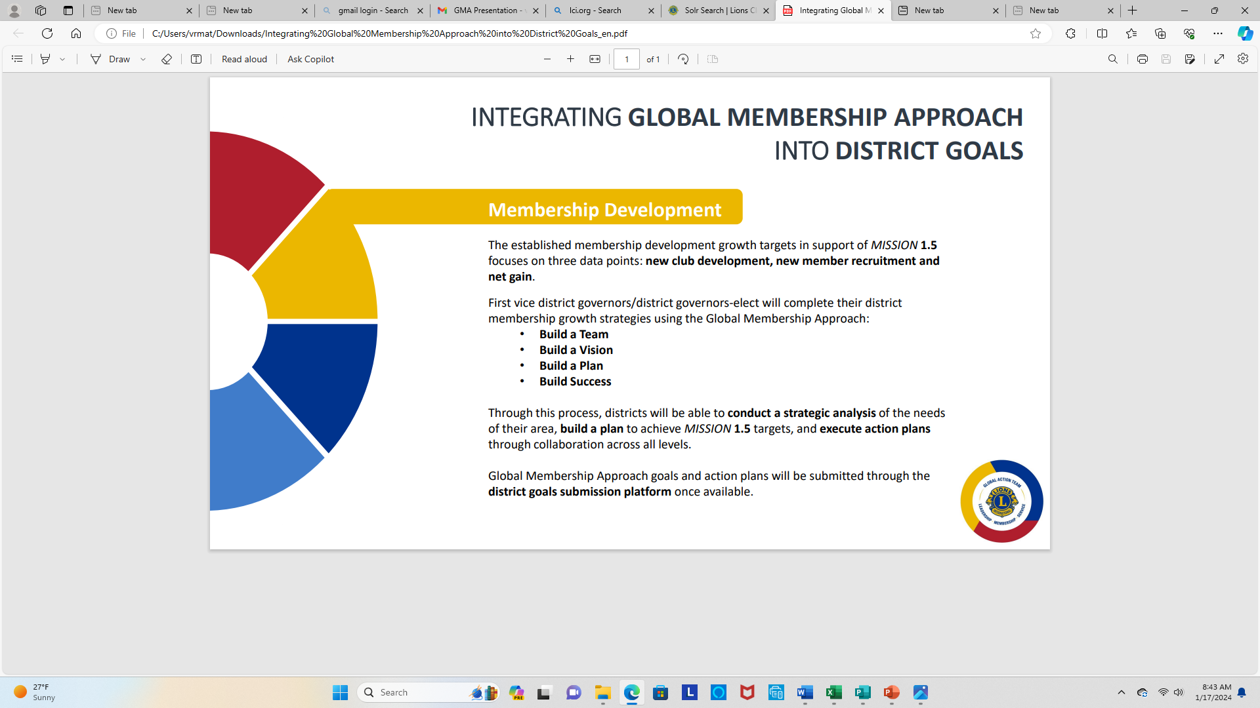
Integrating Global Membership Approach into District Goals
Membership Development
Membership growth targets in support of Mission 1.5
Focus on new club development, new member recruitment and Net Gain
FVDG and DGE will use GMA process
- Build a Team
- Build a Vision
- Build a Plan
- Build Success
Through this process, districts will be able to conduct strategic analysis and build a plan to achieve MISSION 1.5 targets and execute action plan
4

Slide 5

Global Membership Approach Areas of Focus
1
2
3
4
Rejuvenate districts with new clubs
Revitalize clubs with new members
Re-motivate members with new fellowships and exciting service
Provide training and support for our Lion leaders
New
clubs
New
members
Member satisfaction
Leader
support
Notes:
Presenter notes:
Remember to regionalize how these four areas are approached; if there is a stronger focus on leadership in your area, tie everything back to the training and the development of members. If there is a stronger focus on service, remind the group that increased member satisfaction ensures more Lions participate in service activities.
________________________________________________________________
Before we dive into team organization, you may remember that the Global Membership Approach has three objectives: rejuvenate districts with new clubs, revitalize clubs with new members and re-motivate members with new fellowships and exciting service.
Each of those is a Global Membership Approach Area of Focus, along with, (click) providing training and support for our Lion Leaders. Without that, none of the other objectives are possible.
You’ll see the four Areas of Focus summarized as New Clubs, New Members, Member Satisfaction and Leader Support.

Slide 6
Global Membership Approach for Clubs
1
Build a Team of Club Leaders
2
Build a Vision, Assess Needs and Set Goals
3
Build a Plan to Achieve our Goals
4
Build Success
6

Slide 7
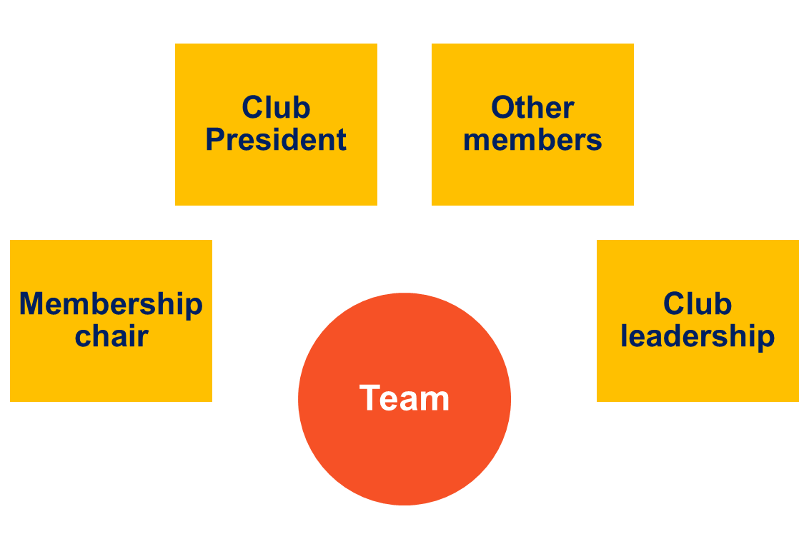
1. Build a Team of Club Leaders
7

Slide 8
2. Build a Vision, Assess Needs. and Set Goals
Grow membership within the club
Revitalize your club with new service opportunities
Rejuvenate your club with new members
Excel in leadership development and club operations
Share your club’s achievements with your community
2
3
1
4
8

Slide 9
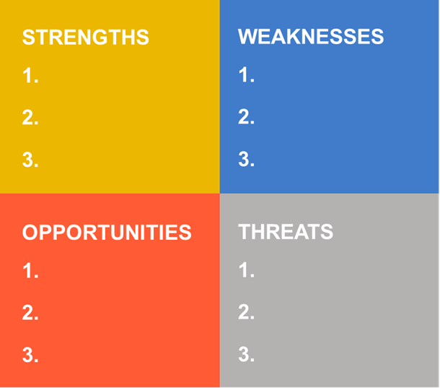
The Path to Club Improvement (SWOT ANALYSIS)
Focus on Strengths and Weaknesses
Leverage your strengths
Manage your Weaknesses
9

Slide 10
Focus Area 1
Rejuvenate Club with New Members
What opportunities exist to expand membership?
What do we need to do to better recruit members?
Why are members not joining our club?
Why do people join our club?
10

Slide 11
Focus Area 2
Revitalize Clubs with New Service Opportunities
Are the club’s service projects relevant to current community needs?
Are members enthusiastic and actively involved in service projects?
Is club leadership receptive to members’ ideas for new service ideas?
Do our service projects attract new members?
11

Slide 12
Focus Area 3
Excel in Leadership Development and Club Operations
Do club officers participate in training for their positions?
Are members encouraged to take leadership positions?
Do members regularly attend and participate in club functions?
Do you need to reconsider the format of club meetings?
12

Slide 13
Focus Area 4
Share your Club’s Achievements with your Community
Is the club active on social media (Facebook, Instagram, Twitter)?
Does your club have an e-Clubhouse or website?
How are you keeping the public informed of your events?
Do we include welcoming messaging that encourages people to join?
13

Slide 14
3. BUILD A PLAN
Establish Goals
14

Slide 15
S
M
A
R
T
S
M
A
R
T
pecific
easurable
ctionable
ealistic
ime Bound
Ensure that the objective is clear.
Benchmarks and progress must be measurable.
Each goal must be achievable.
Timeframe that outlines a schedule of progress.
Challenging but not unrealistic.
15

Slide 16


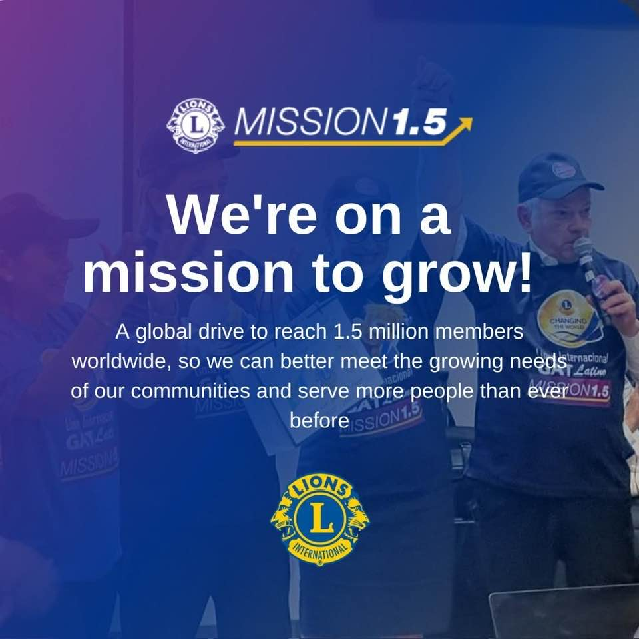
aa
MISSION 1.5
The GMA PROCESS, DISTRICTS
Grow our global membership to 1.5 Lions by 2027
To meet the growing needs of our community and serve more people
Current membership is 1.4 million
Global membership to increase membership by 100,000
District
Zones
Clubs
16
Notes:
Presenter notes:
Regionalize the questions listed on this slide to best represent the various important teams/roles of your area.
Use breakout rooms to help facilitate discussions in an online environment. Divide the audience into 3-5 people per group to ensure all members get to speak in the allotted amount of time.
If breakout rooms are not an option, have an open discussion per each question for as long as time allocates and record answers on a word document.
________________________________________________________________
Let’s start by talking about our own expectations as Lions and Lion leaders.
What do Lions and club officers expect from their district governor team? We’ll take 5 minutes to break out into groups, where you will have the opportunity to discuss your thoughts on the matter. After 5 minutes, please designate a spokesperson to summarize the group’s ideas. {discuss}
What do Lions and club officers expect from their zone chairperson? Again, we’ll take 5 minutes to break out into groups, where you will have the opportunity to discuss your thoughts on the matter. After 5 minutes, please designate a spokesperson to summarize the group’s ideas. {discuss}
What do we expect of Lions clubs? Again, we’ll take 5 minutes to break out into groups, where you will have the opportunity to discuss your thoughts on the matter. After 5 minutes, please designate a spokesperson to summarize the group’s ideas. {discuss}
Let’s keep our expectations in mind as we move to the next step…

Slide 17
3. BUILD A PLAN TO ACHIEVE YOUR GOALS
17

Slide 18
3. Build A Plan to Achieve Our Goals
For Each Area
What? (Goal Statement)
How? (Action Steps)
When? (Deadline for Completion)
Who? (Person (s) Responsible for Action)
How Will You Know? (How Will You Know It’s Accomplished)
DEVELOP YOUR ACTION PLAN by outlining the steps you will take to achieve your goals.
This step outlines how the goal will be achieved (action steps), when each step will be completed, who will be responsible for the step, and how you can determine each step has been completed. The Action Plan Worksheet is a tool you can use as you develop a plan to achieve each goal. Together, the plans for each goal comprise your Vision.
18

Slide 19


ACTION STEPS (Membership Development)
ACTION STEP | RESPONSIBILITY | Required Resources (team members, funding, technology | DATE July 1 | End DAte
Form a team 4-6 members Club Extension Team. Member development as per goals | GMT | MD-2 Membership Dev. Grant | June 2024 | June 2025
Help conduct Membership events (Virtual or face to face) | GMT and Team/Club Memb Chair/Zone Chairs | Memb. Development Grant. Just Ask guide | July-ongoing | May
Focus on underrepresented groups and younger members | GMT/Team/Zone Chairs | Team members. Conduct district wide analysis and focus on specific areas | July 2024 | June 2025
Have a Retention Plan | GMT/Team | Encourage exit interviews. Clubs to keep members engaged. Member satisfaction | July-ongoing | June 30, 2025
Clubs to be flexible MyClubMy Way | Club Presidents | Club Satisfaction Survey | Ongoing
Membership Chair Training | GLT | Zoom virtual or face to face. | Sep-Oct
Goal:
By end of June 2027, District 2-X1 will recruit 400 new members and have a net of 110 members
SAMPLE
19
19
Notes:
Presenter notes:
_____________________________________________________
Script for GAT Area Leader to prepare district leaders to lead a Build Success workshop:
Regular check-ins to monitor progress on action plans are good times to make adjustments to plans based on changing conditions. In the following section, you will review the Assessment and Alterations section of the action planning template. Knowing when to change your plans – and how to document those changes – is an important part of staying on track to meet your goals. You will use one of the sample goals and action plans to practice applying these techniques.
This discussion also emphasizes that everyone should become comfortable with adapting plans as conditions change. Being able to adapt our plans is not a sign of failure or weakness, it is a sign of ongoing commitment and flexibility.
Let’s review the following slides and answer any questions you have about how to facilitate this with your teams.
Script for district leaders when leading a Build Success workshop:
As we continue to think through our check-in meetings and the potential need to make updates to the plan, it is important to review the reasons why an action plan could be updated.
Let’s talk about some reasons our actions could change.

Slide 20
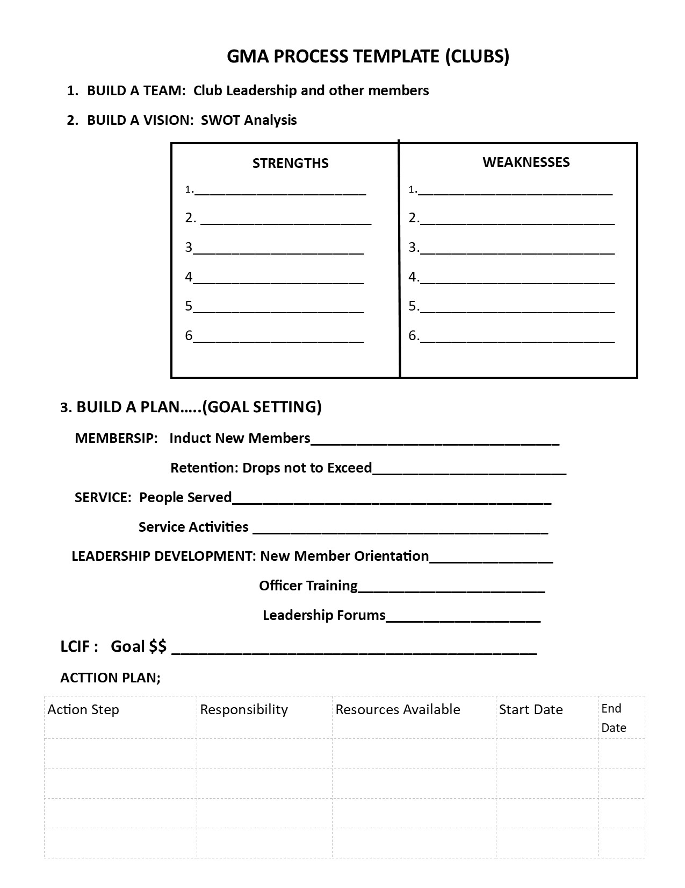
GMA Template
A one page simplified GMA Process template for clubs to be used
To be distributed to club Presidents
After completion to be given to Zone Chairs and to the Governors.
20
20
Notes:
Presenter notes:
_____________________________________________________
Script for GAT Area Leader to prepare district leaders to lead a Build a Vision workshop:
Congratulations! We have completed our practice of a district analysis and creation of district goals. What happens next? Gather your district team together and lead them through this workshop, too.
Once you complete the Build a Vision workshop with your district team, communicate the results of the SWOT analysis to your members and offer the opportunity to provide anonymous feedback to add their opinion. This will provide clubs the chance to become invested in the goals set by the working group and potentially provide insights into other strengths, weaknesses, opportunities and threats that were not thought of.
Next, present progress to your Council Chairperson and GAT-MD.
In preparation of our next meeting, review the courses on Action Planning to Achieve District Goals and Succession Planning on the LLC. Then, we will meet again to review the Build a Plan workshop which leads the working group in the creation of a Global Membership Approach action plan.
Then you’ll get your entire district involved to execute our plan and achieve your goals.
Does anyone have any questions?
Script for district leaders when leading a Build a Team workshop:
Congratulations! We have completed our district analysis and created district goals. What happens next?
First, communicate the results of the SWOT analysis to your members and offer the opportunity to provide anonymous feedback to add their opinion. This will provide clubs the chance to become invested in the goals set by the team and potentially provide insights into other strengths, weaknesses, opportunities and threats that were not thought of.
Next, our Council Chairperson and GAT-MD will review our progress.
In preparation of our next meeting, review the courses on Action Planning to Achieve District Goals and Succession Planning on the LLC to better understand the process of defining goals, writing an action plan, and then managing your goals for the best results.
Then, we will meet again as a working group to Build a Plan and create our own Global Membership Approach action plan.
Lastly, we’ll get our entire district involved to execute our plan and achieve our goals.
Does anyone have any questions?

Slide 21
4. BUILD SUCCESS
21

Slide 22
4. Build Success
To be Successful:
SHARE
SUPPORT
RECOGNIZE
EVALUATE
CHANGE
Share
Support
Recognize
Evaluate
Change
22
Notes:
Share: your club’s Vision with all club members so that they are aware of what the club wants to achieve, along with their role in achieving club goals. It is very important to the health and vibrancy of any club that its members feel connected to the club’s success.
Support: the members committed to the plan by ensuring they have the resources they need to succeed. Leaders should check in with members to make sure they feel supported and receive the guidance they need.
Recognize: milestones so members feel valued and know they are moving in the right direction. Every journey was started with a single step. Reassure members frequently to keep them motivated and engaged. Don’t keep your success a secret! Share the success with your community to get like-minded (and prospective members) involved!
Evaluate: the plan. It is also critical to evaluate your plan on a regular basis. As circumstances change, your plan may require revision. The creation of the initial Vision is just the beginning. Keep it alive and relevant by measuring progress and gathering feedback from club members on a routine basis. This is how you will realize your desired results.
Change: the Plan. Don’t be afraid to change the plan as opportunities change to keep the plan relevant. Regularly revisit the plan, assess needs and refine action steps. Keep plan members involved in decisions so they stay involved and committed.

Slide 23




Resources
23

Slide 24
Thank You
© 2022 Lions International
24

