Slide 1


Global Membership Approach
Process Example
June 20, 2026

Slide 2

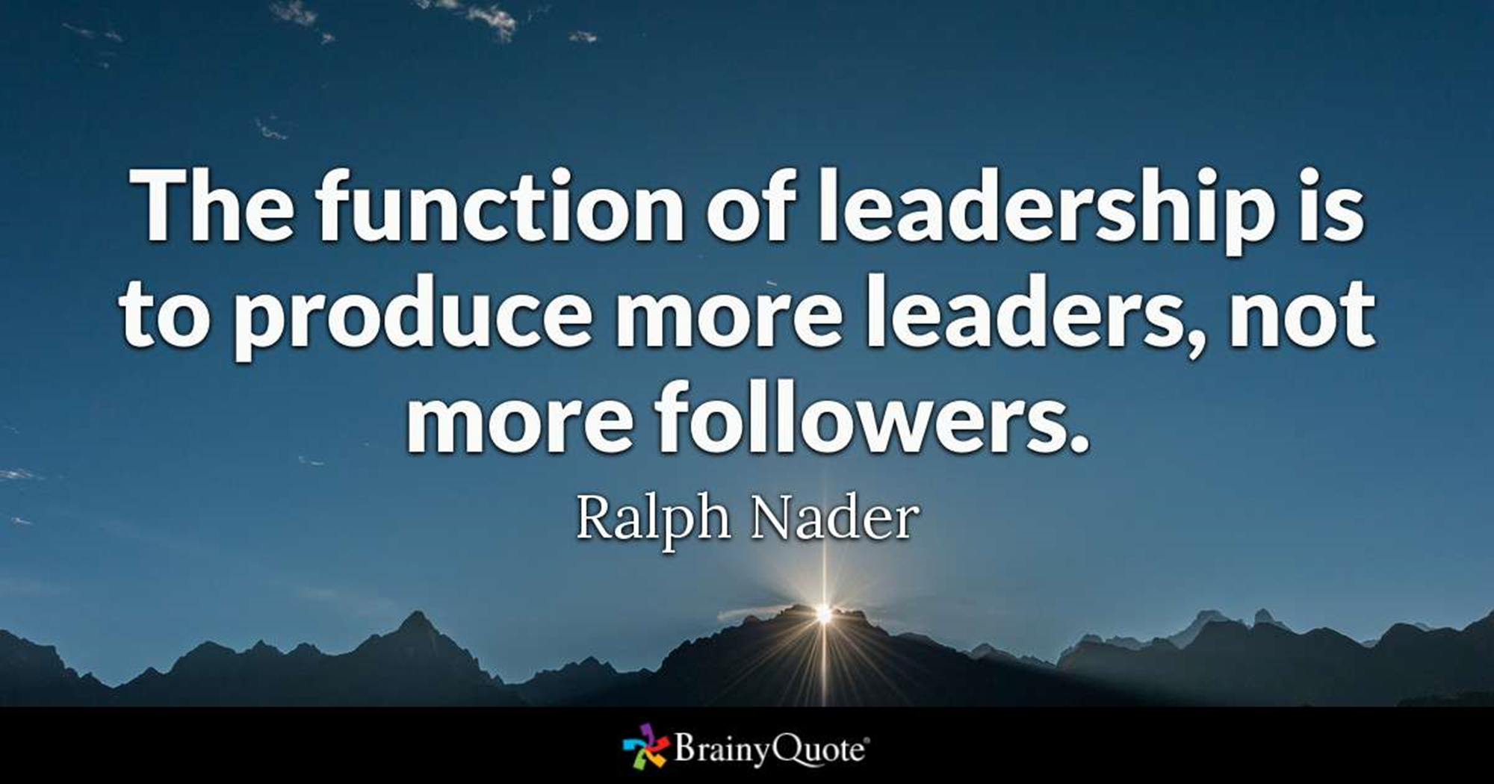
Leadership

Slide 3

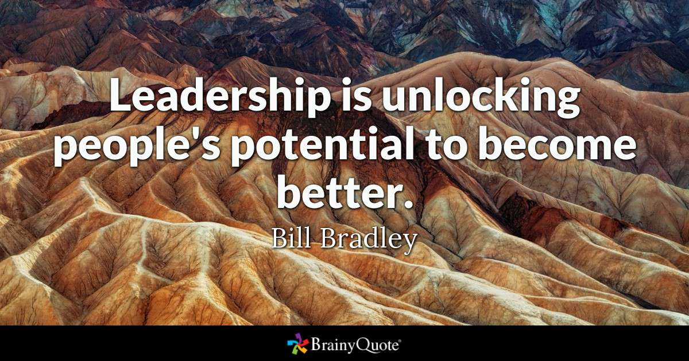
Leadership

Slide 4
Leadership
Leadership is Action.
Not just a Position!

Slide 5


Global Membership Approach process: Four Steps to the GMA process.
Build a Team, Build a Vision, Build a Plan, and Build Success
Purpose - Develop membership to deliver service to those in need by:
• Revitalizing clubs with new members:
• Re-motivating existing Members with fellowship and exciting service: Through increased service activities, membership growth, leadership development and support of LCIF.

Slide 6
GMA Step 1. Build a Team – for Local Lions Clubs
Club Officers
  President Global Action Team Leader
  Secretary
  Treasurer
  1st VP Leadership Chair
  Membership Chair Membership Chair
  Service Chair Service Chair
  Immediate Past President LCIF Coordinator
  Marketing & Communication
  Board Members

Slide 7
GMA Step 2. Build a Club Vision:
Begin with a SWOT Analysis
Global Membership Approach (SWOT)
Leverage your strengths (internal)
Manage your weaknesses (internal)
Take advantage of Opportunities (external)
Minimize impact of threats (external)
      Internal = In our control
      External = Outside our control
It is Important to Carry Forward earlier year Visions with only needed Adjustments

Slide 8


2026-2027 Global Membership Approach SWOT Analysis Results
Strengths (Internal) Members are dedicated to helping others with time and money. Club is Service focused. Club Supports LCIF with major donations. Good availability of LCIF DCG funds. Strong Recognition of club member efforts. New Member Orientation Officers Attend Zone, Executive Council, and District Cabinet Meetings. Host District Cabinet and Zone meetings. Sponsor two Leo Clubs. Have Great Fundraiser events. Have a good Social Media presence, especially Facebook. Have a City Government connection. Have a strong FUMC service project involvement. Good and low-cost meeting facility. Large involvement in District Leadership | Weaknesses (Internal) Need increased visibility within the community. Need more participation in Coppell Chamber Need an improved outreach via social media followers. Need improved Leader succession. New Member Orientation Not often enough Have a Graying membership. Need for more outreach to community for members. Few members bring friends. Need better mentorship of new members. Need more frequent New Member Orientations. Need improved club project reporting for improved club event publicity. Low usage of club, district and LCI web sites. Too few social activities. Not Consistent Limited fun social events.

Slide 9
2026-2027 Global Membership Approach SWOT Analysis Results
Opportunities (External) Large Population Base Diverse population (ethnicities) Many Churches and Service Organizations. Opportunities to make contacts with businesses. Identify what club members do (business opportunities) Strong Technology availability Opportunities for Branch Clubs, Cyber Clubs and Leo Clubs. Social Media options, Club Web Site, and community publications can increase our Community visibility. Use of AI. | Threats (External) Politics, religion, and personal conflicts Competition from other Service Organizations Limited Citizen Time for Service Potential Member Ability/Willingness to pay dues. Maintaining and Marketing the Lions Brand Our Social Media can get lost among other’s media. Member Apathy

Slide 10
GMA Step 3. Build a Plan: for Local Lions Clubs
(Set Goals and Develop Action Plans to achieve those goals)
Verify that all your goals are “SMART” Specific, Measurable, Actionable, Realistic, Time Bound
    Four LCI Goal Areas
      Service Activities
      Membership Development
      Leadership Development
      LCIF Contributions
          Plus any Club Custom Goals

Slide 11
GMA Step 3. Build a Plan: Service Activities
Proposed Club Goal: By the end of the 2026-2027 fiscal year, the TBD Lions Club will have served a minimum of _______ persons, performed ________ service activities, and added ___ new club service activities with one of the new service activities for a specific LCI cause.

Slide 12
GMA Step 3. Build a Plan: Membership Development
Proposed Club Goal: By the end of the 2026-2027 fiscal year, the TBD Lions Club will achieve a positive membership growth of at least 5 members (20%) to qualify the membership growth requirement for the 2026-2027 LCI Club Excellence Award and thereby increase our club’s service to the Coppell community.
We will also work towards creating a new Branch Club in the Valley Ranch community.

Slide 13
GMA Step 3. Build a Plan: Leadership Development
Proposed Club Goal: During the 2026-2027 fiscal year, the TBD Lions Club’s President,1st VP, Secretary, and Treasurer will attend training for those club officers. We will encourage the club Membership Chair, Service Chair, Leadership Chair, Marketing Chair and LCIF Coordinator to also attend at least one training event and encourage new members to also receive training in anticipation of becoming club officers.
The club’s Leadership Chair (1st VP) will stay aware of district, state, and International leadership development opportunities and communicate them to the club membership and encourage and promote individual member leadership development.

Slide 14
GMA Step 3. Build a Plan: LCIF Support
Proposed Club Goal: By the end of the 2026-2027 fiscal year, the TBD Lions Club will support Lions Clubs International Foundation (LCIF) in its endeavor to achieve its fundraising goal by contributing $________ to LCIF from the club’s Foundation account.
As the club LCIF Coordinator, the Immediate Past President will personally donate to LCIF, and encourage every member of my club to make a personal donation.

Slide 15
GMA Step 3. Build a Plan: Custom Goals
Proposed Club Custom Goals: By the end of the 2026-2027 fiscal year, the TBD Lions Club will have achieved the following:
Used the Global Action Team concept to establish the club’s 2026-2027 goals and actions plans and monitored their progress throughout the Lion year.
Earned LCI’s Club Excellence Award for the 2026-2027 Lion Year.
Ensured that the next years newly elected President, 1st VP, Secretary, and Treasurer (for 2027-2028) attend the District 2-X1 Lions University or a virtual Global Leadership Team provided officer training. And use LCI’s GMA process to set their goals and action Plans for the 2027-2028 Lion year.
Recruited one or two future club leaders who attended either an Emerging Lions Leadership Institute, a Regional Lions Leadership Institute, or the Texas Lions Leadership Forum whichever was offered by Lion Multiple District 2 (Texas).

Slide 16
Once Goals are set - Create & Get BOD approval
Goal Action Plans to accomplish your 2026-2027 Goals.
Create an Action Plan to achieve each Goal
  Write Goal Statement
  Identify Action Steps Required
  Assign Responsible Party(s)
  Identify Required Resources
  Assign Begin Date
  Select Due Date

Slide 17
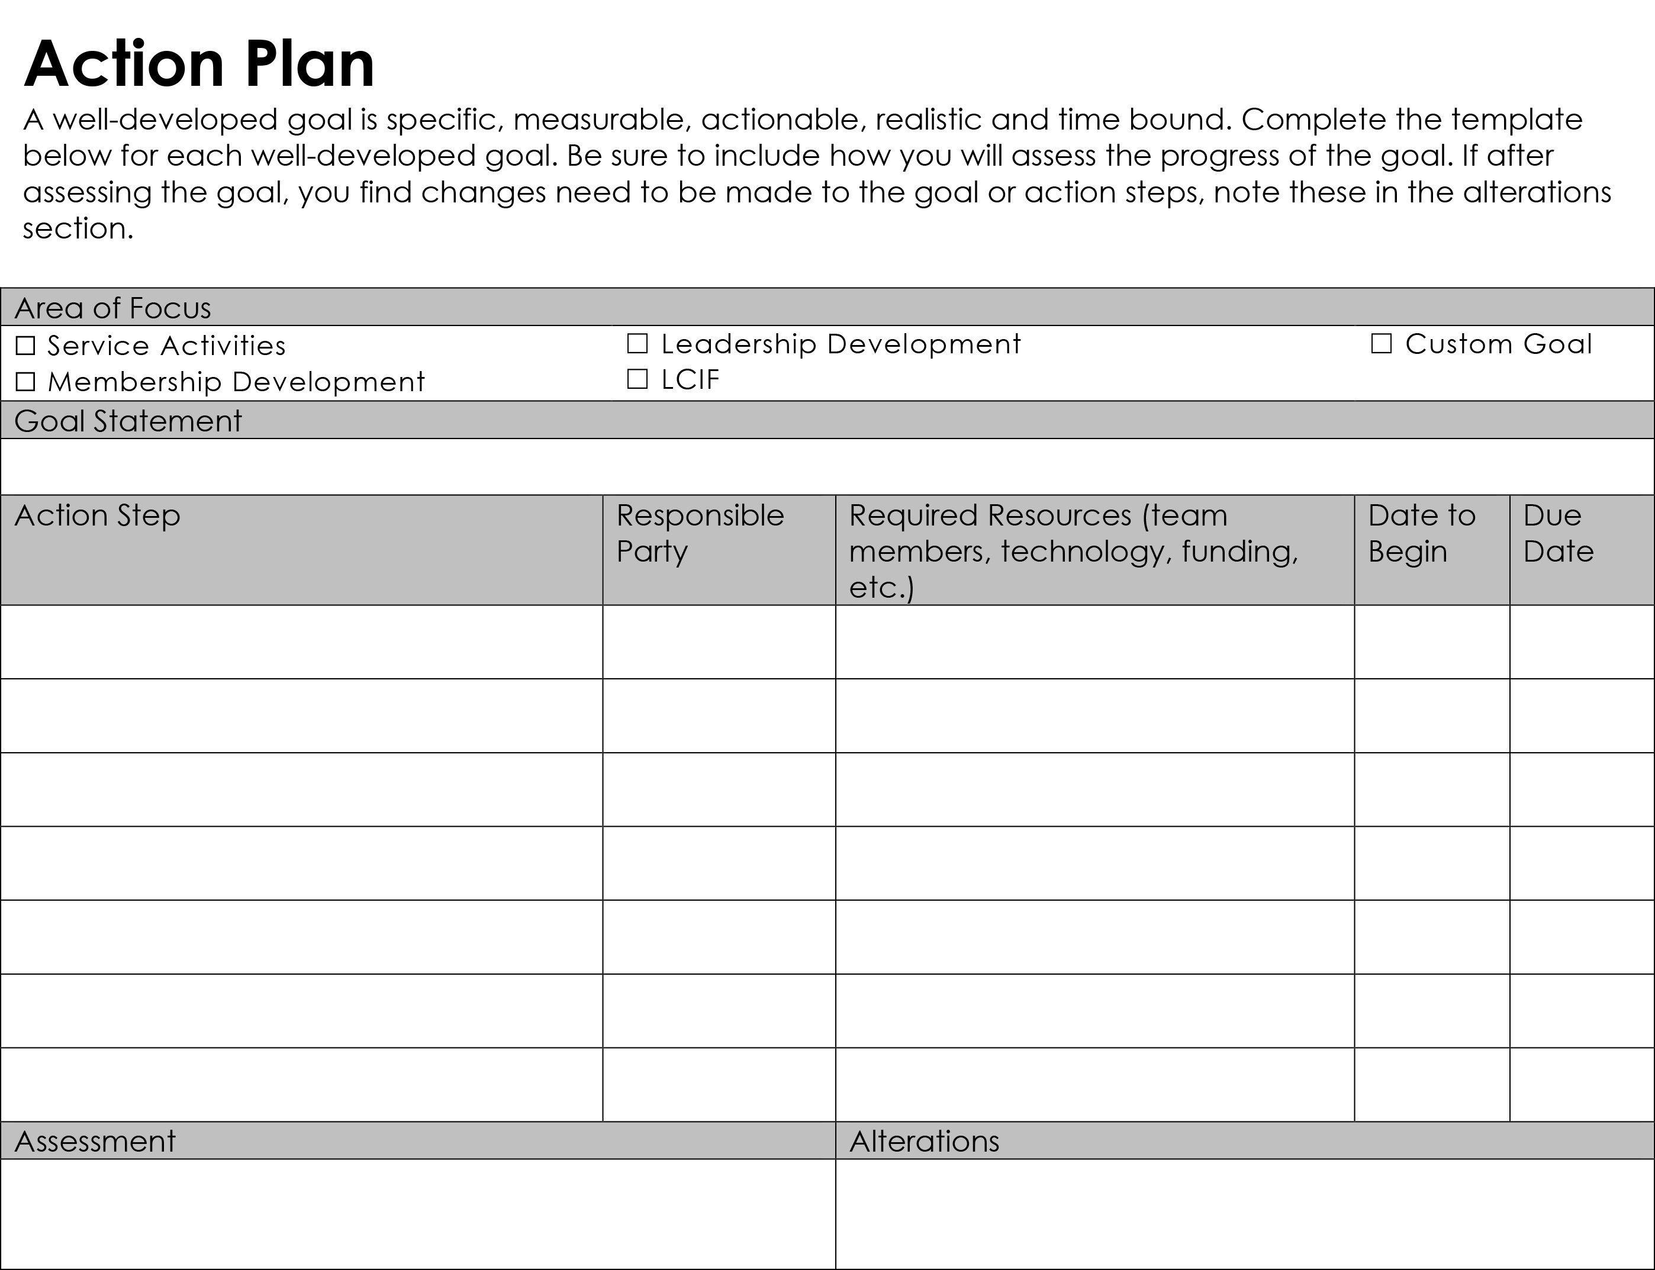

Slide 18
GMA Step 4. Build Success: Execute the plan, Maintain accountability, and adjust, as necessary.
Review and communicate at GAT meetings and Board of Directors meetings.
Remind GAT and club members that they are the club’s goals.
Club GAT team Roles:
Communicate, demonstrate, explain, and promote the GMA process and GAT structure.
Achieve club member buy-in and participation.
Earn LCI’s Club Excellence Award

Slide 19
Have Questions?
Need Help?
Just Ask!

