Slide 1
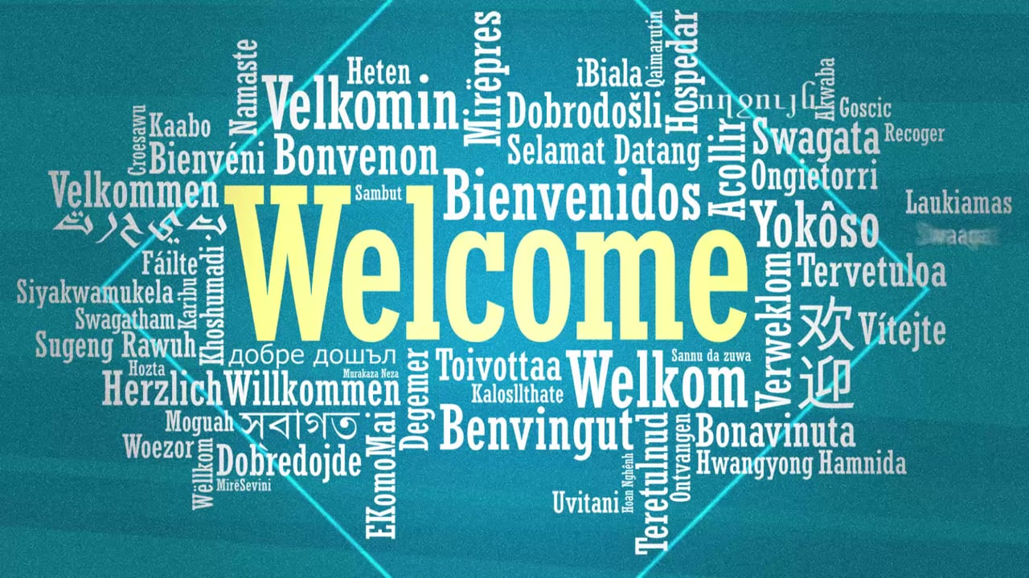

Slide 2

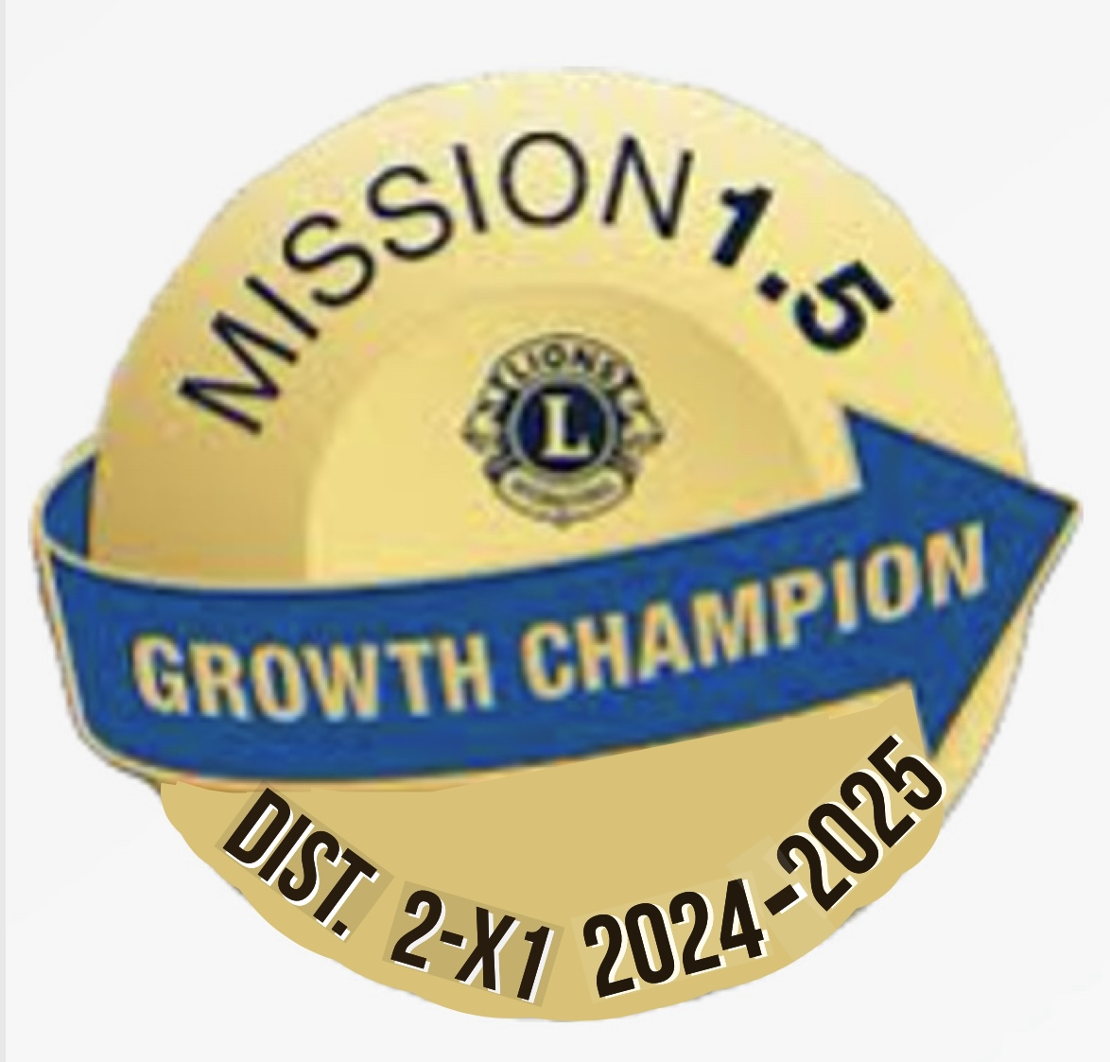
2x1 Lion University
Membership Training
Why Should OUr Lions Club Grow?
Stronger Together, Greater SErvice, Brighter Futures.
Facilitated BY:
PDG Esmeralda Rodriguez
Saturday, June 21, 2025

Slide 3
AGENDA
1. Why Should our Lions Club Grow?
2.Club Extension Tips
3. LCI Resources
3. Q & A

Slide 4
WHy Should a Club Grow?Stronger Together, Greater Service, Brighter Futures.
A Lions Club should grow for several important reasons, all of which directly align with its mission to serve communities and develop leaders:

Slide 5
1.Increased Impact in the Community
1.More hands = More help: With more members, the club can run more service projects or scale up existing ones (e.g., vision screenings, food drives, literacy programs).
Greater outreach: Growth brings diversity of ideas and connections, expanding the club’s reach into schools, neighborhoods, and underrepresented populations.

Slide 6
2. Sustainability and Continuity
ensures leadership continuity.
Avoid burnout: A larger membership base helps distribute the workload, preventing burnout among existing members.

Slide 7
3. Enhanced Leadership Development
A growing club offers more opportunities for members to take on leadership roles, which builds confidence, professional skills, and personal growth.

Slide 8
4. Stronger Partnerships and Visibility
Community influence: A larger club has more visibility and credibility, making it easier to attract partnerships (with schools, libraries, nonprofits).
More resources: Growth can open doors to sponsorships, donations, and in-kind support.

Slide 9
5. Qualification for Expanded Lions Support
Some Lions Clubs International Foundation (LCIF) grants and programs favor clubs that demonstrate consistent growth and engagement.
A growing club may qualify to sponsor more Leo Clubs or service activities.

Slide 10
Why Members Drop & How to Retain our Members & Clubs!
1.Lack of Engagement or Personal Connection
Members often drop when they don’t feel connected to the club's activities or other members. If they aren't asked to participate or feel their skills aren't being used, they may disengage.
2.Unclear Purpose or Value
Some members join without a clear understanding of the club’s mission or what’s expected. If they don’t see the impact or personal benefit, their motivation wanes.
3.Poor Member Onboarding and Follow-up
A common mistake is not making new members feel welcome or integrated into club life. As one training module highlights, clubs that don’t make a “special effort” to engage new members often see higher dropout rates.
4.Leadership Gaps or Club Management Issues
When clubs struggle with leadership turnover or lack of direction, members may perceive instability or ineffectiveness, prompting them to leave.
5.Ineffective Communication and Inclusion
Poor communication from club leaders or exclusion from planning and service decisions reduces a member’s sense of ownership and involvement.
6.Failure to Evolve with Community Needs
If a club doesn’t align with the changing interests or demographics of its community, members may find it less relevant.
7.Unaddressed Member Satisfaction Issues
Surveys have shown that when clubs don’t act on feedback or address dissatisfaction, it contributes to higher attrition. The Membership Satisfaction Survey and follow-up action plans are crucial to identifying and fixing root causes of disengagement.

Slide 11
Lions Club Extension Tips!“Grow the Pride by Planting New Roots.”
🔍 1. Identify a Strategic Location
Look for areas where:
No current Lions Club exists or the closest one is far away.
A library, school, community center, or church is eager for collaboration.
A population base exists that could benefit from service (e.g., underserved neighborhoods, rural towns, youth-heavy areas).
✅ Libraries are great candidates—built-in community trust and foot traffic!
👥 2. Start with a Core Group of Committed People
You only need 20 charter members to start a new club.
Begin by identifying 5–7 committed individuals to form a nucleus.
Consider teachers, librarians, parents, business owners, health workers, and civic leaders.

Slide 12
🛠️ 7. Build with Purpose
Align the new club around a theme or cause (e.g., youth, literacy, food access).
Tie in to a Service Carnival or library partnership to kickstart visibility.
🗓️ 8. Set a 90-Day Plan
Break it down:
Month 1: Interest meeting(s) & recruit 10+
Month 2: Gather 20+ members, choose leaders
Month 3: Charter the club and plan the first service project!

Slide 13
5. Use the Right Materials
Bring:
Club Charter Application (DA-51)
Lions Club Member Application Forms
Flyers about Lions’ global and local impact
Leo Club or Branch Club info if targeting youth or special groups
🧲 6. Offer Flexibility
Consider starting a Branch Club (only 5 people needed initially).
Explore Virtual or Specialty Clubs (e.g., health professionals, Spanish-speaking, parents).
Be flexible with meeting formats: monthly in-person, hybrid, or quarterly projects.

Slide 14
LCI RESOURCES
Membership Chairperson Guide
New Club Extension Powerpoint
Global Membership Team (GMT) District Coordinator
Global Extention Team (GET) District Coordinator
Global Membership Approach
Membership Reports Toolbox
Membership Development Grants
Just Ask Guide
Global Membership Tool Kit
New Member Orientation Guide
New Member Orientation Powerpoint
New Member Welcome Booklet
Lions Club International Facts sheet (PR-799)

Slide 15
THE 7 C’S
1. Connecting
2. Committing
3. Caring
4. Communicating
5. Creating engaging service
6. Collaborating
7. Celebrating
The 7 C’s above are keys to Improve Retention and Growth in Membership, Leadership and Service in our district and clubs.
Notes:
Connecting with each other and our community by sharing our Why and our stories!
Committing to be our best, do our best and try our best!
Caring for one another in words and actions!
Celebrating the good things we accomplish!
Communicating effectively the strengths, weaknesses, opportunities and threats to our members, clubs and district and brainstorming solutions.
Creating engaging service opportunities for current and new prospective lion members!
Collaborating with each to other at district, club, zone and also community partners is important!
We must remember that Connecting, Committing, Caring, Celebrating, Communicating, Creating Engaging Service and Collaborating are key to Increasing Retention and Growth in membership, Leadership and Service in our district and clubs.
We need to take a close look at where we are, what is working and what we need to add or change to increase the strong foundation in our district and clubs.
We need to be willing to each individually take a risk and commit to dare to get out of our comfort zone and together face the challenges, obstacles and struggles with a positive attitude and respect.

Slide 16

Feedback/Comments/Questions? Thanks for attending training today!
16
Notes:
Presenter notes:
____________________________________________________________
Thank you for participating today. All the work we have done will help Lions clubs grow in our district and eventually around the world.
Would anyone like to provide feedback on this process? How did this meeting work for you?
Thank you again for all your contributions to the Global Action Team and Global Membership Approach and all you do for Lions clubs.

