Slide 1
New Member Orientation
Kaufman Lions Club
Notes:
Trainer Tip: Enter additional information as you see fit, such as the name of the New Member Orientation trainer. Use this PowerPoint along with the New Member Orientation Training Guide. Be sure each of your participants has a New Member Orientation Guide to follow along with the presentation.

Slide 2

New Member Orientation Summary
New member orientation is broken out into
four sections:
  Who Lions Are
  Your Club
  District and Multiple District
  Lions Clubs International (LCI)

Slide 3

Who Lions Are
Lions are men and women dedicated to serving those in need, whether in their own community or around the world.
  Over 1.4 million members
  Over 200 countries
  More than 48,000 clubs

Slide 4
Who Lions Are
Vision Statement: To be the global leader in community and humanitarian service.
Mission Statement: To empower volunteers to serve their communities, meet humanitarian needs, encourage peace and promote international understanding through Lions clubs.
Motto: “We Serve”
Slogan: Liberty, Intelligence, Our Nation’s Safety
Purposes: LCI has a list of purposes to convey why Lions clubs exist.
Code of Ethics: LCI has a code of ethics which set the standard that Lions should aspire to adhere to.

Slide 5
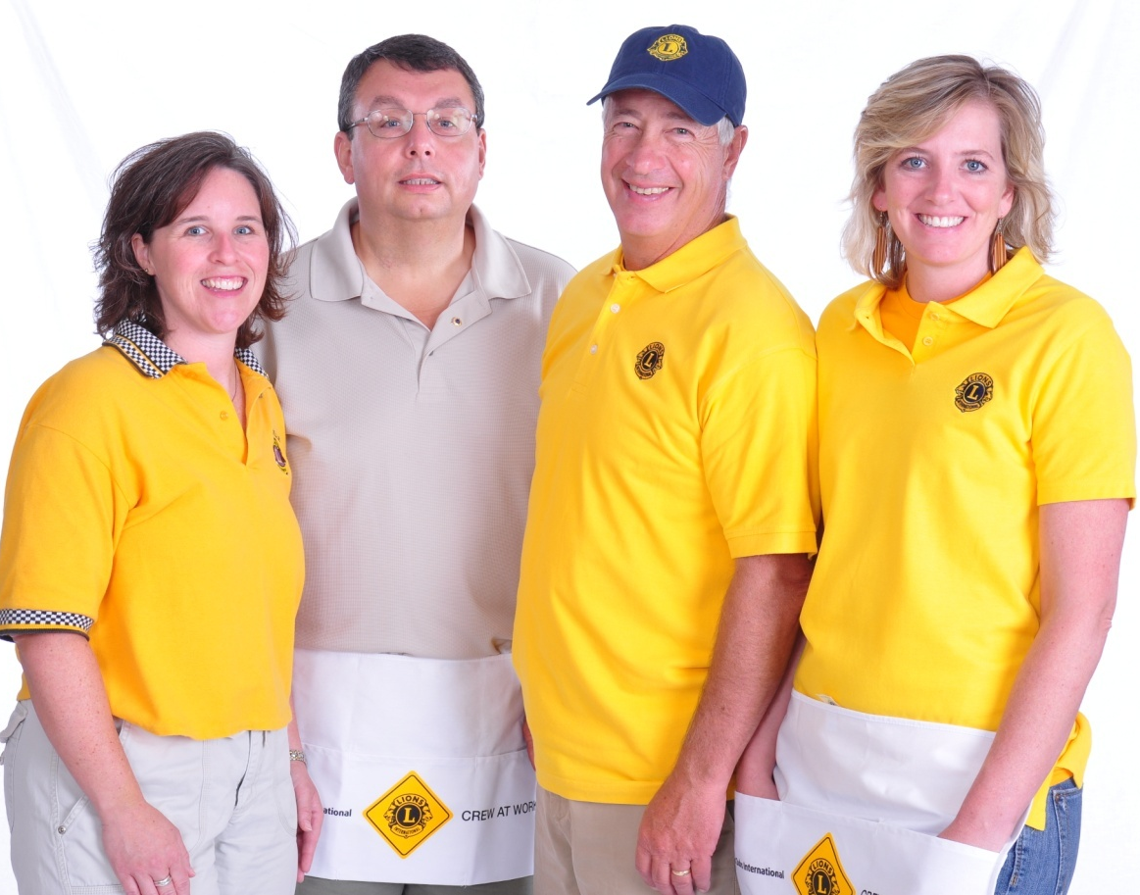
Lion Title Abbreviations
LCI: Lions Clubs International
LCIF: LCI Foundation
IP: International President
PIP: Past International President
ID: International Director
PID: Past International Director
MD: Multiple District (Texas has 16 districts)
CC: Council Chair (MD Council of Governors Chair)
1st VP: First Vice President
2nd VP: Second Vice President
DG: District Governor
IPDG: Immediate District Governor
PDG: Past District Governor
GST: Global Service Team
GMT: Global Membership Team
GLT: Global Leadership Team
GET: Global Extension Team
CT: District Cabinet Treasurer
CS: District Cabinet Secretary
RC: Region Chairperson
ZC: Zone Chairperson

Slide 6
Kaufman Lions Club

Slide 7
History
Year chartered: 1927
Number of charter members: 31
Clubs sponsored by us: 4
Significant award or achievements: #1 club District 2-x1. 2024-25 Numerous Club Excellent Awards
Notes:
Trainer Tip: Edit this slide as you see fit. Remove things that don’t apply to your club, or add things that are not currently included.

Slide 8
Club Officers
President: David Hunt
Immediate Past President: Chet Mc McDonald
Vice President: David Asbill
Secretary/Treasurer: Larry Eggett
Membership Chairperson: Mike Williams
Marketing Communication Chairperson: Carma Sullivan
Service Chairperson: 2nd VP Jim Woods
Lion Tamer: Bob Babovec
Tail Twister: Jeff Lang
Notes:
Trainer Tip: Add the names of the current club officers. Add or remove bullet points if your club has different officers than those listed.

Slide 9
Traditions
Organize and facilitate youth baseball. 77yrs
Leo scholarships; four-year college, and two year trade school

Slide 10
Elections
Officers are elected annually
Club president appoints a nomination committee in March
The nomination committee selects candidates
The club votes on in April
The term begins July 1st

Slide 11
Awards
While service is its own reward, special accomplishments and milestones should be recognized and celebrated. The awards below are awards that all Lions can achieve.
Membership Keys
Chevrons
Member Sponsor Recognition
Extension Awards
Notes:
Trainer Tip: Add additional information to this slide to show additional awards that are available through your club, district or multiple district.

Slide 12
Service and Fundraising Activities
Fundraisers: Baseball field concession stand; Gun Raffle; Pancake Bkft; Cornhole Tournament:
Activities: Organize and facilitate youth baseball; 3 Parade Barricade duties; Sight clinics, schools, 501-3c; Sleep in Heavenly Peace;
Notes:
Trainer Tip: Consider adding photos from the projects to the slide if they are available.

Slide 13
Membership
The benefits of Lions clubs membership are numerous,
and include:
Be part of a global community for good
Support, tools and resources to enhance your service
Leadership development opportunities
The satisfaction and joy of helping those in need
Networking opportunities with local and international community leaders
Friendship and fellowship with service minded people
Respect and credibility of being a Lion

Slide 14
Meetings
When: [Insert]
Where: [Insert]
Notes:
Trainer Tip: Add any additional meeting information you feel is important.

Slide 15

Dues and Budgets
Total Dues
  Club dues: [Insert]
  District and multiple district dues: [Insert]
  International dues: US$43
Activities Budget
Administrative Budget
Notes:
Trainer Tip: Explain that the activities budget consists of funds raised form the public through club projects and may only be expended to satisfy a community or public need. The administrative budget is what finances club operations and comes mostly from club dues.

Slide 16
How We Communicate
[List all forms of club communication including newsletters, e-mails, Facebook page, website etc.]

Slide 17
District and Multiple District

Slide 18
Organizational Structure
There about 750 districts with 35 or more clubs and at least 1,250 members in each district.
  Each district has a district governor
Multiple districts are formed by two or more districts within a territory.
Our Multiple District: [Insert]
Our District: [Insert]
Notes:
Trainer Tip: Consider adding additional information about your district and multiple district, such as boundaries of your district and multiple district.

Slide 19
District Leadership
District Governor: [Insert]
First Vice District Governor: [Insert]
Second Vice District Governor: [Insert]
Cabinet Secretary-Treasurer: [Insert]
District Chairpersons: [Insert]
Zone Chairperson: [Insert]
Council of Governors: [Insert]
Global Action Team:
  Global Action Team District Chairperson (District Governor): [Insert]
  Global Membership Team District Coordinator: [Insert]
  Global Leadership Team District Coordinator: [Insert]
  Global Service Team District Coordinator: [Insert]
Notes:
Trainer Tip: Briefly go over the roles of each of these positions. The roles are found in the trainer and participant’s guide.

Slide 20
District Convention
District conventions are held to:
  Develop fellowship among the Lions of the district
  Conduct general district business
  Elect the district governor and other district-elected officers
  Conduct seminars
[Insert information about this year’s district convention.]

Slide 21
How the District and Multiple District Communicate
[List all forms of district and multiple district communication including newsletters, Facebook page, e-mails, website etc.]

Slide 22
Lions Clubs International

Slide 23
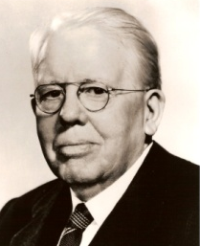
History
1917: Melvin Jones founded LCI.
1920: LCI becomes international with Canadian club.
1925: Helen Keller challenged Lions to become “knights of the blind.”
1945: LCI helped draft the United Nations Charter.
1957: The Leo Club Program is created.
1968: The Lions Clubs International Foundation is established.
1990: SightFirst is launched.
Today: Our international network has grown to include more than 200 countries and geographic areas.
1987: LCI became the first service club organization to admit women as members.

Slide 24

Name and Logo
The official name of the association is “The International Association of Lions Clubs” or simply “Lions Clubs International.”
The name Lions was chosen on a secret ballot over several others because the lion stood for strength, courage, fidelity and vital action.
The Lions logo consists of a gold “L” on a blue field surrounded by a gold circle. On either side of the circle is the profile of a Lion’s head, one looking back upon a proud past and the other looking optimistically toward the future.

Slide 25
Organizational Structure
International officers implement policy and serve as inspirational leaders of the world’s Lions.
  International President: [Insert]
  First Vice President: [Insert]
  Second Vice President: [Insert]
  Third Vice President: [Insert]
  Immediate Past President/LCIF Chairperson: [Insert]
The International Board of Directors is the governing body of the association.
  34 members
The International Constitution and By-Laws govern the operations of the association and establish the rules by which the association is to function.

Slide 26
International Convention
Convention brings together thousands of Lions from around the world for a week of business, education, celebration and fellowship.
To learn more visit LCICon.lionsclubs.org

Slide 27
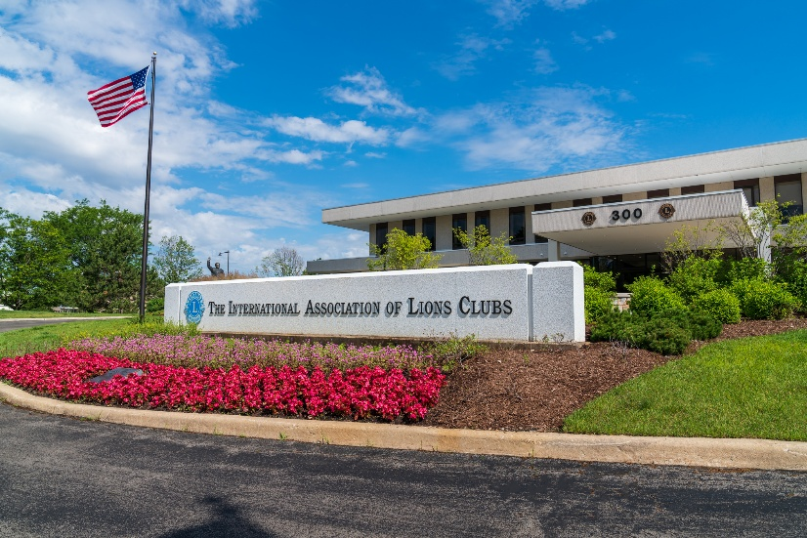
International Headquarters
Located in Oak Brook Illinois
Approximately 275 staff members
in 11 divisions:
  Convention
  District and Club Administration
  Finance
  Information Technology
  Leadership Development
  Legal
  Lions Clubs International Foundation
  Marketing
  Membership
  Member Operations and Support
  Service Activities

Slide 28
Lions Clubs International Foundation (LCIF)
Important Facts
  Founded in 1968: official foundation of Lions Clubs International, empowering the service of Lions
  Provides grant funding for large-scale humanitarian projects
  Relies on donations
  More than US$1 billion in grants awarded to date
  Amidst the most ambitious fundraising campaign in its history

Slide 29
Lions Clubs International Foundation (LCIF)
50+ Years of Impact
  US$120 million in disaster relief funding
  16 million children served by Lions Quest
  9.1 million cataract surgeries
  Millions of children vaccinated against measles

Slide 30
Leadership
LCI provides training and development opportunities for Lions. The Global Leadership Team (GLT) is the driving force behind these programs, including:
  Emerging Lions Leadership Institutes
  Advanced Lions Leadership Institutes
  Faculty Development Institutes
  Regional Lions Leadership Institutes
  District Governors-Elect Seminar
  Multiple District Leadership Development Funding
  GLT District Funding Support Program
  Webinars
  Lions Learning Center
  Lions Certified Instructor Program

Slide 31
Service Activities
Because Lions seek to address the greatest needs in their communities, our activities are varied, although Lions are united behind five global causes. The Global Service Team (GST) is the driving force behind these programs and collects and shares service stories that empower leaders to act.
  Diabetes
  Vision
  Hunger
  Environment
  Childhood Cancer

Slide 32
Membership Development
Recruiting new members into your club ensures that there will be a continual influx of enthusiastic members to serve those in need and identify new service that can be done in your community. Membership programs designed to help stimulate growth and foster quality members include:
  Family Membership
  Student Membership
  Leo to Lion
  Lions Worldwide Induction Day
  Leo Clubs
  Club Branches
In addition, forming new clubs is essential to serving a new or underserved area. Membership has several club types to help every member find the right fit:
  Traditional Lions clubs
  Campus Lions clubs
  Leo Lions clubs
  Lioness Lions clubs
  Specialty Lions clubs

Slide 33

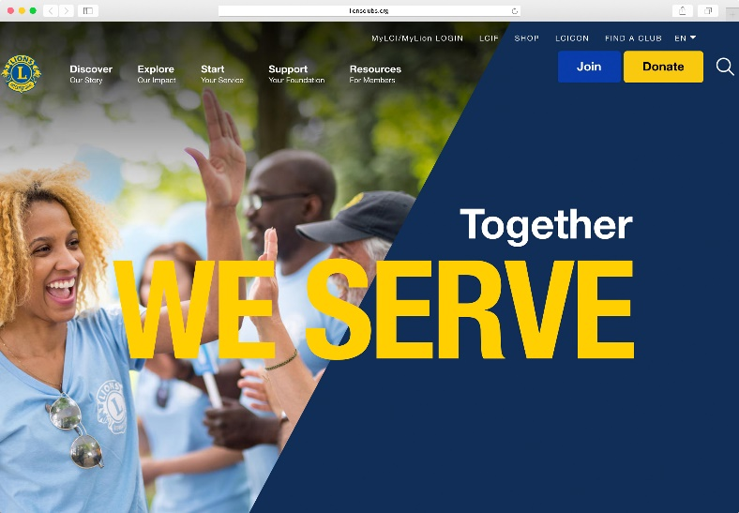
Communications
LION Magazine
E-mail Messages
Website
  lionsclubs.org
Social Networking
  Facebook
    facebook.com/lionsclubs
  Twitter
    twitter.com/lionsclubs
  YouTube
    youtube.com/lionsclubs

Slide 34
Welcome to our Lions Club!
Any Questions?

