Slide 1



Global Action Team
Presented at:
District 2-X1 Lions University
PDG Fred Conger

Slide 2

Global Action Team
Did you know?
Your Club President
Your Club Membership Chair
Your Club Service Chair
Your Club Leadership Chair (1st Vice President)
And Your Club LCIF Coordinator (Immediate Past President)
Form your Club’s Global Action Team!

Slide 3
Global Action Team
Is your club missing any of these positions?
Fill them if at all possible!
They are all extremely important to your club’s success!

Slide 4
Global Action Team
The GAT structure bridges Clubs, Districts, Multiple Districts, to the international association.
It connects clubs, districts, and Lion leaders to tools and resources developed to improve our service impact.
LCI’s GAT web page.
Global Action Team (GAT) | Lions Clubs International

Slide 5
Global Action Team purpose
The GAT structure helps clubs and districts achieve their goals by creating a unified approach to the 4 key areas of Lionism.
Membership Growth
Leadership Development
Expanded Humanitarian Service and
support of our International Foundation LCIF
The GAT structure has levels from club level up to constitutional area level. These levels help foster positive membership growth in clubs, increase Lion’s visibility in the community through impactful service, and help build strong and innovative leaders in clubs and districts.
This network of GAT leaders directly supports districts in inspiring action at the club level.

Slide 6
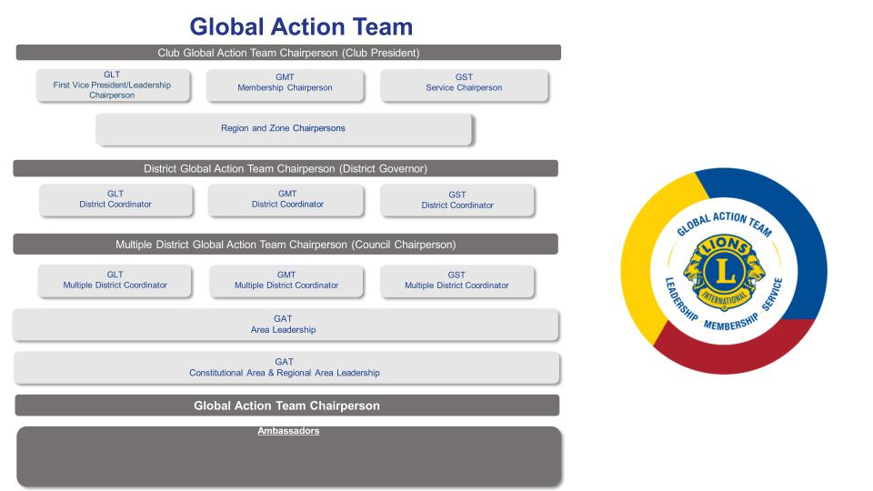
Global Action Team Purpose
GAT Structure:
Clubs to District to MD to Area to LCI Constitutional Area.

Slide 7
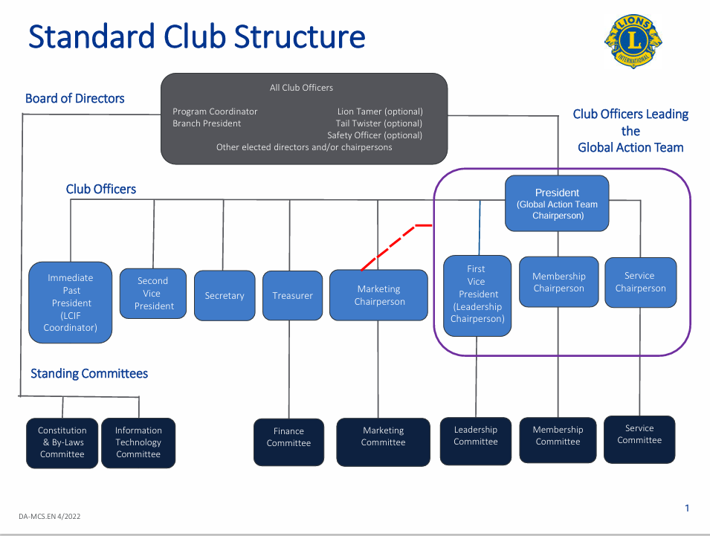
LCI’s Standard club structure
Note Club GAT Members
Also include the LCIF Coordinator

Slide 8
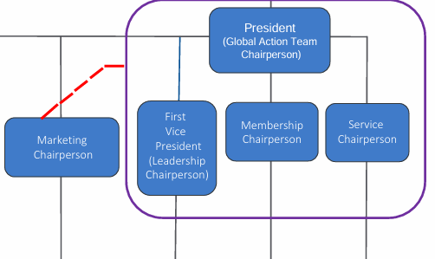
Global Action team club structure GAT GLT/GMT/GST
*
* Also Include LCIF Coordinator (Immediate Past President)

Slide 9
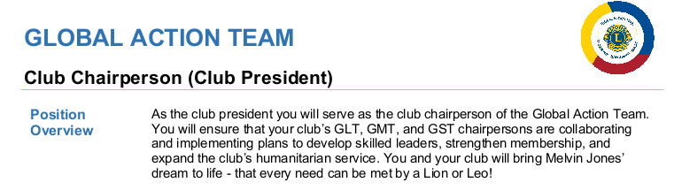
Global Action team club structure Member Overview

Slide 10
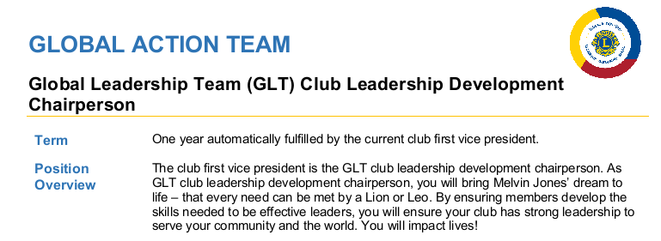
Global Action team club structure Member Overview

Slide 11
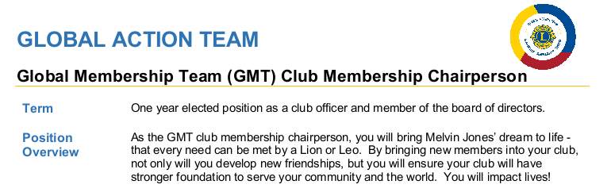
Global Action team club structure Member Overview

Slide 12
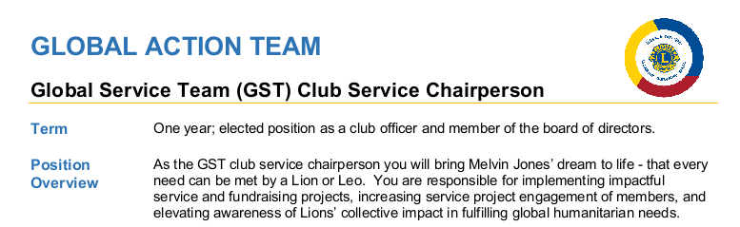
Global Action team club structure Member Overview
*

Slide 13
Why global action teams?
They:
Promote collaboration (communication) between a club’s GLT, GMT, and GST (Leadership Chair, Membership Chair, and Service Chair) officers and the District’s GLT, GMT, and GST officers.
Improve coordination of your club’s plans/goals to develop skilled leaders, strengthen membership, and expand your club’s humanitarian service.
Improve the success rate of achieving your Club’s goals.
Improve Leadership and Organizational Excellence (Club Excellence Requirement)
They are the Driving Force of the Global Membership Approach (GMA)
More on GMA later

Slide 14
Club Global action team
Club’s President (GAT),
Service Chair (GST),
Membership Chair (GMT),
Leadership Chair (GLT)
and LCIF Coordinator:
Identify your respective Roles and Responsibilities per LCI’s website.
Global Action Team

Slide 15
Club Global action team
As a team,
Meet to share your respective roles.
Define your respective Club Goals and create Action Plans necessary to achieve those goals for:
Leader Development,
Membership Growth,
Increased Service and LCIF support,
and any Custom club Goals.
Meet periodically (meetings called by the club President GAT) to review the progress toward the club’s goals and identify issues preventing successful goal completion.
GAT members should communicate your club goals to district GLT, GMT, GST, respectively.
GAT members should attend Zone meetings to report support of the district and LCI goals.

Slide 16
Need Help? Call me.
Thank you!

