Slide 1


Global Membership Approach
Process Example
June 21, 2025

Slide 2

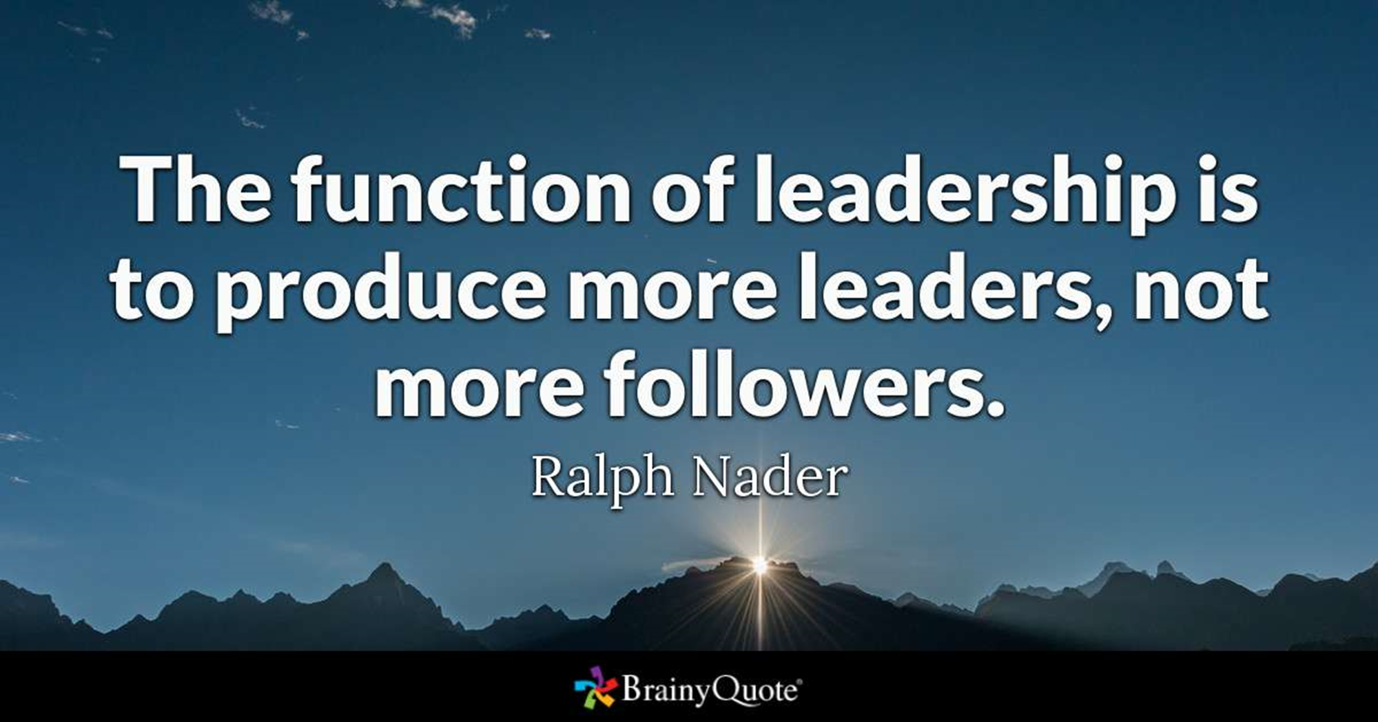
Leadership

Slide 3

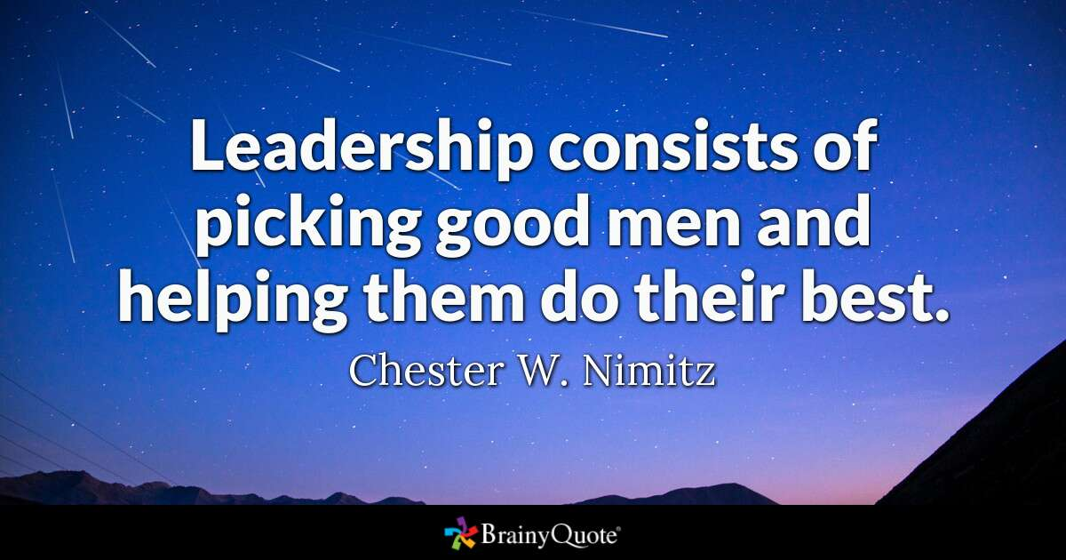
Leadership

Slide 4
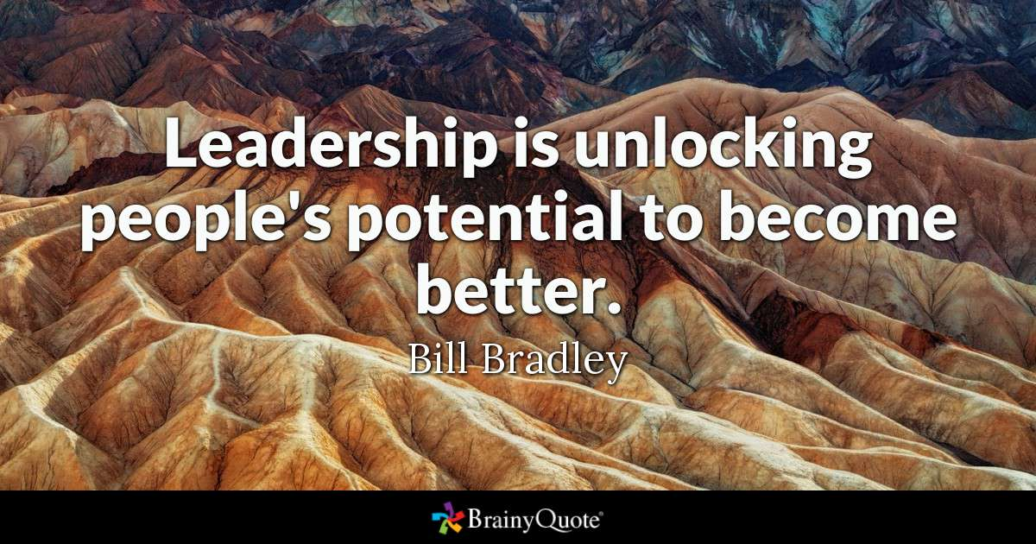
Leadership

Slide 5
Leadership
Leadership is Action.
Not just a Position!

Slide 6


Global Membership Approach process: Four Steps to the GMA process.
Build a Team, Build a Vision, Build a Plan, and Build Success
Purpose - Develop membership to deliver service to those in need by:
• Revitalizing clubs with new members:
• Re-motivating existing Members with fellowship and exciting service: Through increased service activities, membership growth, leadership development and support of LCIF.

Slide 7
GMA Step 1. Build a Team – for Local Lions Clubs
Club Officers
President Global Action Team Leader
Secretary
Treasurer
1st VP Leadership Chair
Membership Chair Membership Chair
Service Chair Service Chair
Immediate Past President LCIF Coordinator
Marketing & Communication
Board Members

Slide 8
GMA Step 2. Build a Vision: for Local Lions Clubs
Begin with a SWOT Analysis
Global Membership Approach (SWOT)
Leverage your strengths (internal)
Manage your weaknesses (internal)
Take advantage of Opportunities (external)
Minimize impact of threats (external)
Internal = In our control
External = Outside our control
Noted the Importance to Carry Forward earlier Visions with only needed Adjustments

Slide 9
2025-2026 Global Membership Approach SWOT Analysis Results
Strengths (Internal) Social Media/Publicity New Member Orientation Good meeting location City Mayor is a member | Weaknesses (Internal) Social Media/Publicity New Member Orientation Not often enough Lack of Mentorship of new Lions Need to use the 1st VP as Leadership Chair to promote training Need to use the IPP as LCIF Coord. To promote individual club member donations. No new member information packet.

Slide 10
2025-2026 Global Membership Approach SWOT Analysis Results
Opportunities (External) Diverse population (ethnicities) Vibrant/Large Corporations Moving to Area Many Churches and Service Organizations Opportunities to make contacts with new businesses Technology availability Opportunities for Branch Club or Cyber Club. | Threats (External) Politics, religion, and personal conflicts Competition from other Service Organizations Lack of Volunteers Affordability to pay dues Marketing the Lions Brand Social Media

Slide 11
GMA Step 3. Build a Plan: for Local Lions Clubs
(Set Goals and Develop Action Plans to achieve those goals)
Verify that all your goals are “SMART” Specific, Measurable, Actionable, Realistic, Time Bound
Four LCI Goal Areas
Service Activities
Membership Development
Leadership Development
LCIF Contributions
Plus any Club Custom Goals

Slide 12
GMA Step 3. Build a Plan: Service Activities
Proposed Club Goal: By the end of the 2025-2026 fiscal year, the Coppell Lions Club will serve a minimum of _______ persons and increase the number of club service activities by with one of the new service activities for a specific LCI cause.

Slide 13
GMA Step 3. Build a Plan: Membership Development
Proposed Club Goal: By the end of the 2025-2026 fiscal year, the Coppell Lions Club will achieve a positive membership growth of at least 5 members to qualify in membership growth for the 2025-2026 LCI Club Excellence Award but more importantly to increase our club’s service to the Coppell community.
We will also work towards creating a new Branch Club in the Valley Ranch community.

Slide 14
GMA Step 3. Build a Plan: Leadership Development
Proposed Club Goal: During the 2025-2026 fiscal year, the Coppell Lions Club’s President, Secretary, and Treasurer attend training for those club officers. We will encourage the club Membership Chair, Service Chair, Leadership Chair, Marketing Chair and LCIF Coordinator to attend at least one training event and encourage new members to also receive training in anticipation of becoming club officers.
The club’s Leadership Chair (1st VP) will stay aware of district, state, and International leadership development opportunities and communicate them to the club membership and encourage and promote individual member participation.

Slide 15
GMA Step 3. Build a Plan: LCIF Support
Proposed Club Goal: By the end of the 2025-2026 fiscal year, the Coppell Lions Club will support Lions Clubs International Foundation (LCIF) in its endeavor to achieve its fundraising goal by contributing $________ to LCIF from the club’s Foundation account and increase in the number of individual club members who made their own personal contributions by ____.

Slide 16
GMA Step 3. Build a Plan: Custom Goals
Proposed Club Custom Goals: By the end of the 2025-2026 fiscal year, the Coppell Lions Club will have achieved the following:
Earned LCI’s Club Excellence Award for the 2025-2026 Lion Year.
The incoming President, Secretary, and Treasurer for 2026-2027 have attended District 2-X1 Lions University or other officer training.
Used LCI’s GMA process to set goals and action Plans for the Lion year.
Used the Global Action Team concept to monitor the progress of our club’s 2025-2026 goals and actions plans.
Recruited one or two future club leaders who attended either an Emerging Lions Leadership Institute, a Regional Lions Leadership Institute, or the Texas Lions Leadership Forum whichever is offered by Lion Multiple District 2 (Texas).

Slide 17
Once Goals are set - Create & approve
Goal Action Plans to accomplish your 2025-2026 Goals.
Create an Action Plan to achieve each Goal
Write Goal Statement
Identify Action Steps Required
Assign Responsible Party(s)
Identify Required Resources
Assign Begin Date
Select Due Date

Slide 18
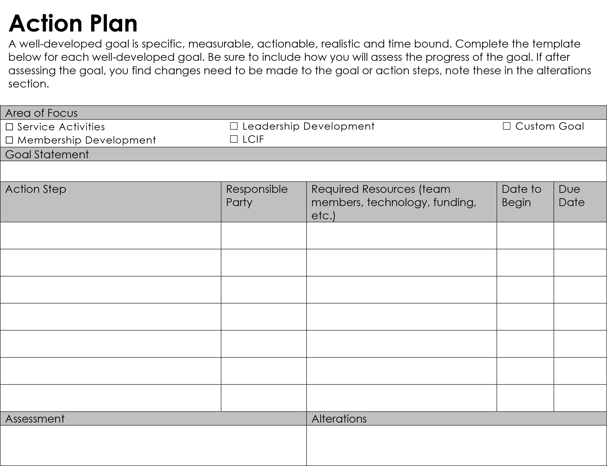

Slide 19
GMA Step 4. Build Success: Execute the plan, Maintain accountability, and adjust, as necessary.
Review and communicate at GAT meetings and Board of Directors meetings.
Remind GAT and club members that they are the club’s goals.
Club GAT team Roles:
Communicate, demonstrate, explain, and promote the GMA process and GAT structure.
Achieve club member buy-in and participation.
Earn LCI’s Club Excellence Award

Slide 20
Have Questions?
Need Help?
Just Ask!

