Slide 1
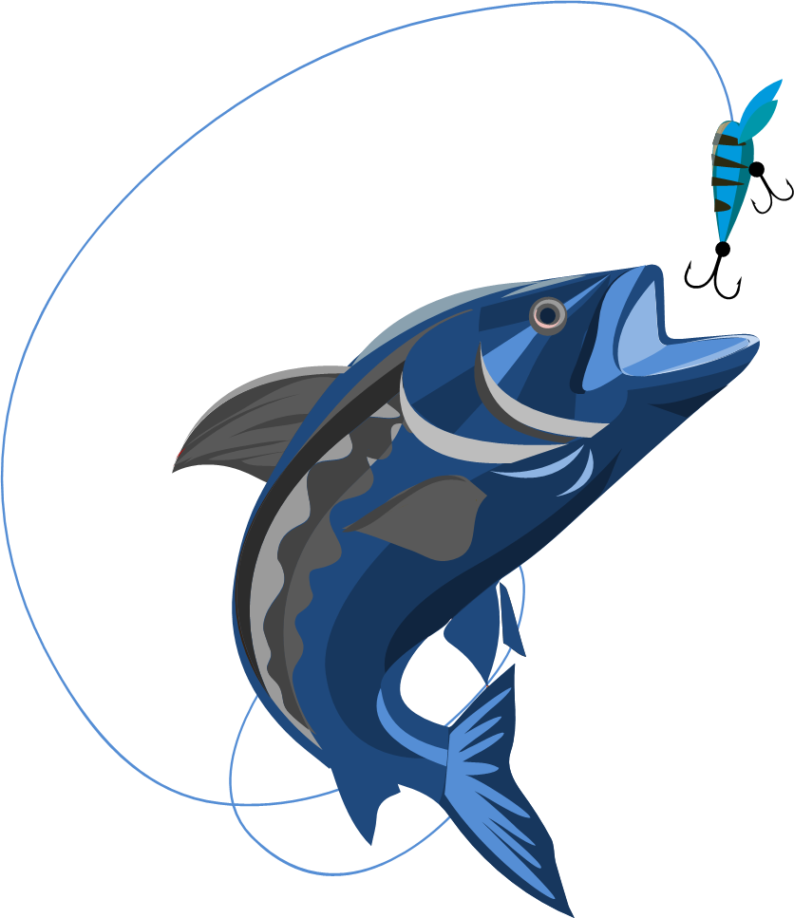
Let’s Go fishing!

Slide 2
Fish where the fish are!
What kind of fish do you want to catch?
Where should you look for them?
What kind of bait should you use to catch them?

Slide 3
The Baby Boomer
Ages 60-78 (1946-1964)
76 million Americans in 2024
Retired or soon-to-be (10,000 per day)
90% are married
Value Interpersonal skills and relationships

Slide 4
The Baby Boomer
Appreciate the value of networking
Value collaboration and high-functioning teams
Less likely to be tech-savvy
Prefer direct and personal communication (newsletters, emails)
Familiar with structured meetings meant to build a sense of community and purpose

Slide 5
The Boomer pond
More likely to be worshippers than younger generations
More likely to belong to other organized groups
  Chamber of Commerce
  Civic Groups, Homeowners Associations
  Cultural Institutions
  Veterans Organizations

Slide 6
The Boomer bait
Leave a legacy
Apply your skills and expertise
Opportunity to socialize
Non-physical volunteer options

Slide 7

The gen x-er
Ages 44 to 59 (1965-1980)
Latchkey kids – single, divorced or working parents
Appreciate having control over their own projects
Independent and adaptable
Lifelong learners
Pragmatic decision makers

Slide 8
The gen x-er
Focus on work-life balance
They volunteer! (Almost 36%)
Skeptical about authority and institutions
  Analyze thoroughly before committing fully

Slide 9
gen x pond
Facebook
Community Centers
Libraries
Involved parents or adult children’s activities

Slide 10
gen x bait
Skills-based volunteering – leverage their strengths and expertise: Manage our Facebook Page
Mentoring and coaching: Lions Quest? Leos?
Environmental causes

Slide 11
The millennial
Ages 28 to 43 (1981-1996)
80+ million Americans
Largest of the generational groups
More racially/ethnically diverse
Optimistic about the future
High educational attainment
Marry and start families later in life

Slide 12
The millennial
Internet generation/social media savvy
Believe they can have a positive impact on the world
Free agents – harder to get them to commit to one organization
Want to see more immediate results and impact of volunteer efforts
Top concerns include education, health care and the environment
Financially stressed and more likely to donate time than money

Slide 13
The millennial pond
Facebook parent groups/community groups
Daycare centers
PTA/PTO School-based groups
Scouting troops
Activity clubs (dance, yoga)
Sports leagues

Slide 14
The millennial bait
Identify service activities that speak to their interests
  Environment/Climate
  Youth Development Programs
Provide family-friendly service opportunities
Flexible volunteer opportunities
Leverage their specific skills and knowledge

Slide 15
The gen z
Ages 12 – 27 (1997 – 2012)
60+ million
“Digital natives” – smart phones/internet
Focused on social justice
Experience seekers, not interested in meetings
Higher educational debt

Slide 16
The gen z pond
Social Media
  TikTok, Instagram
Schools and College Campuses
Peer influencers

Slide 17
The gen z bait
Digital presence
Flexible volunteer opportunities
Time-bound experiences
Advances social cause
Focus on the environment/climate change

Slide 18
Gone fishing!

