Slide 1

Leadership
Considerations
District 2 X1 Lions University
June 21, 2025
PDG Paul S. Moore
Notes:
Thank you for the kind introduction.
I would also like to thank DG Radha, DGE Kedar, and District GLT PDG Fred for asking me to be here.
I would like to thank you for being here today. I am very impressed with the turnout. Your commitment to leadership of your club, the District, and Lions International is admirable and should be applauded.
Leadership can mean a lot of different things to different people.
Your leadership style is the driving force behind your current professional and Lions Club position. I am not here to try to get you to change your leadership style. After all it is working for you.
My goal today is to bring you ideas that have impacted my leadership style for the better. While I am retired (thank goodness) , I continue to take leadership roles in my club (Secretary), my District (LCIF Coordinator and Vision Chair), and now the Multiple District as MD 2 Global Leadership Team Coordinator. As such, the more I can learn and pass on about Leadership the better.
The first thing I would like to discuss is Management and Leadership, are they the same?

Slide 2









Management and Leadership –
Are they the same thing?
Management
Leadership
Running the Club
  Strategy and Guidelines
  What are we going to do?
    What are we required to do?
    What do we want to do?
  How are we going to run events?
The Organization comes First
People come First
2
Notes:
Are Management and Leadership the same?
Discuss Management items
Budget. Collecting Dues, Finding locations to meet, Negotiations with Vendors
Recommend a goal of earning the Club Excellence Award.
The different ways you communicate with people and serve the people defines the type of leader you are
Getting to know the member
Mentoring the member
Coaching the member

Slide 3
Leadership Ideas
“Faith, Family, and Business comes before Lions.”
“I just want the rest of your time!”
PDG Shirley Dillman
District 2 S3
Notes:
There are things in life that are more important than Lions and Lions Club activities.
Every Lion will not be available for every meeting or event. Plan accordingly.

Slide 4
Leadership Ideas
“Before you are a leader, success is all about growing yourself. When you become a leader, success is all about growing others.”
Jack Welch, Former CEO of General Electric
Notes:
In business, you often need to train your replacement before your can be promoted.
Think of the leader as both a coach and a cheerleader for a team:
They call the plays (set strategic direction)
They design the training regimen (provide the necessary tools)
They entrust each player with the responsibilities for their position (allow task ownership)
They inspire and empower their team to take action

Slide 5
Leadership Ideas
All Lions are volunteers and should be treated as a precious resource.
You are their leader but not their boss. Lions do not work for you.
Don’t do things you have assigned to another that they can do themselves
Notes:
Volunteers may find they have a Faith, Family, or Business conflict when instructed to do something they really are not interested in doing.
When you give ownership of a task to someone, do not do part of it on your own. This undermines their confidence and their authority to complete the task.

Slide 6
Leadership Ideas
Communicate Well; Listen effectively
Be the last person to speak on a subject
Notes:
Get to know your club members. Listen, listen, listen.
You have two ears and one mouth. Use them proportionally.
Identify the members wants and needs. Help them to grow as a person and a Lion through tasks and learning opportunities.
If you speak first, you may limit the input of others. A friend that is former military told me they start with the most junior person when discussing a topic.
Do not be afraid to allow someone else the credit even if their idea is the same as one you have not yet provided.

Slide 7
Leadership Ideas
“There are 1.5 million non-profit organizations in the United States. When your volunteers are making the choices about where to spend their time and energy – what to say Yes to – they will choose based on how their needs and wants are being met.”
Rachelle Strawther
2019 USA/Canada Lions Leadership Forum
Notes:
I checked at the total number of 501(c)3 organizations in the USA is now 1.8 million.
This statement impacts our ability to gain new members and retain our existing members.

Slide 8
Leadership Ideas
“It is not about filling the seat on the bus but rather filling it with the right person.”
  “Good to Great” by Jim Collins
Notes:
Matching Lions members to Roles
What are their skills?
Are they willing to do the job?
Does this project match their passion for service?
Do they understand their role and your expectations?

Slide 9
Leadership Ideas
It may be better to be happy than to be right
Notes:
If you are in any type of personal relationship, you know this. Apply idea this to your Lions Leadership

Slide 10
As you plan your clubs Lions year, I encourage you to
Provide the club with your vision for the year
Guide your club to a common purpose
Set Goals, preferable SMART goals
Define Action items to reach your goals
Execute the plan
Celebrate Success and Have Fun!
Inclusion in Leadership and
Unity in Service

Slide 11

CA 1 and 2 In-Person Training
Lions Year 2025 - 2026
USA/Canada Lions Leadership Forum
  Described as the premier learning opportunity in Lions
  Atlantic City, New Jersey
  September 18-20
  https://lionsforum.org/
Notes:
As the MD 2 GLT for next year I would like to encourage you to seek out additional training avenues.
The first major opportunity is the USA/Canada Lions Leadership Forum
In September 2026 the forum will be in Memphis, TN so will be drivable for many of us.

Slide 12

MD 2 In-Person Training
Lions Year 2025 - 2026
Locations, Dates, and Cost to be announced
no later than August.
Emerging Lions Leadership Institute
Regional Lions Leadership Institute
Texas Lions Leadership Forum
Lions International Institutes
Faculty Development Institute
Denver, CO
Oct 24, 2025 – Oct 26, 2025
Application due by July 11, 2025

Slide 13
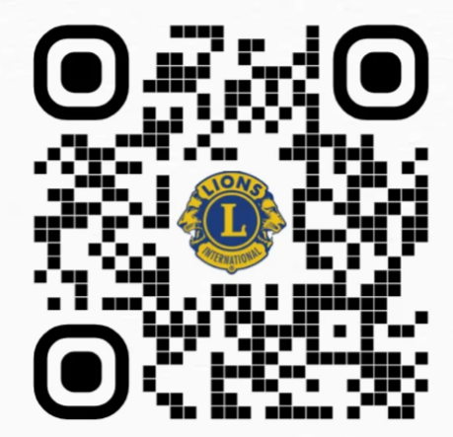
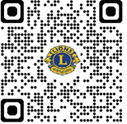

Online Training Opportunities
Lions Learning Center
Free online training
Available via the Lions Member Portal
Servant Leadership Information
YouTube: Lead to Serve: Serve to Lead Academy
Servant Leadership Certification:
https://www.lions27d2.org/servant-leadership

Slide 14
Recommended Reading
Some of the books I have read and may have quoted in this presentation:
Engaging the Head, Heart, and Hands of a Volunteer
by Barry Altland
The Secret
by Ken Blanchard and Mark Miller
Good to Great
by Jim Collins
Five Levels of Leadership
by John C. Maxwell
Getting to Yes
by Robert Fisher, William Ury, and Bruce Patton

Slide 15
Thank you for your attention!
“If you stop learning, you stop leading.”
from “The Secret” by Blanchard and Miller
PDG Paul S. Moore
PSMoore2S2@gmail.com
512-565-0484
Notes:
In Conclusion:
Your leadership abilities are what have led you to your current position in Lion Clubs. Trust yourself.
The more you know about your members, the more likely you are to meet their wants and needs.
Growing your member’s abilities provides a pathway top the future for your club and your district.

