Slide 1


The Global Action Team
1

Slide 2

We’re on a MISSION
MISSION 1.5 is our drive to reach 1.5 million members worldwide on July 1st, 2027. Leaders at every level are invested and responsible for success – so GAT leaders will lead by example and encourage collaboration and accountability at every level.
2
2
Notes:
The Global Action Team is at the forefront of driving MISSION 1.5 forward. We're your go-to resource for achieving MISSION 1.5 targets, boosting membership, and inspiring Lions to lead by example. Our aim is clear: foster collaboration and accountability at every level. Let's make a meaningful impact together.

Slide 3

Why GAT is Needed
The GAT is a vast network of dedicated Lions of all levels who are focused on helping districts achieve their goals. This important team helps foster club membership growth, increase Lions’ visibility in the community through impactful service and build strong, innovative leaders.
3
Notes:
Ever felt the need to do more for your community or district, only to find yourselves short on Lions to support those ambitions?
Or perhaps struggled to fill leadership roles within your club?
Maybe your club has seen members drift away due to conflicts or a lack of meaningful engagement in service?
As Lions leaders, we bear the responsibility of leaving our district or club better than we found it. That means making strategic changes, ensuring improvements across the board – from leadership and membership to service, club operations, and marketing.

Slide 4

GAT Priorities
MISSION 1.5
Global Membership Approach
District Goals
MISSION 1.5 is the drive to reach 1.5 million members worldwide on July 1, 2027, so we can better meet the growing needs of our communities and serve more people than ever before.
Equips districts to develop membership through a strategic process focused on rejuvenating districts with new clubs, revitalizing clubs with new members and re-motivating existing members with fellowship and exciting service.
Provide districts with the opportunity to create goals and action plans that are directly tailored to each district’s annual priorities. Action plans to support MISSION 1.5 targets will be submitted through the district goals process.
4
Notes:
Membership growth, leadership development, and service are the lifeblood of any Leo or Lions club. To empower clubs in their growth journey, the GAT has focused in on a trio of powerful strategies: the MISSION 1.5, Global Membership Approach and our District Goals process.
The Global Membership Approach provides districts with a strategic blueprint focused on injecting new energy into districts through new clubs, infusing existing clubs with fresh faces, and reigniting passion among current members through exciting service and fellowship opportunities. This approach is instrumental in helping districts achieve their MISSION 1.5 targets.
By synchronizing the Global Membership Approach with MISSION 1.5, districts carve out unique pathways to bolster membership, fortify clubs, and amplify service efforts. This entails crafting tailored district goals and action plans geared towards fostering membership and leadership development, driving impactful service activities, and supporting LCIF initiatives. Action plans geared towards achieving MISSION 1.5 targets are submitted through the District Goals process.

Slide 5

Who is the GAT?
The GAT is uniquely positioned at all levels of our organization
Notes:
As the heartbeat of Lions Clubs International, the Global Action Team (GAT) spans across every club, district, zone, and region. Let's dive into the makeup of the team, breaking it down level by level.

Slide 6
At the Club Level
At the Club Level
Club Global Action Team Chairperson (Club President)
GMT
Membership Chairperson
GLT
First Vice President/Leadership Chairperson
GST
Service Chairperson
6
Notes:
At the club level, where the real 'Action' takes place, the President leads the charge as the Chairperson of the Global Action Team. Working alongside them, the first Vice President takes on the role of GLT Chairperson, spearheading training initiatives for leaders and facilitating member participation in district and multiple district level trainings.
Next up, we have the GMT Club Membership Chairperson, dedicated to not only attracting new members but also ensuring the continued engagement of existing ones. Their primary focus lies in fostering a vibrant and active club community.
Last but not least, the GST Club Service Chairperson shoulders the responsibility of organizing and orchestrating captivating service activities for the club, ensuring members have meaningful opportunities to make a difference in their communities.

Slide 7
At the District Level
At the Club Level
District Global Action Team Chairperson (District Governor)
GMT
District Coordinator
GET
District Coordinator
GLT
District Coordinator
GST
District Coordinator
Region and Zone Chairpersons
7
Notes:
At the district level, effective leadership is critical. The District Governor serves as the Chairperson of the Global Action Team, collaborating with their team to craft and execute goals for the fiscal year.
The GMT Coordinator is dedicated to implementing membership growth and retention strategies, crucial for achieving the district’s objectives.
Introduced in July 2022, the GET Coordinator focuses on chartering new clubs.
Responsible for organizing district-wide service events and equipping clubs with valuable service resources, the GST Coordinator plays a key role in fostering impactful service initiatives. They also oversee the reporting of district-level service activities in the Lion Portal.
Meanwhile, the GLT Coordinator oversees training initiatives for both clubs and individual members, including the reporting of local trainings in LEARN, accessible through single sign-on.
Region and Zone Chairpersons act as bridges between coordinators and clubs, facilitating communication and relaying vital feedback to districts from club members.

Slide 8
At the Multiple District Level
At the Club Level
Multiple District Global Action Team Chairperson (Council Chairperson)
GMT
Multiple District Coordinator
GET
Multiple District Coordinator
GLT
Multiple District Coordinator
GST
Multiple District Coordinator
8
Notes:
At the multiple district level, leadership plays a pivotal role in driving collective success. The Council Chairperson leads the Global Action Team, collaborating with their team to support districts in achieving their goals and setting overarching objectives for the multiple district.
The GAT Coordinators mirror their counterparts at the district level, providing guidance and support to each district within the multiple district, akin to how district coordinators engage with individual clubs within their respective districts.

Slide 9
At the International Level
At the Club Level
GAT Area Leadership
GAT Constitutional Area Leadership
International Vice Presidents
International President
GAT Ambassadors
Past International Presidents
Past International Directors
International Board of Directors
Past District Governors
LCIF Board of Trustees
9
Notes:
At the international level, support and guidance are provided while developing region-specific strategies focused on Membership, Leadership, Service and LCIF initiatives.
Ambassadors play a vital role in disseminating the message and excitement generated by the Global Action Team to Lions worldwide.
The International President and Vice Presidents collaborate closely with Constitutional Area leaders and Lions International to ensure leaders have robust strategies and necessary staff support for implementation.
Constitutional area leaders collaborate with area leaders to uphold Lions International goals and provide valuable feedback to headquarters for program and resource enhancement.
Area leaders work closely with multiple district and district coordinators, offering support to help them achieve their goals.

Slide 10









What does the GAT do?
Provide Input and Feedback
Report and Monitor Progress
One Team Approach
Support Membership Growth
Share and Utilize Resources
Enhance Service Impact
Leadership Development
Communicate and Collaborate
Promote LCIF
Notes:
As you can see on the slide, everything the GAT does is interconnected with membership and association growth.
Membership Growth: The GAT assists districts and clubs in developing effective membership programs to start new clubs and attract new members. Additionally, they aid in creating a remarkable membership experience to retain both new and seasoned members, enabling clubs to expand their service footprint in communities.
Provide Input and Feedback: GAT members have opportunities to provide input on resource development and offer feedback on its utilization and regionalization for their area.
One-Team Approach: The Global Action Team unites GMT, GLT, and GST to support districts and clubs in achieving their goals. Collaboration as a team maximizes impact.
Enhance Service Impact: GAT aids districts and clubs in identifying resources and best practices to enhance service projects and their impact. Quality service projects increase member satisfaction and attract new members.
Communicate and Collaborate: Effective communication with district teams and leadership fosters the facilitation of useful information and better teamwork towards district goals.
Promote LCIF: GAT promotes Lions donations to LCIF, which in turn supports Lions worldwide through grants and financial assistance.
Leadership Development: GAT offers leadership development opportunities, empowering Lions to lead and serve their communities and districts. Strong leaders drive membership, champion new service projects, and position districts and clubs for continued success.
Share and Utilize Resources: Lions International provides GAT members access to a plethora of resources covering membership, leadership, service, operations, and marketing, which can be utilized to support districts and clubs.
Report and Monitor Progress: Clubs are encouraged to submit monthly membership reports and report on conducted service projects. Multiple districts and districts provide reports on conducted trainings. Monitoring progress is facilitated through dashboards in the Lion Portal such as Insights and KPI dashboards.

Slide 11
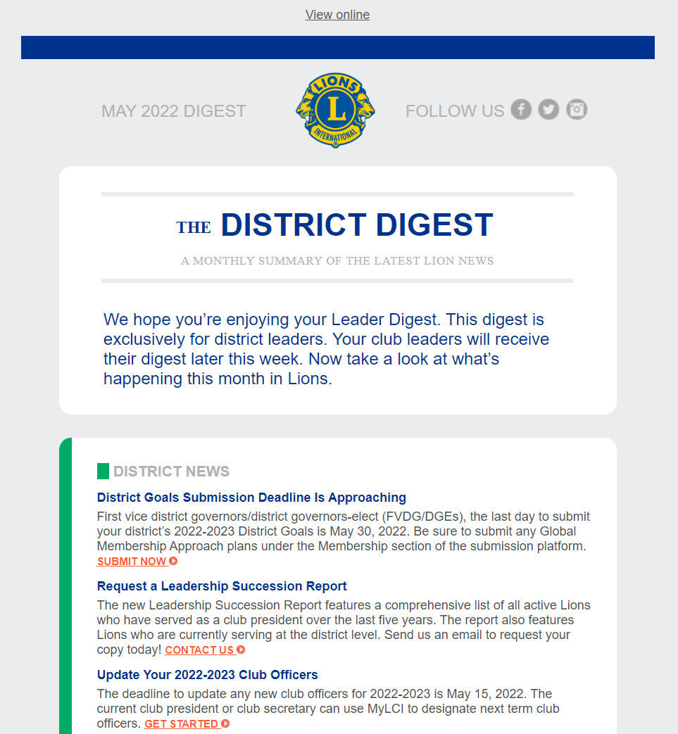

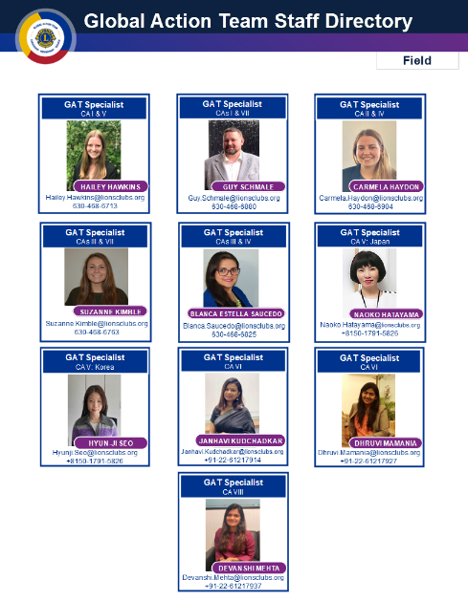
Communication Channels
Lion’s Monthly Digest
GAT Facebook Group
GAT Regional Specialists
11
Notes:
GAT staff at Lions International ensure seamless communication with Lions worldwide through various channels.
Monthly Digest and Facebook Group: Key messages and updates are disseminated through the monthly digest to club and district officers and shared on the GAT Facebook Group. Additionally, regional specialists collaborate closely with GAT members in their constitutional area, offering support when needed. You can reach out to your specialist by emailing GAT.CA_@lionsclubs.org.
Join the GAT Facebook Group: If you haven't already, make sure to join the GAT Facebook group to connect with fellow Lions globally. Here's the link to join: GAT Facebook Group (https://www.facebook.com/groups/GlobalActionTeam/).
Requesting GAT Specialist Travel: Multiple district and district conventions, as well as GAT-related summits and meetings, serve as ideal platforms to promote GAT and engage with coordinators. If you require support during a GAT-related event and would like a GAT specialist to attend, please submit a Staff Attendance Request Form to GAT@lionsclubs.org as soon as event plans are confirmed. Requests should be limited to one specialist per event, and all forms must be submitted at least four weeks before the scheduled event.

Slide 12
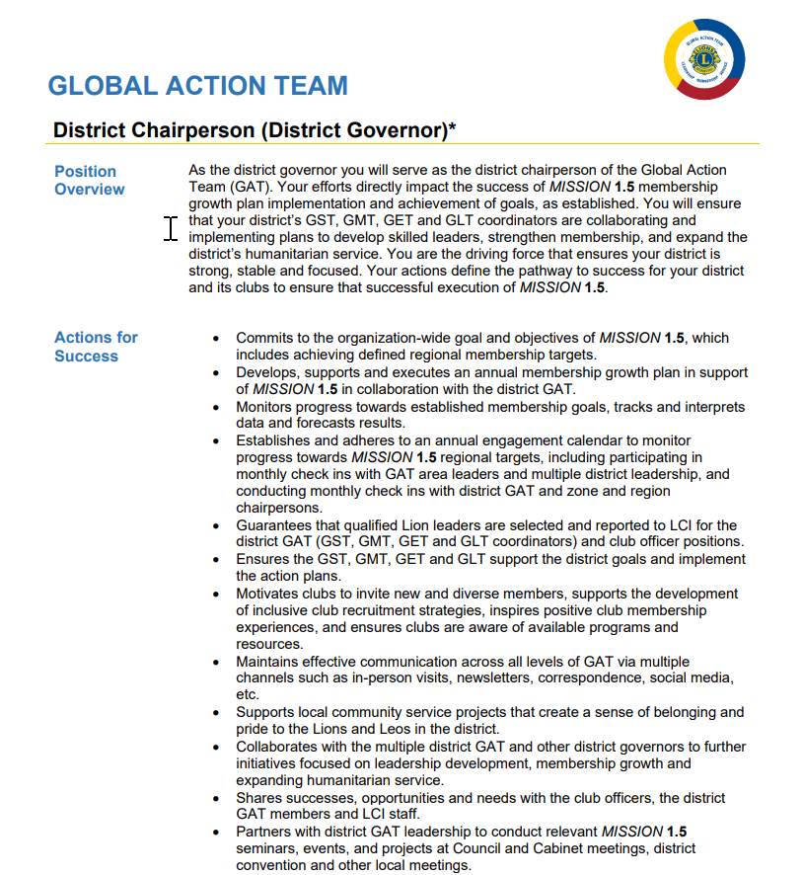
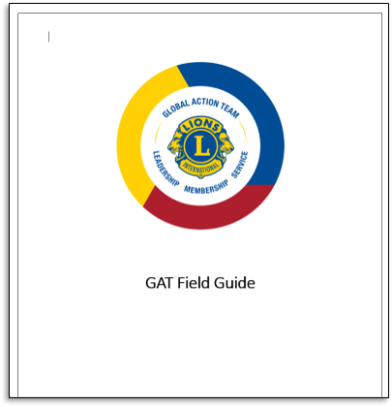
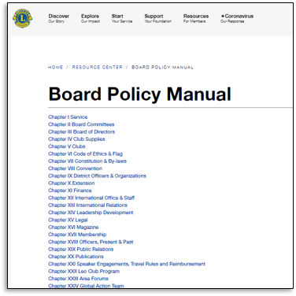
Resources Available
Roles and Responsibilities
GAT Field Guide
Board Policy Manual
Chapter XXIV
12
Notes:
The Global Action Team has access to a wealth of resources covering a wide range of topics relevant to Lions. To begin exploring these resources and understand the scope of the Global Action Team's work, consider referring to documents such as the GAT Roles and Responsibilities, GAT Field Guide, and Board Policy Manual. These resources provide valuable insights into the responsibilities of the Global Action Team and serve as excellent starting points for further exploration.

Slide 13

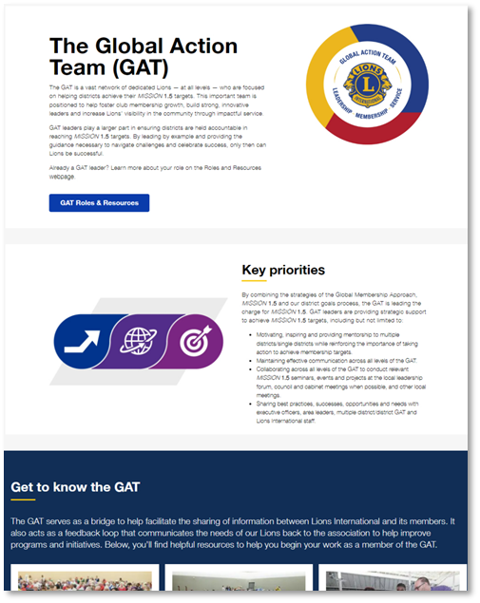
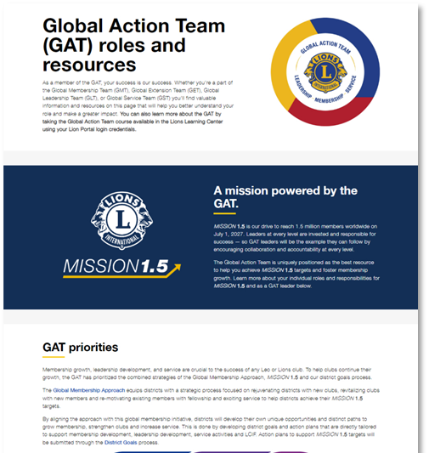
Webpages
Landing Page
Roles and Resources
Notes:
The Global Action Team (GAT) maintains two primary webpages, each with valuable resources for Lions:
The Landing page serves as a hub for general information about GAT initiatives and features success stories showcasing the impact of GAT efforts.
The GAT Roles and Resources page hosts a variety of tools and resources essential for GAT members. Additionally, it provides links to the GMT/GET, GLT, and GST Toolboxes, which offer even more specialized resources tailored to each area of focus within the GAT.
​

Slide 14

District Goals Resources
Landing Page
The district goals landing page offers convenient access to:
FVDG/DGE Resources
Current Lion Year Goals
District Goals Recognition Page
District Goals Progress Dashboard
Track key metrics on district progress towards MISSION 1.5 targets, reported training, service impact and donations statistics.
Reports Directory
Provides a PDF copy of submitted district goals and action plans and MISSION 1.5 district targets per respective Lion year.
14
14
Notes:
The district goals landing page offers links to valuable resources:
FVDG/DGE Resources: Access essential tools and guidance tailored for FVDG/DGEs to support their roles effectively.
Current Lion Year Goals: Find information about the goals set for the current Lion year, providing direction on how to track and monitor progress.
District Goals Recognition Page: Explore the page dedicated to recognizing districts that have achieved or exceeded their goals.
Additionally, the District Goals Progress Dashboard, accessible through the Lion Portal, provides helpful statistics and data to monitor progress towards MISSION 1.5 targets.
Furthermore, the district goals index in the Reports Directory contains a PDF copy of submitted district goals and action plans, along with MISSION 1.5 district targets per respective Lion year.

Slide 15


Lions Clubs International Foundation
LCIF grant funding MAGNIFIES Lions’ service
GAT Leaders are one of LCIF’s strongest resources
LCIF empowers Lions to always answer the call to serve
15
Notes:
As the only foundation to empower the service of Lions worldwide, LCIF grant funding magnifies Lions’ service to help more people in need around the world. ​
​
As GAT Leaders, you are one of LCIF's strongest resources, not only because of your personal donations, but also as ambassadors for the foundation, encouraging others to support LCIF. ​
​
The calls to serve a world in need continue to grow. Through continued support, LCIF empowers Lions to always answer.​

Slide 16
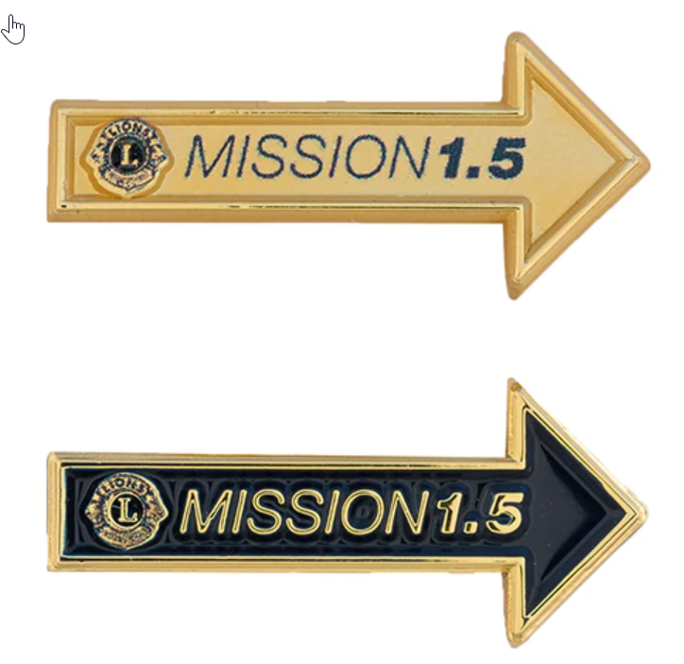

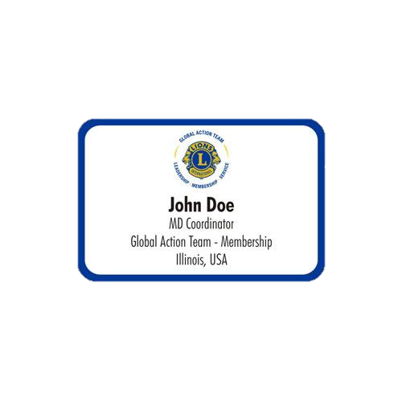


GAT Merchandise
Visit the Lions Shop today!
16
Notes:
Showcase your affiliation with the Global Action Team by sporting GAT merchandise available at the Lions Shop. Alternatively, when purchasing customized Lions apparel, request to include the GAT logo to represent your dedication to service and leadership within the Lions community.

Slide 17
Contact Us!
Email: GAT@lionsclubs.org
Staff Directory
17
Notes:
You can contact your regional specialists directly by emailing
GAT.CA1@lionsclubs.org
GAT.CA2@lionsclubs.org
GAT.CA3@lionsclubs.org
GAT.CA4@lionsclubs.org
GAT.CA5@lionsclubs.org
GAT.CA6@lionsclubs.org
GAT.CA7@lionsclubs.org
GAT.CA8@lionsclubs.org

Slide 18

Thank You!
© 2022 Lions International
18

