Slide 1

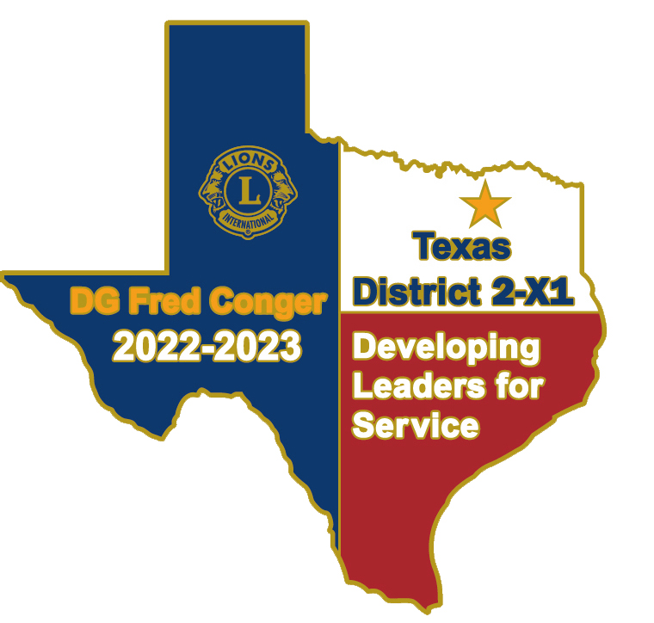
Lion District 2-X1 Supported Charities
And Other Lion Charity Options
2024-2025 Lion Year
PDG/GLT Fred Conger
October 18, 2024

Slide 2
We Serve
Lions Clubs Serve
Local Communities
District 2-X1
State (MD-2 Texas)
Our Nation
The World

Slide 3
Lions Serve Through
Local Hands-On Service
Local Charity Donations
Our District Dues
Includes $21/Year for Texas Lions Camp Fund
District Supported Charities Donations
Optional 100% Charities Contributions
Club Member Awards
Lions Clubs International Foundation
Club and Personal Donations & Melvin Jones Fellowships
LCIF overhead covered by Fund Interest

Slide 4
9 - District 2-X1 Supported Charities
1. Texas Lions Camp
2. Lions Sight & Tissue Foundation
3. Texas Lions Foundation
4. Lions Clubs Int’l Foundation
5. Julien C. Hyer Youth Camp
6. Leader Dogs for the Blind
7. World Services for the Blind
8. Texas Lions Eyeglass Recycling Center
9. Sports Extravaganza

Slide 5
District 2-X1 Supported Charities
So, How are these 9 supported district charities funded?
100% Club Donations, Individual Lion Contributions, and Club Award Donations

Slide 6
100% Club Contribution Amounts
* Per club member based on July 1st membership.
Texas Lions Camp $10 Required for 100%
Lions Sight & Tissue Foundation $2 Required for 100%
Texas Lions Foundation $2 To be a 100% club, also pick 5 more of the
Lions Clubs Int’l Foundation $2 7 remaining charities ($22 total/member)
Julien C. Hyer Youth Camp $2 or pick all 7 ($26 total/member).
Leader Dogs for the Blind $2
World Services for the Blind $2
Texas Lions Eyeglass Recycling Center $2
Sports Extravaganza $2
`` Total: $26 * 100% is Optional

Slide 7
100% Club Contributions
A club’s 100% contributions may be paid from:
the club’s administrative account from member dues or …
from the club’s project/charities account using money raised from the public since these entities are 501c3 charities.
Note: This contribution is NOT a part of a club’s District/MD-2 dues. Clubs receive a notice which is NOT an invoice. Contributions are optional but encouraged to support our district charities.
1900 District 2-X1 Lions x $26 = $49,400 in support.

Slide 8



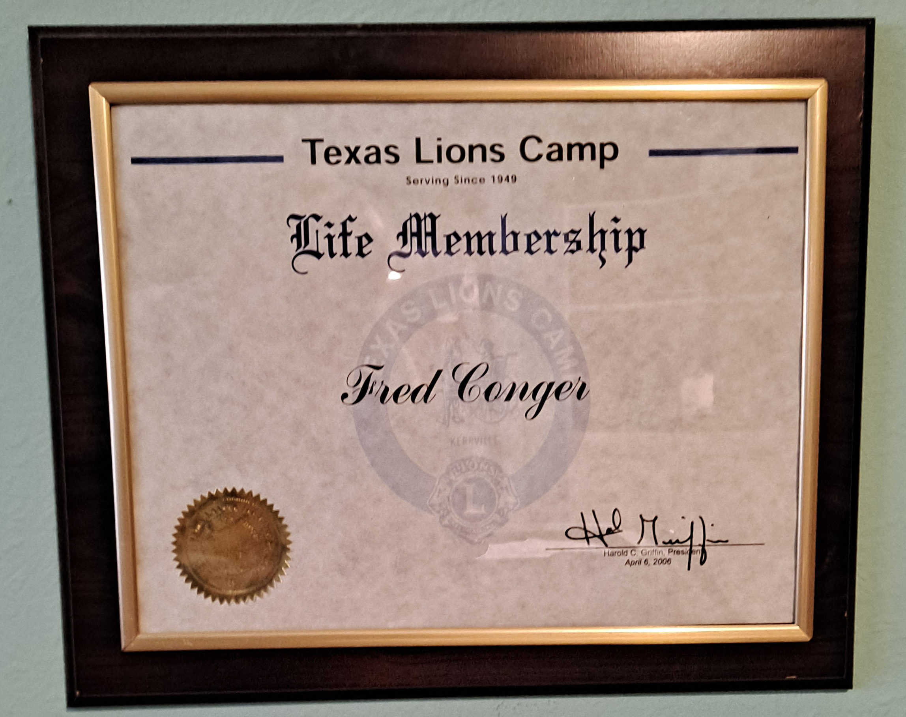
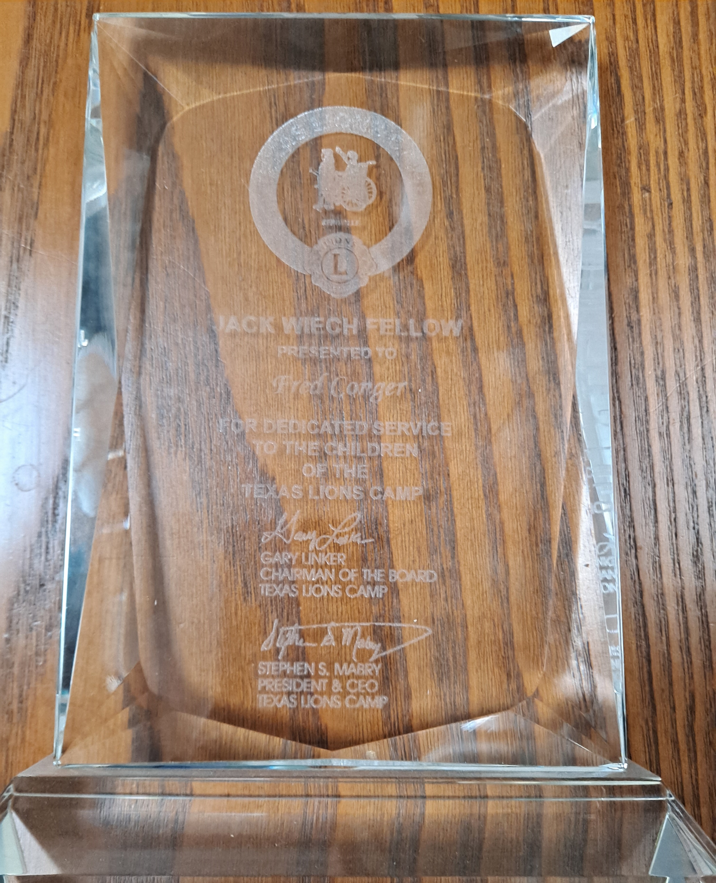
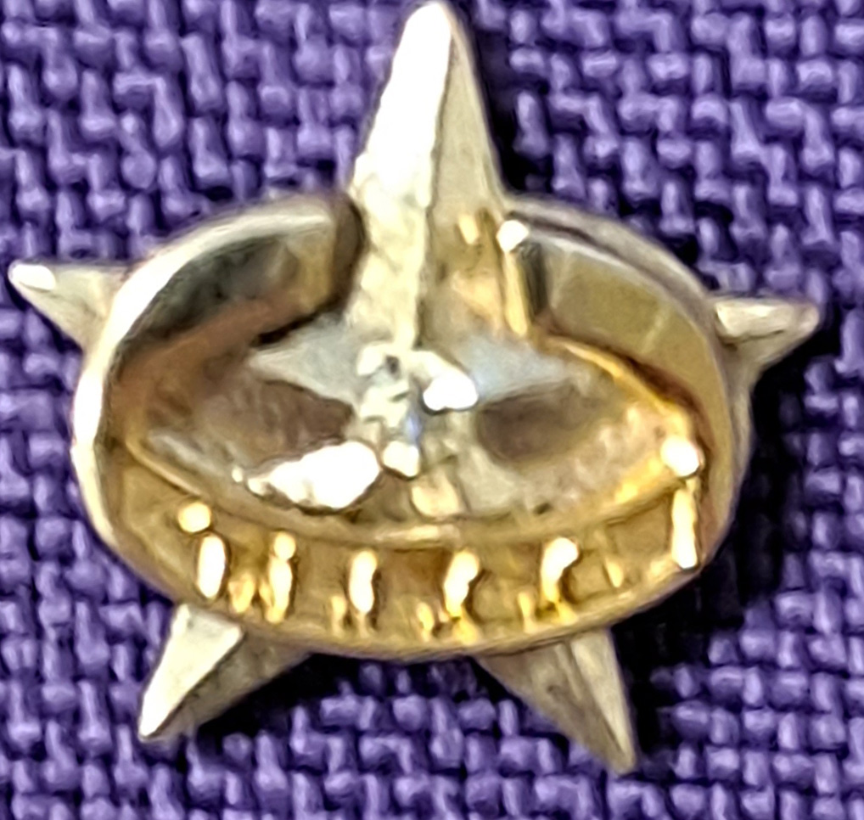


Texas Lions Camp is a residential summer camp for children with physical disabilities, type 1 diabetes and cancer. Children with special medical conditions from all over the State of Texas can attend free of charge.
Texas Lions Camp
4100 San Antonio Hwy, Kerrville, TX 78028
lionscamp.com
Camp video
83,000 Campers Served
12,500 Summer Staff Members
1500 Volunteers this Year
21,000 Texas Lions Support this camp with …
$10 - 100% club donations, and
life memberships $100 + $25 for plaque,
Century Club Key memberships $100/year or $250/year, $500/year, $1000/year, $5000/year,
Endowment bricks $250, and
Jack Wiech Fellowships $1000

Slide 9
The Lions Sight and Tissue Foundation of District 2-X1 Inc. (LS&TF) has been serving the citizens of the Dallas area from it’s beginning in 1956 as an eye bank devoted to cataract surgery and cornea transplantation to its current purpose as a resource for the people in District 2-X1 (which includes the Counties of Dallas, Ellis, Hunt, Rockwall, Kaufman & parts of Collin) to receive eyeglasses as well as medical assistance for vision issues.
Through the years, the LS&TF has grown from a few dedicated volunteers meeting a plane at the airport at midnight to deliver corneas to a person in need, to an organization staffed by volunteers from Lions Clubs all over District 2-X1. Utilizing a state-of-the-art Mobile Clinic equipped with all the modern equipment needed to provide complete eye exams the LS&TF reaches out to children and adults who need vision care but lack the resources for such care.
The impact of this service on the lives of these children and adults is profound. Without glasses, children are less likely to succeed in school, leading to drop-outs, gang involvement, and potential incarceration. Vision problems are 3 times as likely in Juvenile Detention Centers as in the general population. For adults, having a pair of glasses can mean the difference in getting a job or becoming a drain on society’s resources. The sense of pride in becoming self-sufficient can change their lives.
LS&TF is a Lions Club District 2-X1 Charity. As a 501(c)(3), all contributions made are tax deductible under law. We welcome all donations and would be glad to discuss our work with any group or individual who is interested. Only through the generous donations of Lions Clubs, Foundations, Corporations and individuals can the important work of the LS&TF continue to help the people of District 2-X1.

Slide 10
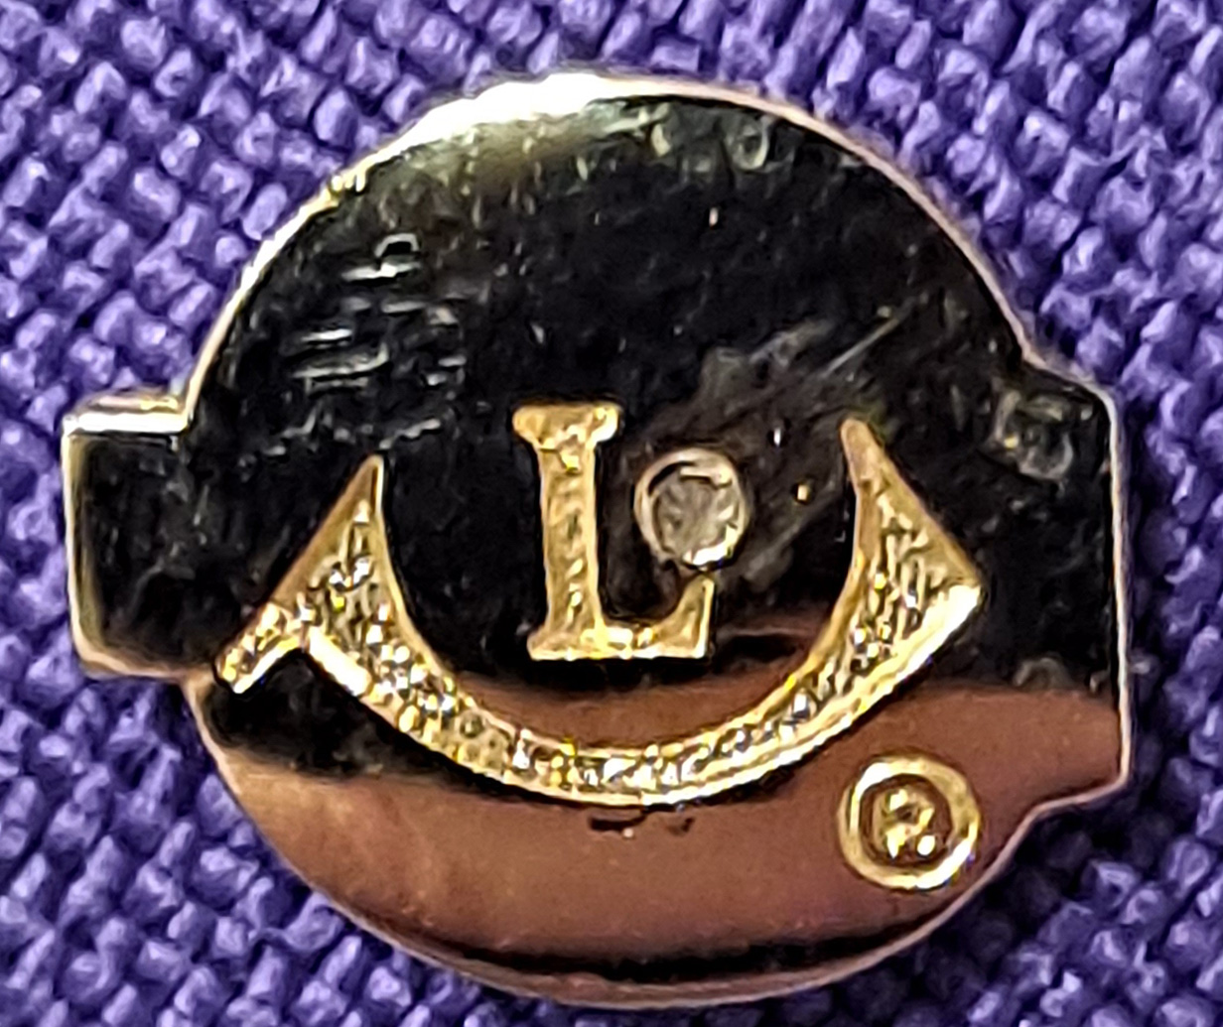
$2 - 100% club donations and
$100 – TS&LF Life Membership ($150 with Plaque)
$250 – William S. Harris Memorial Award (Bronze Plaque)
$500 - Pete Anderson Award (Desktop Award)
$750 – Neil Roach Award (Desktop Award)
$1000 – PDG F.X. “Pancho” Luna Award (Bronze Plaque)
Denim & Diamonds Fundraiser – June 29th

Slide 11

Texas Lions Foundation
MD-2
Texas Lions Foundation (TLF) is an organization committed to filling humanitarian needs throughout the world. As a public, non-profit, tax-exempt corporation, its purpose is to promote human welfare by careful application of contributed funds.
TLF concentrates its efforts in two areas: humanitarian services and disaster relief. The Foundation strives to support projects that, while falling into one of these two categories, also have long-term and far-reaching effects, and promote the objectives of the Texas Lions Foundation. Overall, the Foundation maintains a strong commitment to helping people achieve their own potential, and to implementing projects that make permanent and positive changes. Projects are favored that provide benefits to as many people as possible.

Slide 12

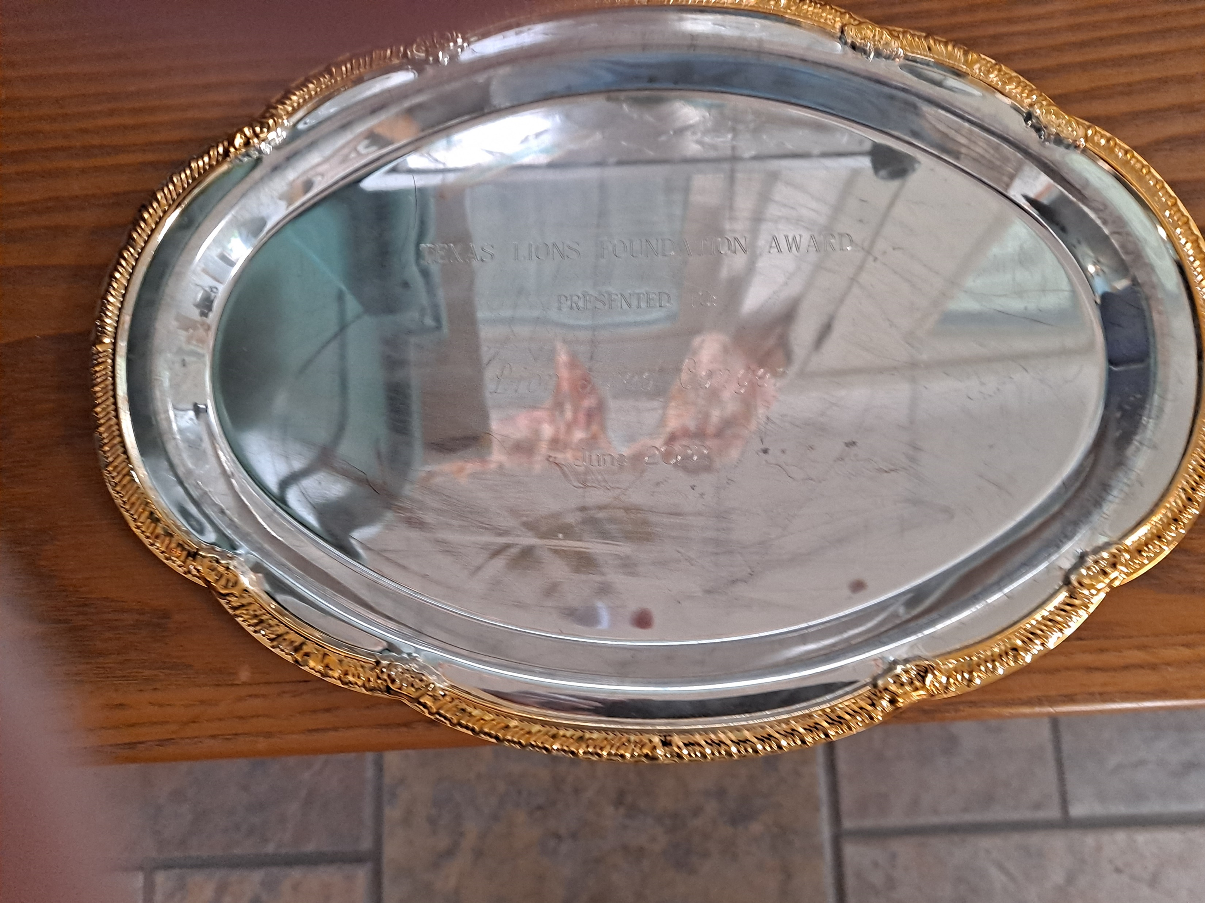
Texas Lions Foundation
MD-2
$2 - 100% club donations and
$125 - TLF Award (Silver & Gold plate)
$500 - TLF Fellow Award (Plaque & lapel Pin)
$500 additional - (pins have a diamond per $500 added)

Slide 13

Lions Clubs International Foundation
Our mission is to empower Lions clubs, volunteers, and partners to improve health and well-being, strengthen communities, and support those in need through humanitarian services and grants that impact lives globally, and encourage peace and international understanding.
Vision, Hunger, Youth, Disaster Relief, Humanitarian, Diabetes, Environment, Childhood Cancer.

Slide 14
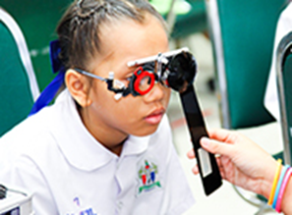

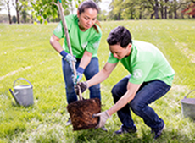
Lions Clubs International Foundation
Global Causes
Vision
LCIF helps Lions prevent avoidable blindness and care for the visually impaired
Hunger
LCIF is on a mission to ensure all community members have access to nutritious foods
Environment
LCIF is dedicated to helping Lions take on large-scale projects that will create a sustainable and healthy future for generations to come.

Slide 15

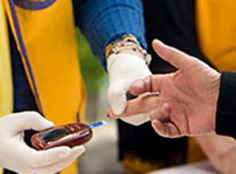
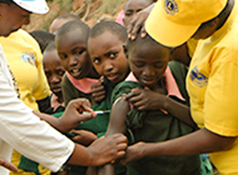
Lions Clubs International Foundation
Global Causes
Childhood Cancer
LCIF is committed to helping cancer patients and their families, and we’re constantly exploring new ways to improve quality of life for these children.
Diabetes
LCIF is fighting to reduce the prevalence of diabetes and improve quality of life for people diagnosed with this disease.
Humanitarian
Lions identify the world’s most crucial needs, and LCIF supports them in their efforts to provide humanitarian aid around the globe.

Slide 16

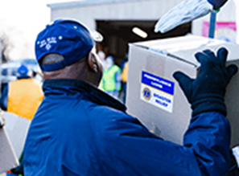
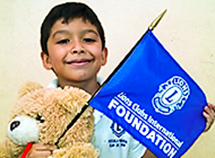
Lions Clubs International Foundation
Global Causes
Disaster Relief
Whenever and wherever disaster strikes, Lions are often among the first to offer aid. LCIF empowers those crucial relief efforts.
Youth
LCIF improves access to quality education, vital health services, and positive youth development for young people around the world.

Slide 17
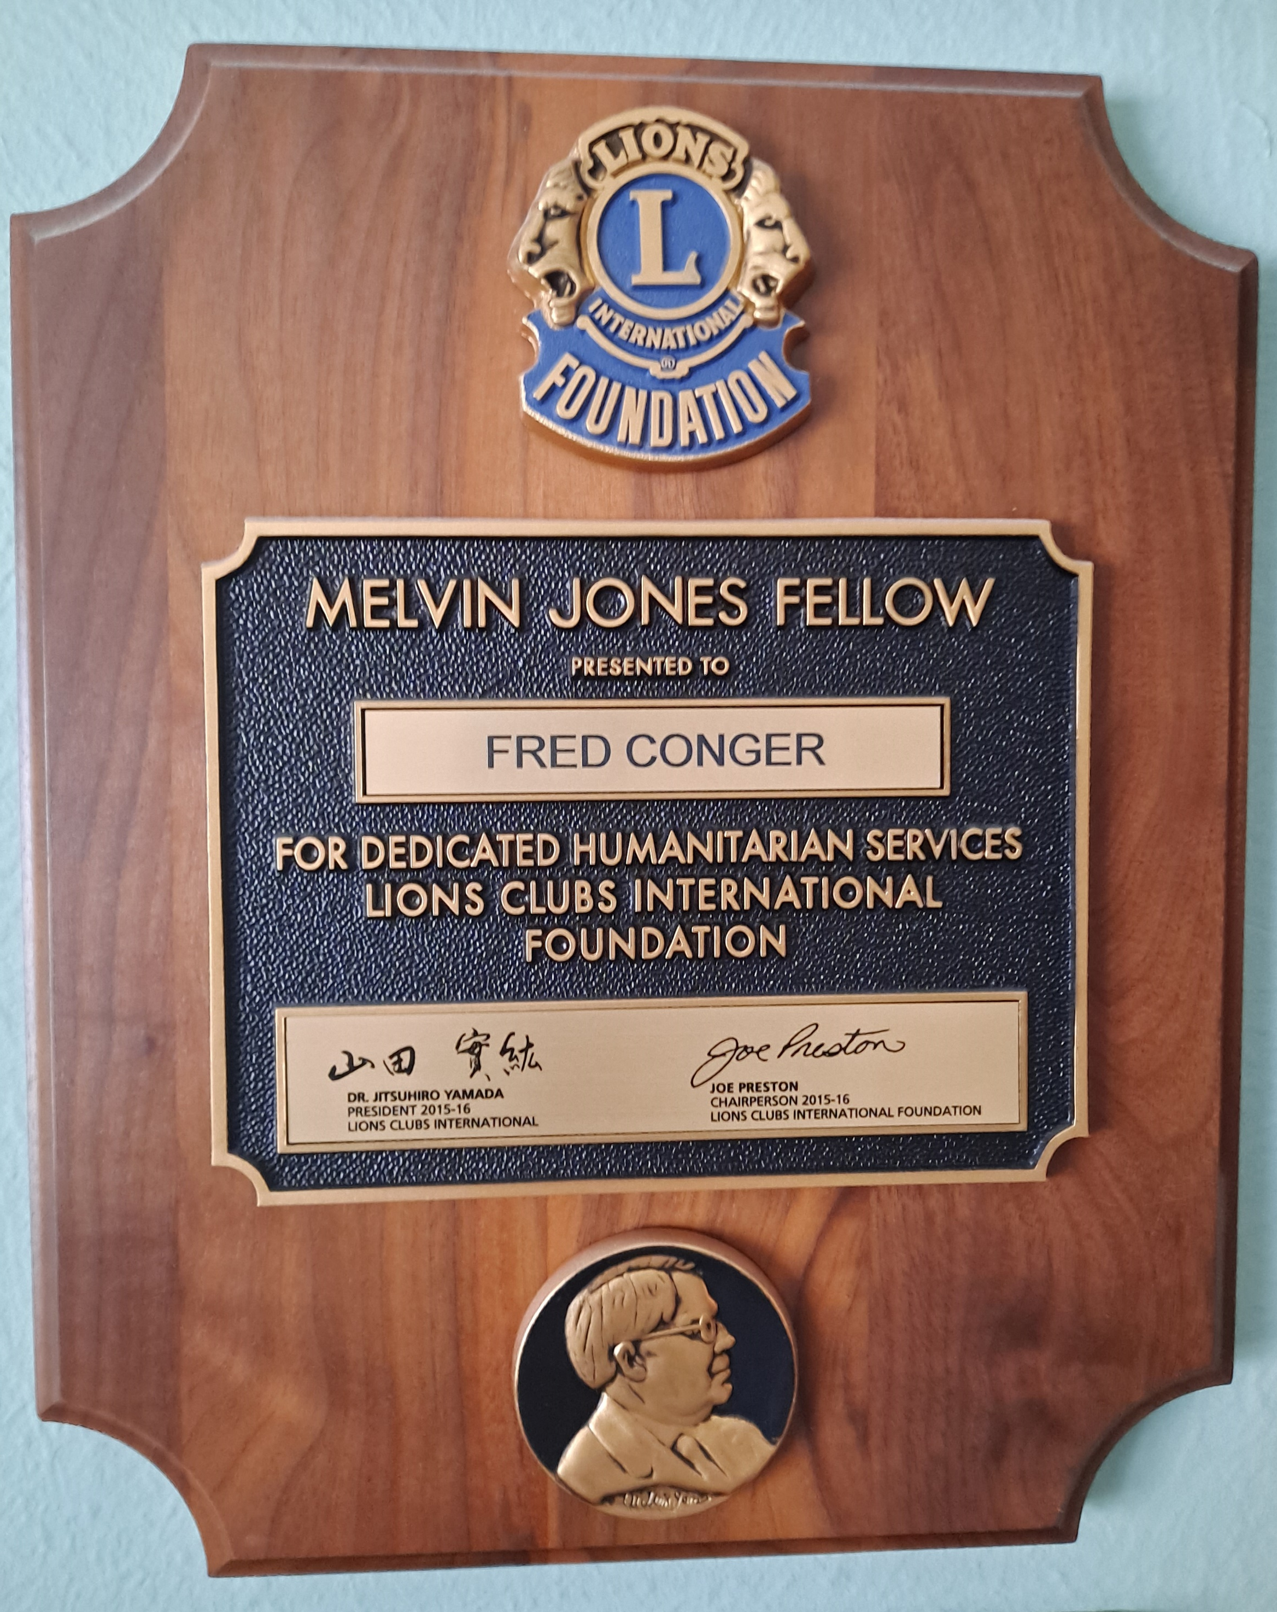
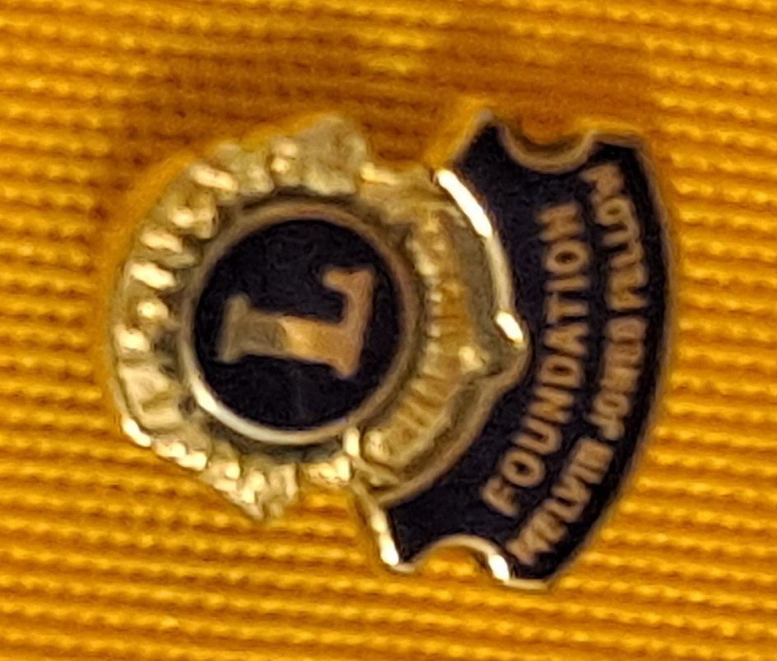
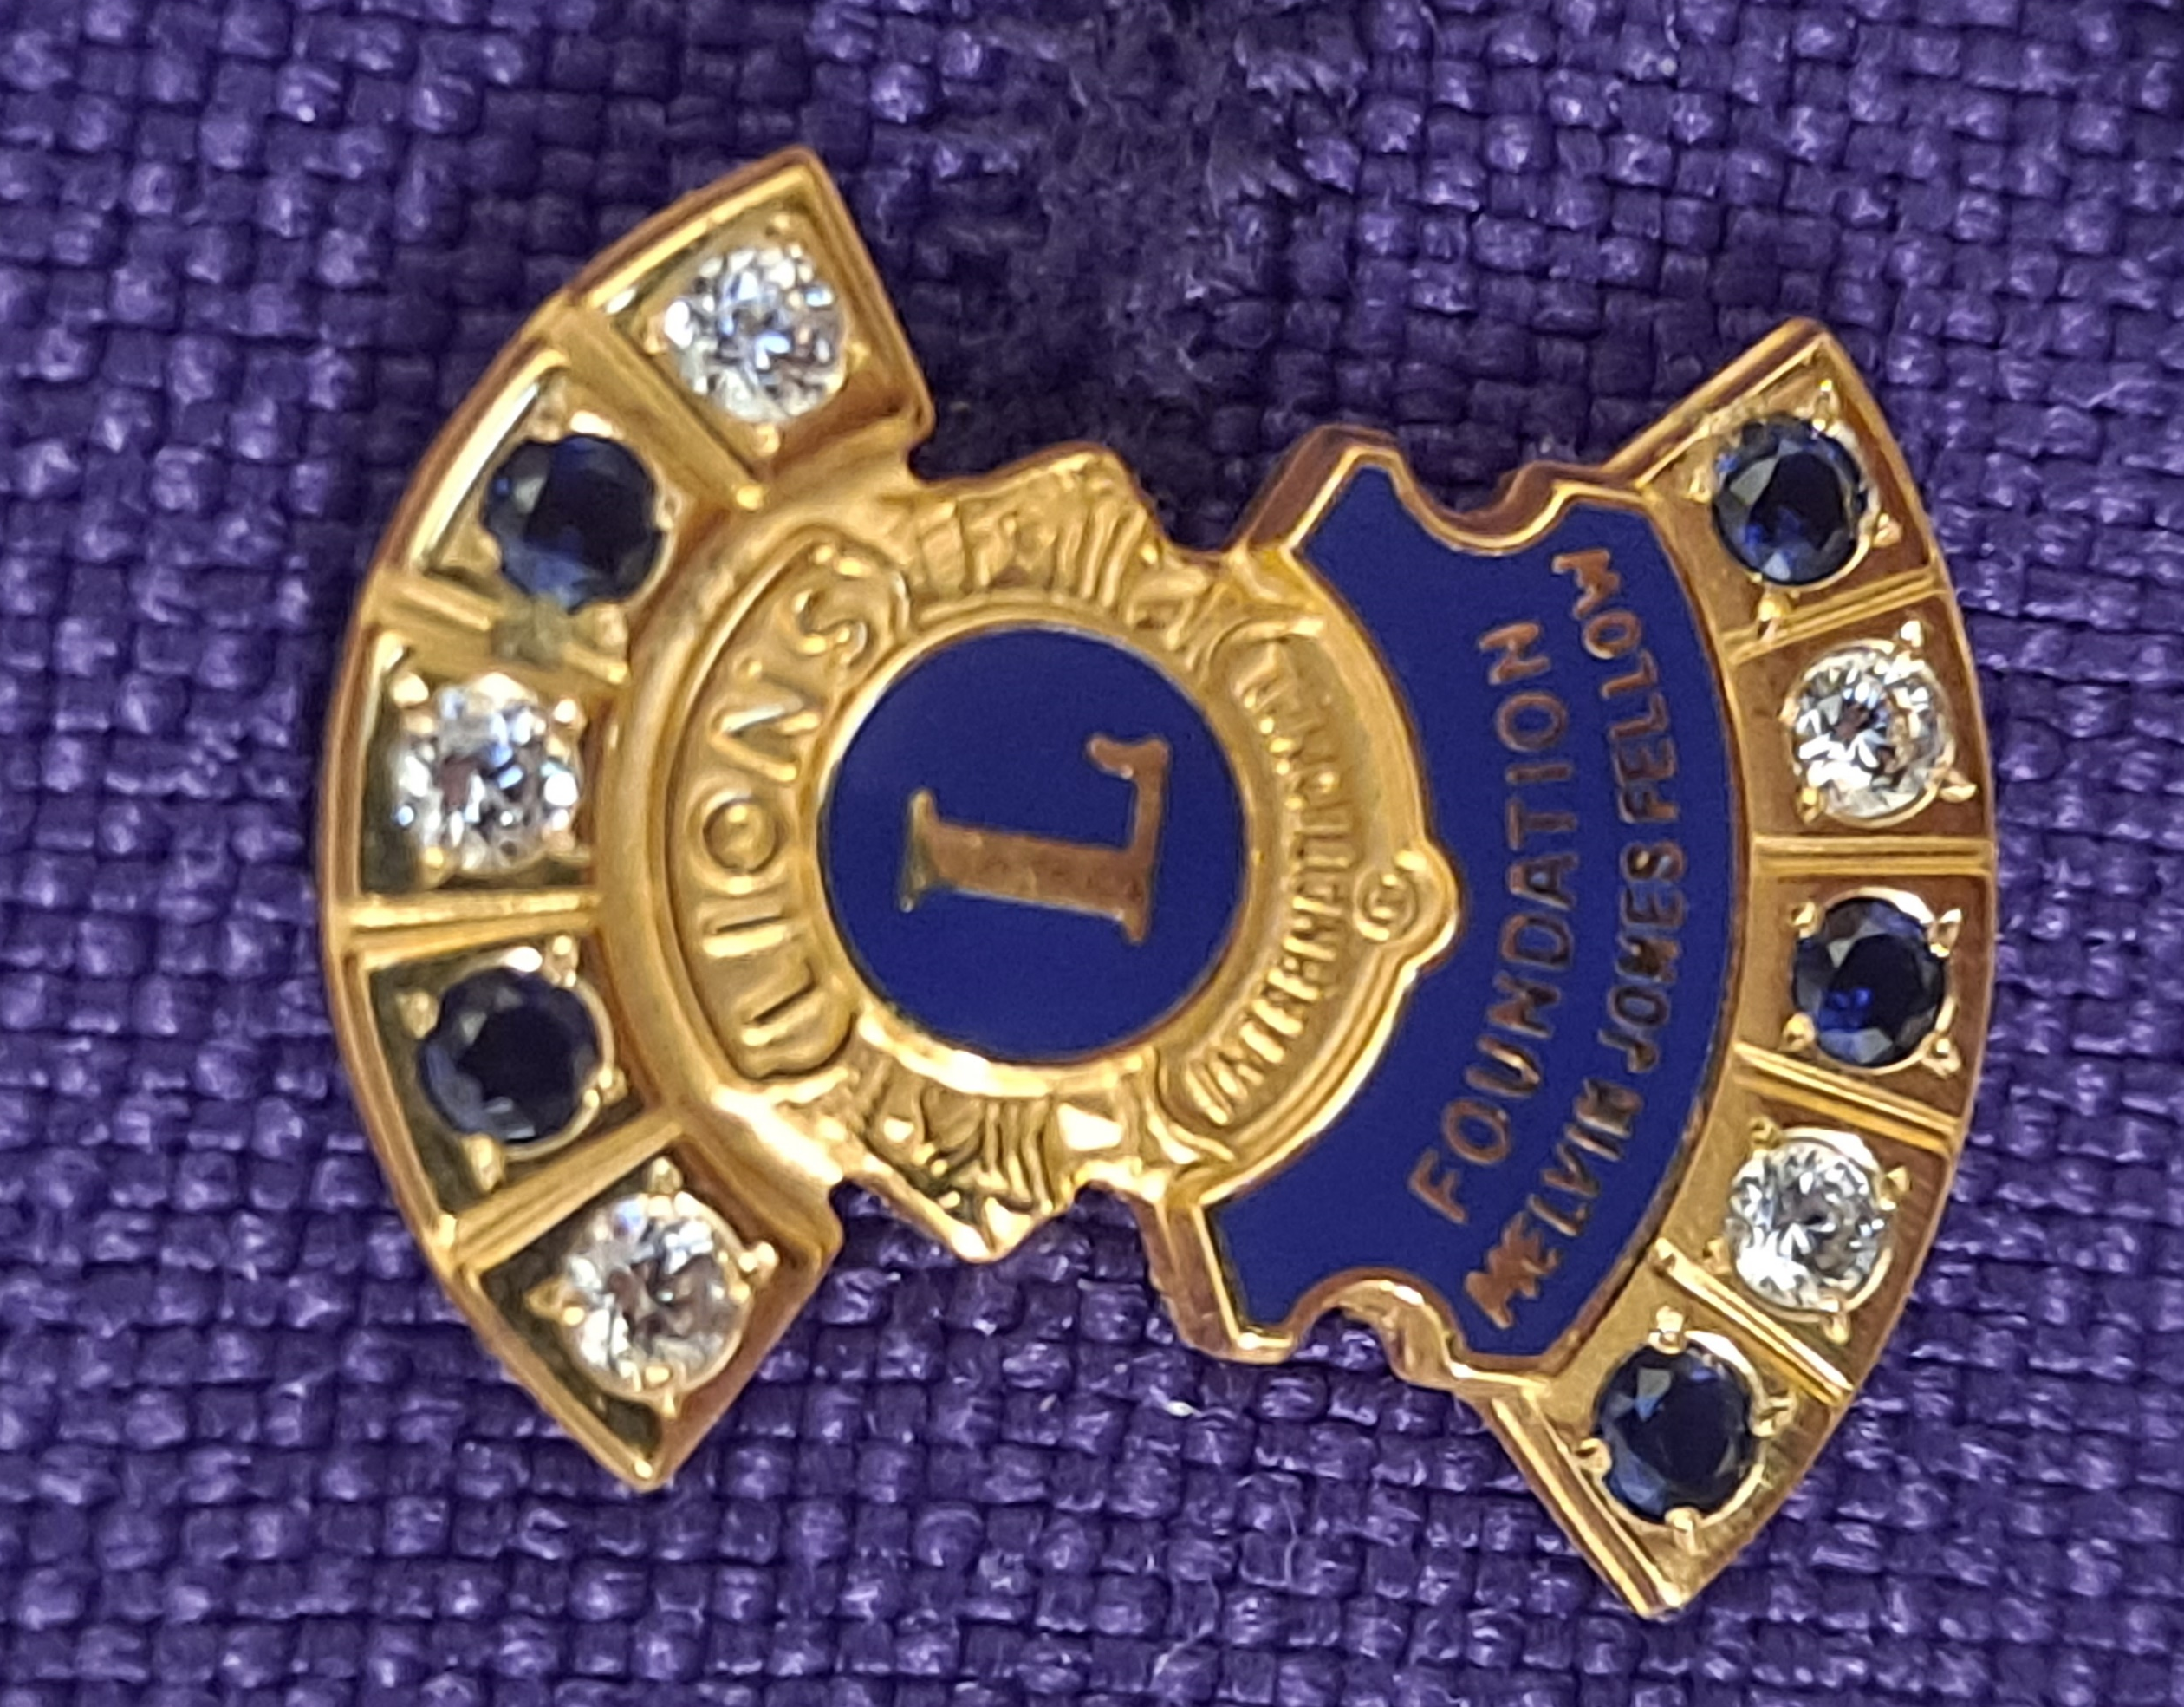
Lions Clubs International Foundation
$2 - 100% club donations and
Lion Member Contributions (counts toward a future MJF)
Club Donations (counts toward a future MJF)
Melvin Jones Fellowship
$1000 - MJF Award (Plaque and lapel Pin)
Progressive Melvin Jones awards
(each $1000 level adds a diamond or sapphire)

Slide 18

Julien C. Hyer Lions Youth Camp
Districts 2-X1 and 2-E2
The Julien C. Hyer International Youth Camp represents a group of students from countries around the world that participate in a six-week program to expose them to life in Texas through stays in Dallas/Fort Worth, Lake Texoma, San Antonio and Lubbock to promote peace and understanding.
The Julien C. Hyer Lions Youth Camp was organized in 1973 and the first camping session was held in 1974. Each year an average of 30 youths (boys and girls) has visited Texas to attend the Julien Hyer Camp. During this time, the program has changed slightly but the objective “to foster and create a spirit of understanding among the peoples of the world” remains the same. This Camp gives each attending youth the opportunity to learn about other peoples of the world while visiting Texas and the United States of America.
The Camp is named in honor of Past International President Lion Judge Julien C. Hyer (1931/1932) the Founder of the Lions Clubs International Youth Exchange Program.

Slide 19
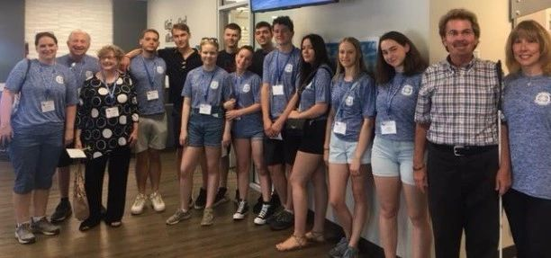
Julien C. Hyer Lions Youth Camp
Districts 2-X1 and 2-E2
$125 – Life Membership Award (Plaque)
$1000 – Jack Harris Fellowship (Plaque)
$1000 – Jimmy Thompson Fellowship (Plaque)

Slide 20


Leader Dogs for the Blind
Our mission is empowering people who are blind or visually impaired with lifelong skills for safe and independent daily travel.
Leader Dog's programs give people the tools, skills and confidence to travel independently. Our Orientation and Mobility (white cane skills) and Guide Dog programs are for people 16 or older whose daily travel is impacted by vision loss. Teen Summer Camp and Youth Orientation and Mobility are for teens 16 and 17. All our programs are free. If vision loss is holding you back, we can help.
Leader Dog is the answer for thousands of people in critical need of services to regain travel independence. Due to the shortage of state-supplied services, we developed our own Orientation and Mobility program to address the need for people to learn how to safely use a white cane. We believe every person deserves equal opportunity for independent travel, so all our services are provided at no cost.

Slide 21

World Services for the Blind
World Services for the Blind was founded by Roy Kumpe in 1947. With a $10,000 donation from the Little Rock Lions Club, Kumpe began building what would become the most comprehensive rehabilitation center for people who are blind or visually impaired.
The mission of World Services for the Blind is to empower people who are blind or visually impaired in the United States and around the world to achieve sustainable independence. We help individuals reach their goals through life skills and career training. Although each client's tuition and fees are covered by their states, WSB relies on financial contributions for almost everything else, from computers and other classroom technology to furnishings and appliances for dorms.
Since 1947, World Services for the Blind has served over 17,000 blind and visually impaired individuals across the United States and from 60 countries. WSB provides comprehensive life skills training, vocational training, and transitional-aged youth programs on-campus in Little Rock, AR and online through our online Learning Management System.

Slide 22

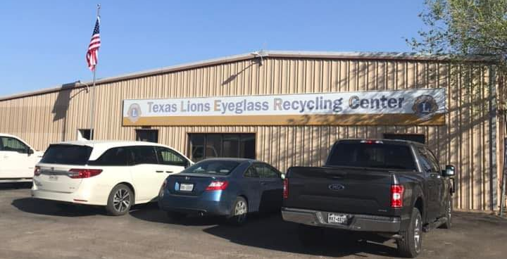
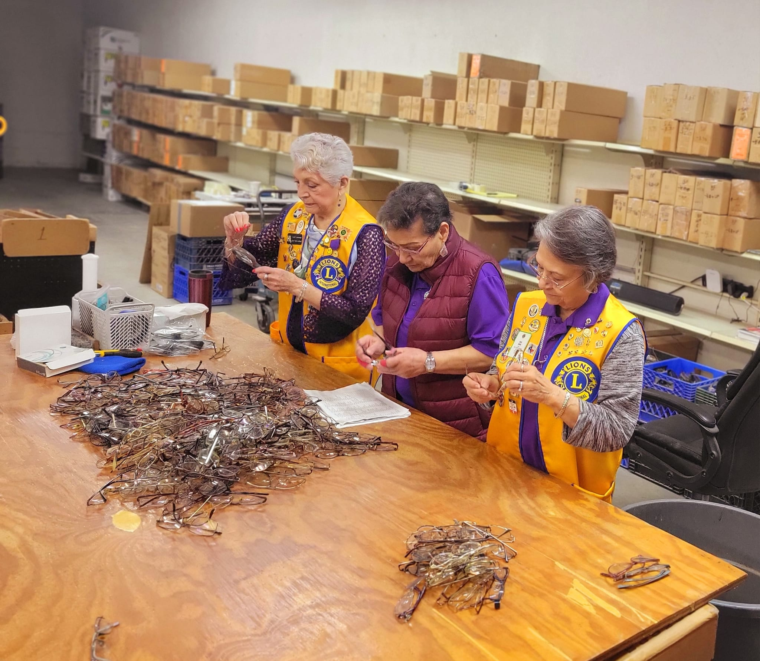

Texas Lions Eyeglass Recycling Center
The TLERC receives, processes and distributes used eyeglasses worldwide to persons without the means and facilities to provide eyecare.
The TLERC, working with Lions Clubs in Texas provides new eyeglasses to the needy children of Texas free of charge.
$250 – Doctor Norman S. Gould Bronze Vision Award (Plaque)
$500 – PID Marshall Cooper Silver Vision Award (Plaque)
$1000 – PDG O. Ike Fitzgerald Gold vision Award (Plaque)

Slide 23

Sports Extravaganza
Region 10 with Lion Districts 2-X1 and District 2-E2
For Blind and Visually Impaired
“Where Dreamers Become Achievers”
Sports Extravaganza serves to provide opportunities for students with visual impairments to participate in a variety of activities that encourage a more active lifestyle and lead to participation in lifelong leisure, recreation, and competitive sports.
Sports Extravaganza has something for everyone. This event gives athletes opportunities to compete with their peers on a level-playing field in a variety of events. Both competitive and non-competitive events are available for school-aged children 5-22 with vision impairments and complex needs. Families have time to network with other families and agencies with a vision focus throughout the day. As an added bonus, a free lunch is included!
$125 – Life Membership Award (Plaque)

Slide 24
District 2-X1 Charities Inc.
Also Supports
Lions Opportunities for Youth (LOFY)
    Diabetes Awareness Essay Contest
    Drug Awareness Speech Contest
    Outstanding Youth Contest
    LCI Peace Poster Contest
Sports Extravaganza
Local Disaster Relief
District SPOT & BLINQ Vision Screening Equipment
Other Special Need Requests
Funds supported by:
Duck Derby Race Fundraiser
Polar Plunge Fundraiser

Slide 25
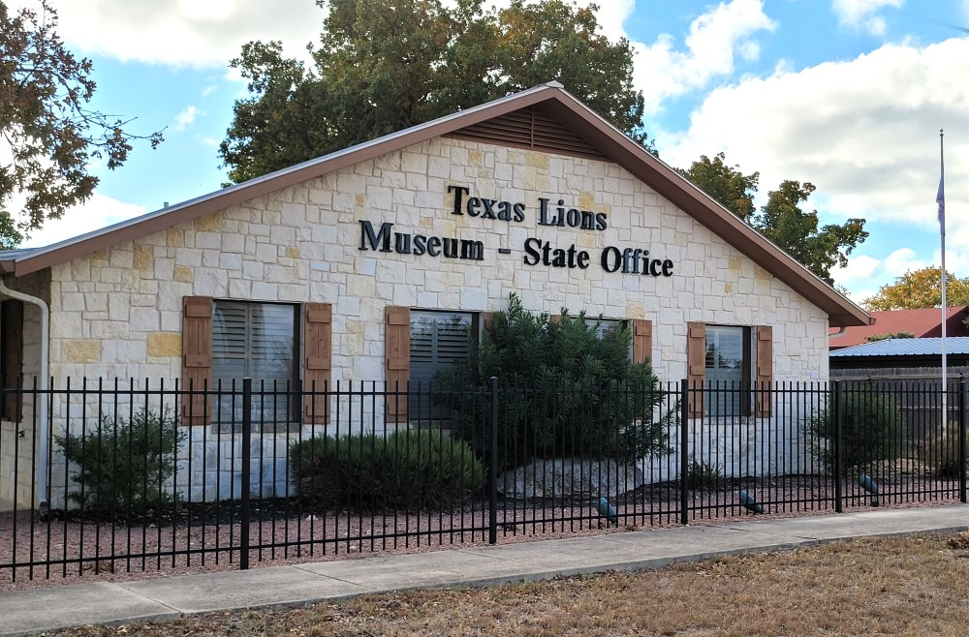
Texas Lions Museum & Office Foundation
$100 – TLM & SO Life Membership (Certificate & Lapel Pin)
$500 – Ebb Grindstaff Fellowship (Plaque and Lapel Pin)
$500 - Cheryl & Mike Butler Fellowship (Plaque and Lapel Pin)

Slide 26

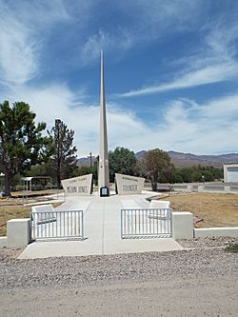
Melvin Jones Lions International Memorial Fellowships
Birthplace of Melvin Jones – Founder of Lions Clubs International
Fort Thomas, AZ
$100, $250, $500 and $1000 Donations are recognized on the Wall of Fame in the Memorial Building.

Slide 27
Other Lion Award Options
Lions Clubs International Website Store
Club Officer Medals
President’s Appreciation Medal
Lion of the Year Patch
Club Officer Patches
Past President Pin
President Pin (passed down to next President)
Lions Clubs International Website Store or a Local Awards Store
President Appreciation Plaque
Lion of the Year Plaque

Slide 28
Refresher
100% Club Contribution Amounts
* Per club member based on July 1st membership.
Texas Lions Camp $10 Required for 100%
Lions Sight & Tissue Foundation $2 Required for 100%
Texas Lions Foundation $2 To be a 100% club, also pick 5 more of the
Lions Clubs Int’l Foundation $2 7 remaining charities ($22 total/member)
Julien C. Hyer Youth Camp $2 or pick all 7 ($26 total/member).
Leader Dogs for the Blind $2
World Services for the Blind $2
Texas Lions Eyeglass Recycling Center $2
Sports Extravaganza $2
`` Total: $26 * 100% is Optional

Slide 29

District 2-X1 Supported Charities
It’s Great to be a Lion, because …

