Slide 1
District 2-X1 Goals 2024-2025
Where are We Headed?

Slide 2
District 2-X1 Goals 2024-2025
A SHORT OVERVIEW OF THE CURRENT LY 2023-2024
Membership: Opening 1805 Current: 1911
Memberships |  | Mission 1.5 Targets(LCI) | District Goal | Actual (Current)
New Clubs | Minimum | 2 | 3 | 4 | 06/01/2024
 | Expectations | 4 | 4 | 4
New Members | Minimum | 351 | 290 | 403
 | Expectations
Dropped Members: | Minimum |  | -
 | Expectations | 200 | 280 | 246
Net members: | Minimum | 36 | 50 | 157
 | Expectations |  | 162

Slide 3
District 2-X1 Goals 2024-2025
A SHORT OVERVIEW OF THE CURRENT LY 2023-2024
2. SERVICE GOALS
Service:
Official Goal: Serve 190K People
Expectations: Serve 325K People Actual: 500K Hours: 88K
Clubs’ Service Reporting:
Official Goal: 72 % Clubs report services Actual: 79% ( Including Leo Clubs)
Expectations: 90 % Clubs report services
Total Clubs Including Leos 82 ( 65+17) Actual : 58 Clubs & 7 Leo Clubs

Slide 4
District 2-X1 Goals 2024-2025
A SHORT OVERVIEW OF THE CURRENT LY 2023-2024
SERVICE ACTIVITIES MATRICES

Slide 5
District 2-X1 Goals 2024-2025
A SHORT OVERVIEW OF THE CURRENT LY 2023-2024
3. Leadership Goals : Trainings
Leadership: Official Goal:
A . Train at least 65% of Club Officers Actual: Completed then Expected
B. Train 100% of Zone Chairs Actual : 100%
4. LCIF Contribution:
Official Goal: - Total Contribution Target 48K Actual $61K
a. At least 37 Clubs donate to the LCIF (Expectation all Clubs) - Actual 42
b. At least 36 Individual Lions donate to the LCIF – Members Actual 78
(Expectation 300 Individual Lions donate)

Slide 6
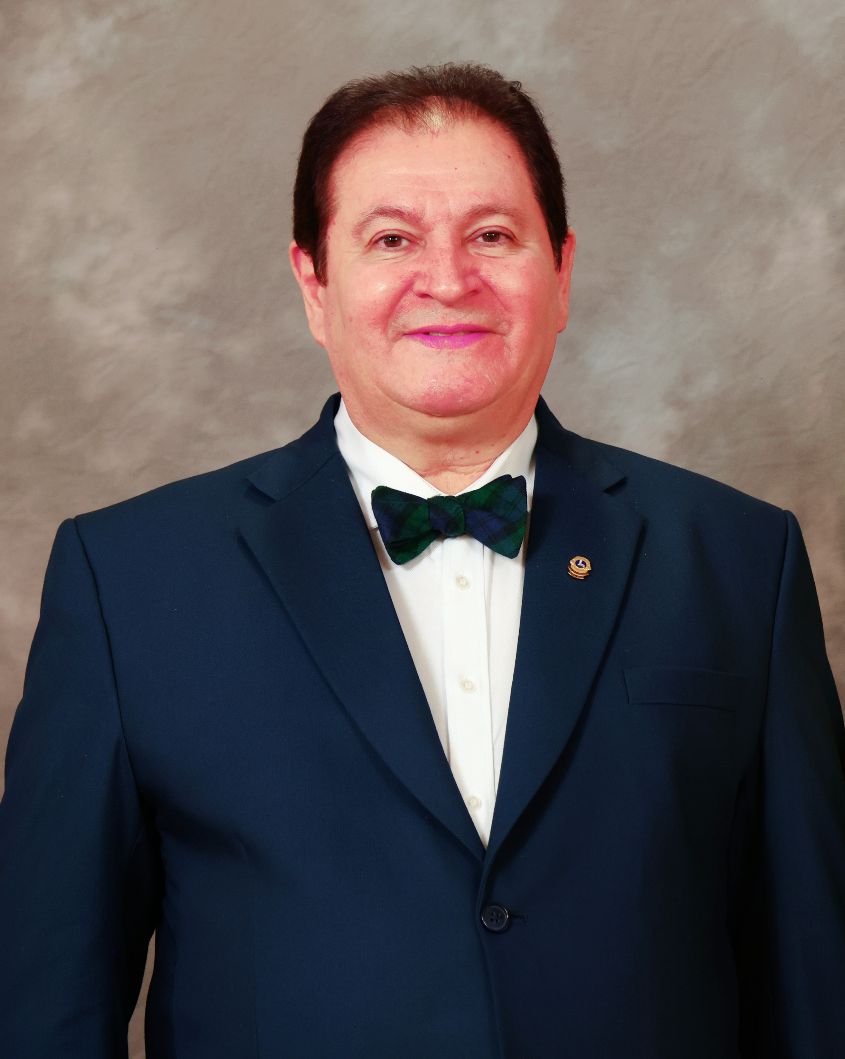
District 2-X1 Goals 2024-2025
LCI Incoming President Fabrício Oliveira
Priorities
Priority One: Grow to Give more
As the need for service grows, we need to grow too,
- To meet our Mission 1.5 goals, we need to invite new members and charter new clubs
- More Lions mean more service and more impact
- We are working towards serving one billion people per year
Priority Two: Be Strong Together
Working hand in hand with LCIF
- We have a global foundation to support our service.
- Together we create a bigger impact and lasting outcomes.
- Let’s Support LCIF so we are ready to serve when and where we are needed

Slide 7
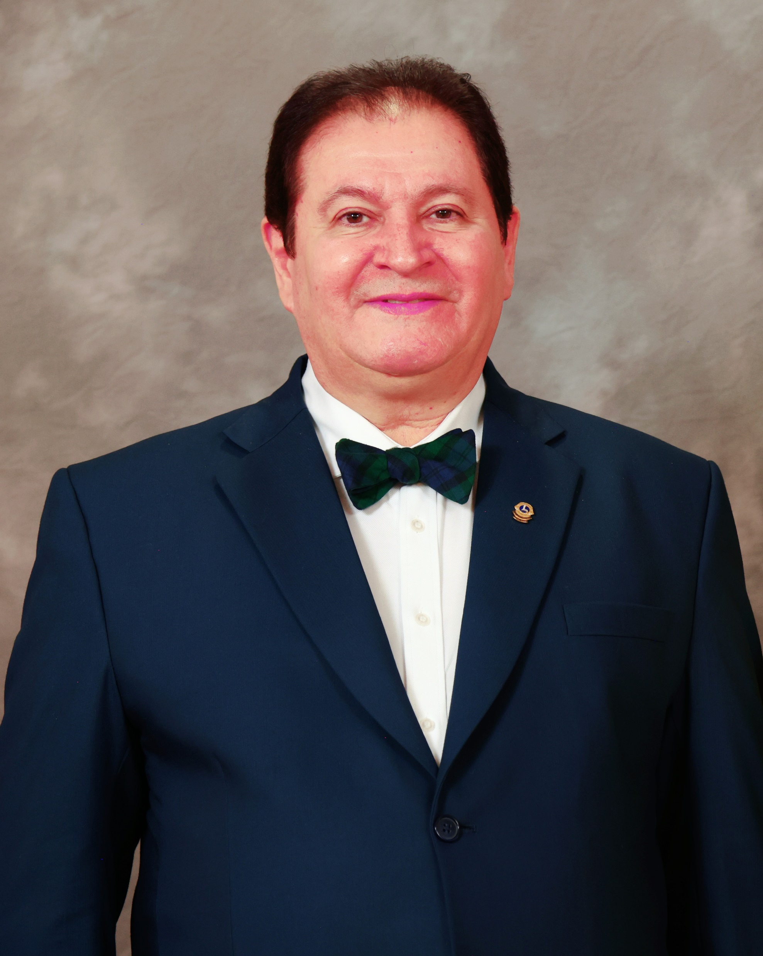
District 2-X1 Goals 2024-2025
LCI Incoming President Fabrício Oliveira
Priorities
Priority Three
Embrace your Leadership potential
- Leaders grow our clubs and service.
- Look for Leadership opportunities at all levels of Lions.
- Find new ways to lead our service forward in our communities.
Priority Four
Capture your community’s imagination, promote our service, stories, success
- Promoting our service inspires others to join us
- Use Marketing and public relations to tell our story
- Tell others about the work we do and invite them to join us

Slide 8
District 2-X1 Goals 2024-2025
LCI President Fabrício Oliveira
Priorities
Stay proactive
Don’t wait to act. Let’s be responsive to the needs of our communities.
Rally others around your service vision. Then take action to bring it to life.
Focus on positive outcomes
- The mark of great service

Slide 9
District 2-X1 Goals 2024-2025
DISTRICT 2-X1 2024-25
SWOT ANALYSIS: GLOBAL MEMBERSHIP APPROACH SWOT ANALYSIS
Strengths (Internal) | Strengths (Internal)
Good District Leadership Districtwide Service Projects District Supports LCIF & use of LCIF Grants Good Training Program (Rebuilding) Successful hybrid training Good Communications Good social media (Facebook, Web, etc.) An Effective Zone Structure (Regions/Zones) | 9. Good Zone Chairs (most zones) 10. Several Colleges/Universities (young Lions) 11. District has various Service Coordinators 12. Clubs & partnership service opportunity 13. Recognition of Lion Services 14. Clubs are reporting – 85% of the clubs reported service activities 15. MMR and Service Reporting – improving 16. District has a Specialty Club Coordinator

Slide 10
District 2-X1 Goals 2024-2025
GLOBAL MEMBERSHIP APPROACH SWOT ANALYSIS
Weaknesses (Internal) Poor Club Leadership Succession (Repeating Club Presidents And Officers) Difficult To Retain Members Graying Membership (Aging)/ Failed To Recruit New Members Lack Of Sufficient Guiding Lions Zone Chairs (Additional Responsibilities Needed) Lack Of Zone/Multiple Zone Level Service Projects Lack Of Club New Member Orientations Club Responsibilities Not Fulfilled Properly (Reporting, Communication To District And Club Members) Web Site Needs Increased Usage Unfilled Club GMT, GST, Memership, Positions Clubs Are Not Using 1st VP As GLT And Promoting Training

Slide 11
District 2-X1 Goals 2024-2025
A BRIEF SWOT ANALYSIS: OVERVIEW
- GLOBAL MEMBERSHIP APPROACH SWOT ANALYSIS
Opportunities (External)
Large/Increasing District Population Base
Diverse Population (Ethnicities)
Numerous College/University Students
Vibrant/Large Corporations Moving To Area
Many Volunteering And Service Organizations
Opportunities To Make Contacts With Businesses
Technology Availability
Opportunities For Specialty Club, Family, Traditional, Branch Clubs, Cyber Clubs, And Leo Clubs
Use Of District Teams/Pdgs To Help Smaller Clubs
Social Media Utilization

Slide 12
District 2-X1 Goals 2024-2025
A BRIEF SWOT ANALYSIS: OVERVIEW
- GLOBAL MEMBERSHIP APPROACH SWOT ANALYSIS
Threats (External)
Politics, Religion, And Personal Conflicts
Competition From Other Service Organizations
Lack Of Volunteers In The Club Level.
Member Resistance To Change And Technology
Affordability To Pay Dues
College Students Have Limited Time/ Finances
Marketing The Lions Brand
Cyber Security Threats

Slide 13
District 2-X1 Goals 2024-2025
CLUBS MEMBERSHIP STATUS:
Those who charter new clubs and increase the number of new members beyond these expectations would achieve an extraordinary accomplishment/recognitions.
Member Status/Club | Current Total | Mimumum Expectation- Net New Members
50 plus members | 9 Clubs | 9X7=63 - Opportunity to charter new clubs
More than 20 -49 members | 31 Clubs | 31X3=93 (Net plus/ Try to Charter a new branch club/club)
Between 15 - 19 members | 13 Clubs | 13X4= 52 ( Try to grow at laest 20 members club)
Between 10 - 14 members | 2 Clubs | 2X4=08 ( Grow to be 20 members Club)
Less than 10 members | 10 Clubs | 10X5 = 50 (Become at least 15 this year)
Total | 65 | 266 + New Chartering Clubs

Slide 14
District 2-X1 Goals 2024-2025
2024-2025 District Goal and Action Plan
GOALS: https://www.youtube.com/watch?v=UTneXvcxvTU
MISSION 1.5 is our latest membership growth initiative, but setting and achieving district growth targets has always been an important part of how we serve as Lions.
Our district teams develop goals and action plans by planning for a successful year ahead.
Driven by the action plans created, Lions in your communities will increase our service impact on a local and global level.
Our commitment in strengthening our District by developing strategic action plans in support of the following association goals

Slide 15
District 2-X1 Goals 2024-2025 Action Plan Membership 2024-2025.docx
A SHORT OVERVIEW OF THE CURRENT LY 2024-2025
Membership: Opening tentative: 1900 End of the year: Expected 2080
Memberships |  | Mission 1.5 Targets(LCI) | District Goal | Actual (Current)
New Clubs | Minimum | 2 | 3
 | Expectations |  | 5
New Members | Minimum | 351 | 350
 | Expectations |  | 450
Dropped Members: (Focus Retention) | Minimum |  | -
 | Expectations | 293 | 270 | 246
Net members: | Minimum | 58 | 80 | 157
 | Expectations |  | 180

Slide 16
District 2-X1 Goals 2024-2025
CLUB LEVEL TARGET: MEMBERSHIP
Each Club’s increase net member should be at least 2 members per 10 existing members, i.e. 20 % of the total existing members (1900*20%)=380
Retention should be targeted to dropped rate decrease by 20% in each club (300*20%) =60, not more than 240 drop
Net growth of membership should be at least 380-240= 140
New Club Chartering at least 3, 20*3=60 members
Total targeted net new members 140+60= 200 end of the year
Retention Clue: If you drop 1 member, add at least 2 members, stay positive

Slide 17
District 2-X1 Goals 2024-2025 Action Plan Service Activities 2024-2025.docx
2. SERVICE GOALS 2024-2025
By the end of the 2024-2025 fiscal year, District 2-X1 will serve minimum of 200,000 persons and will maintain the clubs reporting service at 80%, which is 52 clubs out of 65 clubs.
Service:
Official Goal: Serve 200K People
Expectations: Serve 350K People Hours: 90K
Clubs’ Service Reporting:
Official Goal: 80 % Clubs report services
Expectations: 90 % Clubs report services Actual:
Action Plan Service Activities 2024-2025.docx

Slide 18
District 2-X1 Goals 2024-2025
SERVICE GOALS /Action Plans including Club level……..
District/Zone levels:
Each cabinet meeting and convention has at least one service project involving Leos and Lions or families
District Level Fellowship and service projects working with district charities and LCIF projects (Build a bed, Food Drive, Health Services, DAWN projects, Environment/Community Clean up, Cyber security, Cancer Awareness, Funs raising activities, Picnic and others)
Women and Youth program, Senior Citizen entertainment and fellowship, Lions Quest, Leader Dog and white Can, Sport Extravaganzas, Blood Drive etc
Plan and preparedness to serve disaster and humanity and provide the proper trainings
Club Level:
Plan to add one new service project preferably LCI service areas as per community needs- Vision, Hunger, Diabetes, Environment, and Pediatric cancer
Plan to participate the district level service projects, utilize the district charity services, Texas Lions Camp, Youth competitions,
Notes:
- GST/SERVICE CHAIRS IN THE DISTRICT/CHARITES/CLUB OFFICERS & SERVICE CHAIRS

Slide 19
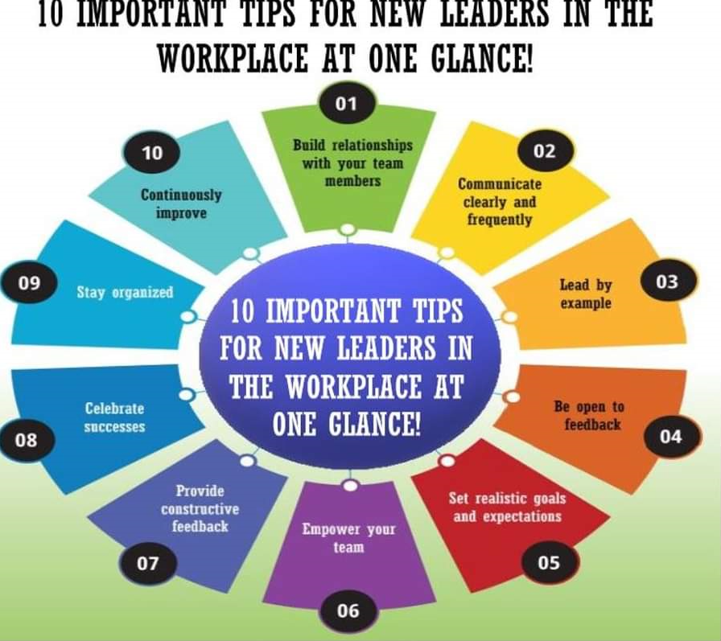
District 2-X1 Goals 2024-2025
3. Leadership Goals : Trainings Action Plan Leadership Devel 2024-2025.docx
Leadership: Official Goal:
A . Train at least 65% of Club Officers Expected : 80%
B. Train 100% of Zone Chairs Expected: 100%
4.
GLT/MENTORS/PDGs/RC, ZCS, GUIDING LIONS
SERVICE CHAIRS, CLUB OFFICERS, OTHER SPECIALISTS
TRAINING OPPORTUNITIES & MATERIALS

Slide 20
District 2-X1 Goals 2024-2025
Leadership Goals : Trainings…………….
By the end of the first quarter of the 2024-2025 fiscal year, District 2-X1 will conduct training sessions for club officers and zone chairpersons. The district GLT coordinator will report each training session using the "manage training" feature in Learn.
The district GLT coordinator will report each training session in Learn.
Our team will ensure that 100% of zone chairpersons attend zone chairperson training.
Our district will confirm that at least 65 percent of club officers (president, secretary, and treasurer) attend club officer training.
The GLT Coordinator form a trainer’s team as required and provide training to new members, club officers, Regional/Zone Chairs, Guiding Lions, and other cabinet and services chairs as necessary.

Slide 21
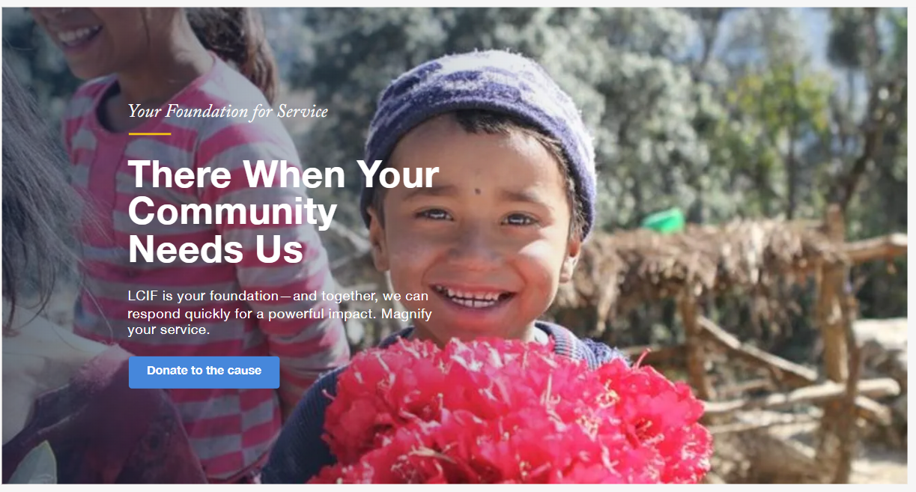
District 2-X1 Goals 2024-2025 Action Plan LCIF Support 2024-2025.docx
4. LCIF Contribution Goals:
Official Goal:
A. At least 40 Clubs donate to the LCIF (Expectation all Clubs)
B. At least 80 Individual Lions donate to the LCIF
(Expectation 250 Individual Lions donate)
C. Fundraising goal for the year will be
to increase the LCIF assigned goal by 10%, i.e. ($52300 in total)
Our team will improve club participation from 60% to 62% for a total of 40 out of 65 clubs donating to LCIF.
Our team will strive to achieve at least 1 club in our district having 100%-member participation.
We will encourage all district cabinet members to make a personal donation of any amount to LCIF.
Our team will organize District level fund raising events and raise funds for at least one MJF award.

Slide 22
District 2-X1 Goals 2024-2025
5. Custom Goals:
By the end of the 2024-2025 fiscal year, district 2-X1 will achieve the following:
Encourage clubs to meet the criteria for Club Excellence Awards at least 5 more clubs
Reduce the number of district clubs with fewer than 10 members by one.
Action Plan Custom Goal 1 2024-2025.docx
https://www.lionsclubs.org/en/resources-for-members/resource-center/club-excellence-awards

Slide 23
District 2-X1 Goals 2024-2025
Celebration of Success
Finally, we want to celebrate and share the success.
Don’t it?
THANK YOU !!

