Slide 1

Lions Club International Foundation
2023-2024
WELCOME
PCT Tom Garriss
District 2-X1 LCIF Coordinator
PDG Bill Smothermon
Area F Vice LCIF Coordinator

Slide 2
TRAINING OBJECTIVES
Learning about Lions Clubs International Foundation
Leading you club to success: Role of the club LCIF Coordinator

Slide 3
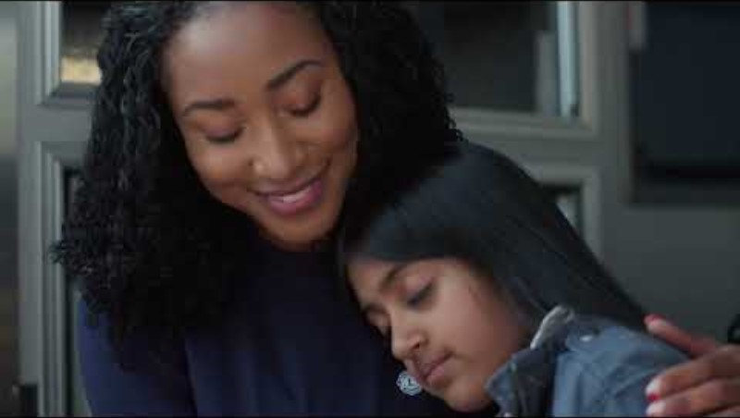

Slide 4


THE FOUNDATION
OF SERVICE
Empowering Lions’ Service
Notes:
LCIF was founded in 1968 to tackle global problems and assist Lions with both large- and small-scale projects that are beyond the capacity of a single club or district. LCIF supports those in need through grants that impact lives globally and encourage peace and international understanding.

Slide 5
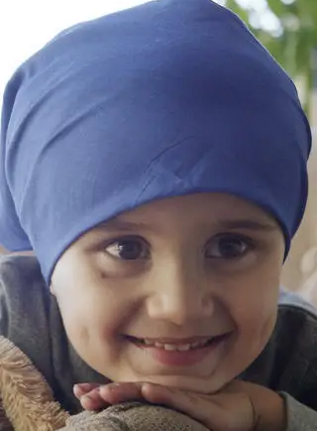

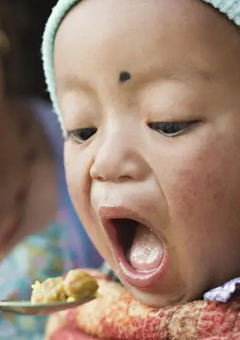

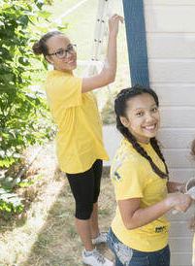

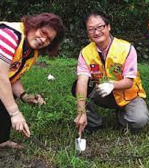

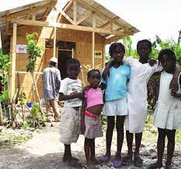
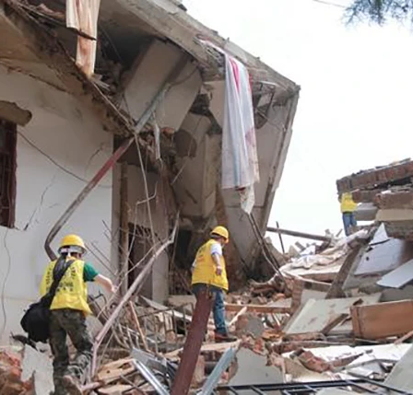
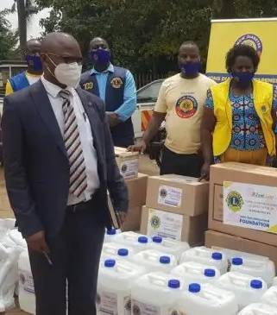
GRANT PROGRAMS
Global Cause Grants
Youth Grants
Childhood Cancer
Diabetes
Hunger
SightFirst
Leo Service
Lions Quest
Humanitarian Grants
Disaster Grants
Community Impact (DCG)
Matching
Community Recovery
Disaster Preparedness
Emergency
Notes:
LCIF has 8 Global cause areas. The 4 grant programs are set up to mirror these eight areas.
Global Cause Grants: Childhood Cancer, Diabetes, Hunger, and Sight First
Youth Grants: Leos Service and Lions Quest
Humanitarian Grants: Community Impact(DCG) and Matching
Disaster Grants: Community Recovery, Disaster Preparedness, and Emergencu

Slide 6
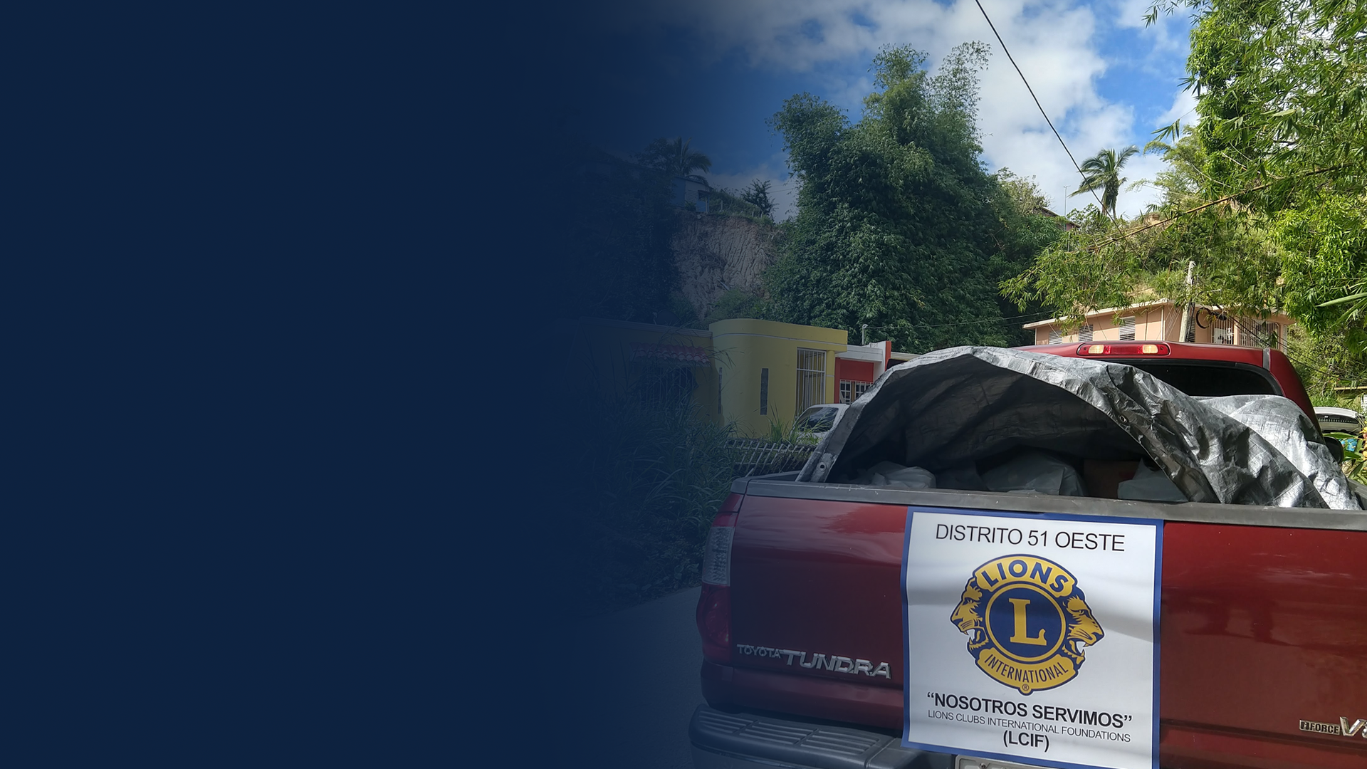
100%
of all donations
support those
in need

Slide 7

Multiple District MD-2 Grant Awards
  LCIF has awarded MD-2 more than $6.6 Million in grants
  LCIF Grant Awards to MD-2 last year: $690,000
  Categories of Grants Received
  10 Community Impact Grants $ 21,187
  3 Disaster Relief Grants $ 130,000
  5 Matching Grants $ 253,362
  1 Diabetes Grant $ 110,021
  2 Hunger Grants $ 175,000
7
Notes:
SOME OF THE MAJOR GRANTS INCLUDE:
PLAYGROUND IN GONZALES COUNTY - $100,000
SHUTTLE FOR PEDIATRIC CANCER PATIENT TRANSPORT - $56,500
SUPPORT DIABETES PREVENTION IN SAN ANTONIO - $110,021
EQUIP FOOD BANK MOBILE PANTRY -$100,000

Slide 8
Examples of District 2-X1 Grant Awards
  Lions District 2-X1 Grants Received
  Mobile Food Pantry $100,000
  Mobile Food Truck – Mabank/Cedar Creek $ 75,000
  Waxahachie Bed Building Projects $ 21,825
  Lions Quest Program $ 15,000
  Spot Equipment $ 50,000
  Vison Bus $ 75,000
  Others (4 grants) $ 19,250
  Last year District 2-X1 donated $65,000 to LCIF
  Received new grants of $102,810!
8
Notes:
District 2-X1 has received $302,000 in grants and has $300,000 in progress.
We collected about $200,000 during Campaign 100. We get way more than we give – it’s a good return on our investment.

Slide 9

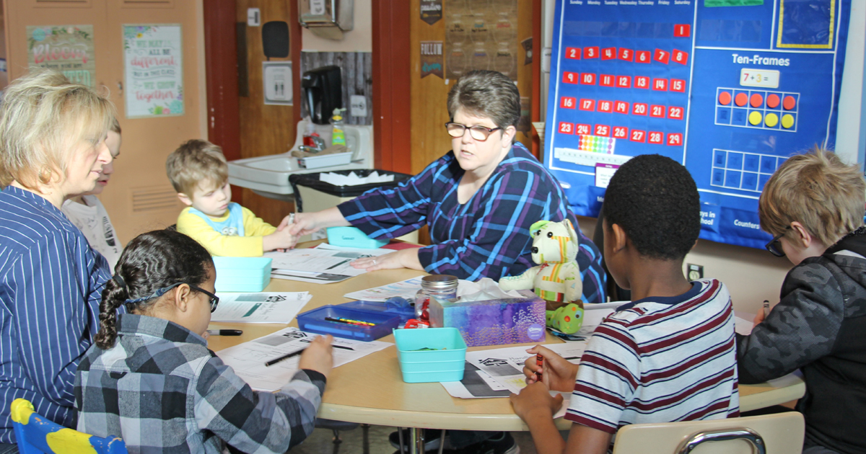
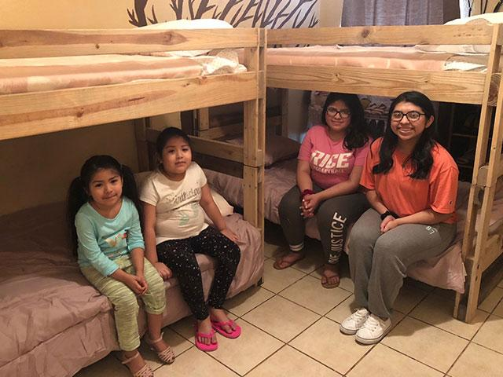
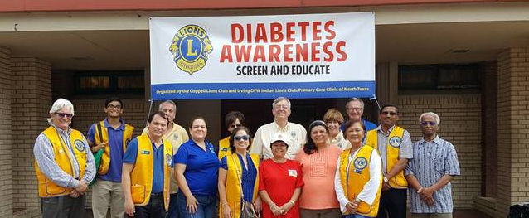
Local Grants
Lions Quest educational program
District 2-X1 Build a Bed Program
Diabetes Awareness Progam
Notes:
Lions Quest Program – in conjunction with Vox Invictus Mentoring, we have started the program in Balch Springs ISD. The program serves 75-100 students
Build a Bed: We are partnering with Sleep in Heavenly Peace to build 350 beds with 175 of them going to Texas Lions Camp.

Slide 10

District & Club Community Impact Grants
(DCG) Program Overview
  15% of unrestricted contributions to LCIF is available for DCG grants
  Donations must be made to Empowering Service Fund, Area of Greatest Need, or General Donation only
  Restricted or designated donations are NOT eligible
10
Notes:
Note: Restricted/designated donations are NOT eligible. Designated gifts include those to Disaster Relief and do not qualify for DCG credits. Unrestricted gifts are eligible, which include gifts to the Empowering Service Fund, or Area of Greatest Need. A minimum club donation is eligible for $750, District $1,500

Slide 11

District & Club Community Impact Grants
  CLUBS
  Must donate a minimum of $5,000 to LCIF in a single fiscal year to qualify.
  DISTRICTS
Must donate a minimum of $10,000 to LCIF in a single fiscal year*. (Includes clubs that did not contribute $5000)
2-X1 has only 3 clubs meeting $5,000 minimum. The rest fall into the district DCG pool
*Fiscal year is July 1 – June 30
Notes:
DISTRICT 2-X1 HAS ONLY ?? CLUBS THAT REACH THE $5,000 MINIMUM
THE REST OF US FALL INTO THE DISTRICT DCG POOL

Slide 12

OTHER DCG FACTS
Only grants a club can apply for
Must support humanitarian service projects
Can be be used as local matching funds for LCIF grant
Have up to 15 year to use funds
Can be used for multiple projects
Notes:
Funding can be accrued, but you must meet the minimum donation threshold each year for accrual. This can be a good option for larger projects

Slide 13

DISASTER GRANTS
  Emergency Grants: up to $10,000 for victims of natural disaster
  Community Recovery Grants: Up to $20,000 for short-term clean-up and repair after immediate needs are met
  Disaster Preparedness Grants: Up to $10,000 to prepare for future relief efforts
  Major Catastrophe Grants - minimum of $50,000 at the discretion of LCI President and LCIF Chairperson
13

Slide 14
APPLICANT RESOURCES & INFORMATION
Grants Toolkit:
lionsclubs.org/grantstoolkit
Grant deadlines:
October || February || May
Email Global Grants:
USAGlobalGrants@lionsclubs.org

Slide 15
PROVIDE RECOGNITION
Lions share program
Melvin Jones/ Progressive Melvin Jones
Club recognition

Slide 16
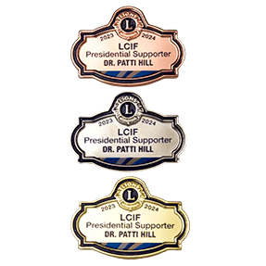
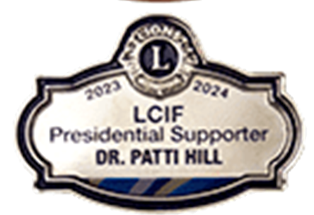
PRESIDENTIAL LCIF SUPPORTER
For individual donations of $50 or more
  Bronze: $50 - $99.99
  Silver: $100 - $199.99
  Gold: $200 and above
Donations also receive Melvin Jones credit
Award of all three requires a donation of $350.
Notes:
Award of all three requires a donation of $350.00

Slide 17
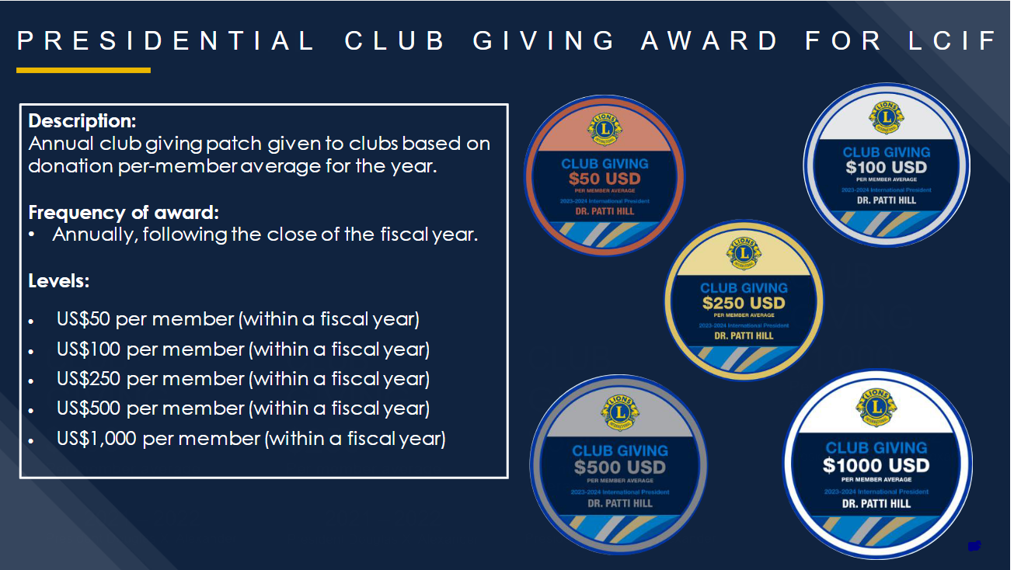

Slide 18

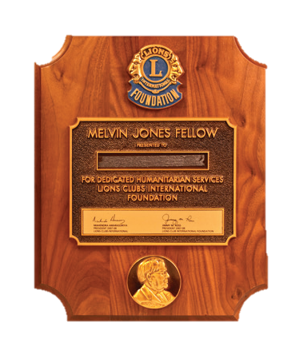



Melvin Jones Fellowship // Progressive MJ Fellowship
$1000 for initial MJF - plaque
Pins are given for each additional $1,000
49 different pins
Option for automatic recurring contributions
Award levels up to $1 million
LCIF gives over 13K MJF’s/year
2-X1 has 655 MJF and 59 Progressives
Notes:
Melvin Jones application is available online only.
Club Recognition is similar to individual recognition

Slide 19

PLANNED GIVING
Planned charitable Gifts from current financial plan/retirement/estate
  Tax benefits
  Estate tax reductions
  Reducing capital gains
  Creation of a current income stream
  .
8
Notes:
Practice of planning charitable gift in context of one’s current financial plan, retirement plan, estate plan
Gifts such as: living trust, wills, retirement accounts, stocks, bonds, charitable gift annuities, charitable lead trust, and others, which my colleague Bob will cover in greater detail next.
Planned gifts often have additional benefits such as current income tax deductions, estate tax reductions, capital gains avoidance and even the creation of a stream of current income for donors and/or their loved ones.

Slide 20
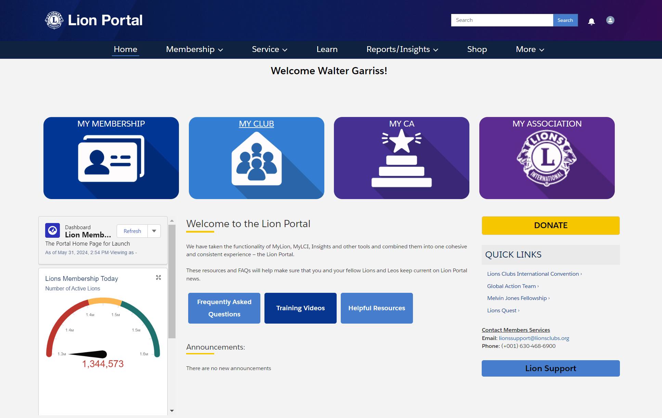
MAKE A GIFT ONLINE AT LIONSCLUBS.ORG
https://www.lionsclubs.org/en
Click on the "Donate" Button
Automatically earn MJF/PMJF Credit
Several options including setting up Recurring Gifts
Would you consider donating $10 per month?
Notes:
Don’t forget to request Lions Share recognition.

Slide 21

MAKE A DONATION BY CHECK
Make checks Payable to:
LCIF
and Mail to:
PCT Tom Garriss
5208 Cornerstone Drive
McKinney, TX 75070

Slide 22
LEADING YOUR CLUB TO SUCCESS
Notes:
As club LCIF coordinator, you will work together with your district coordinator to connect your club to the many ways LCIF helps lions
The club LCIF coordinator is the immediate past president unless a separate coordinator is appointed.

Slide 23
LCIF COORDINATORS ROLE
Educate
Connect & Communicate
Set a Goal
Raise Funds
Notes:
Your role consists of four primary tasks

Slide 24
EDUCATE
What does the foundation do?
Why is the foundation important?
Why should Lions support LCIF?
Why should my club become involved?
Does LCIF support local clubs through grants?
(Invite your District Coordinator to give a club presentation)
Notes:
LCIF is the fundraising and grant-making arm of our global organization
LCIF granted more than $1.2 Billion to lions service projects around the world
LCIF extends and magnifies that impact on a local and global scale. Clubs and Districts can take on larger projects
Be involved so your club can help change the world
Grants: 18,000 grants totaling more than $1.2 Billion

Slide 25
CONNECT AND COMMUNICATE
Connect to a cause
Vision Diabetes
Youth Childhood Cancer
Hunger Disaster Relief
Environment Humanitarian Efforts
Communicate the Outcomes
Notes:
Your club can’t do it all. Select the cause or causes that interest you and focus on them
As an example, My club – Plano Early’s focus is on Vision. We do touch on some of the others, but the majority of our resources are on Vision
Communicate the outcomes not only to your members but to the community through social media etc.

Slide 26

SET GOALS
What projects can we do?
How many individual Lions will support LCIF financially
Develop a fundraising strategy
Notes:
Individual participation is the key to success – strive for 100% participation
Designate a portion of the net proceeds from a fundraising activity to LCIF.
Look for projects. As examples Waxahachie did the build a bed project. Maybank-Cedar Creek is doing a hunger project.

Slide 27
DISTRICT 2-X1 GOALS
Increase member participation (donations) from
30 to 60 members (Year to date: 109)
Improve club participation for 55% to 60%
One club with 100 % member participation
Organize at least one District level fundraiser
Increase LCIF assigned fundraising goal by 10%
Notes:
INDIVIDUAL PARTICIPATION – 109 YTD
CLUB PARTICIPATION – 42/65 OR 65% YTD
DISTRICT LEVEL FUNDRAISER – MJF/PMJF BOARDS RAISED $3,000
FUNDRAISING – 123% OF GOAL YTD

Slide 28
RAISE FUNDS
Invite individual members to donate
  Make your donation first
  Make it easy: lionsclubs.org/donate
Plan Fundraising events
Make a gift from the Club Treasury
Invite support from local businesses and non-Lions
Notes:
At the District Level we’re going to emphasize that all lions in the cabinet should be a contributor to LCIF. A little bit can go a long way
$2 per lion per meeting (about what you kick into the tail twister fund) would generate around $75,000 in contributions for the district.
LCIF goal for our district is based on about $27 per member so next year it’ll be around $54,000 based on a membership of 2000

Slide 29
PROVIDE RECOGNITION
Lions share program
Melvin Jones/ Progressive Melvin Jones
Club recognition

Slide 30
RESOURCES
LCIF Marketing Portal – lcifdevelopment@lionsclubs.org
District 2-X1 – Lion Manuel Palavicini
palavicini@sbcglobal.net 817-504-5066
LCIF Area Coordinator – PDG Bill Smothermon
lionbillsmo@gmail.com 972-571-0806
Regional (US) Specialist – Kristi Garcia
Kristi.Garcia@lionsclubs.org 630-468-6885

Slide 31
QUESTIONS?
DISCUSSION?

