Slide 1


Club Treasurer Training
CLUB TREASURER TRAINING

Slide 2




Welcome
Congratulations
You have been elected to the position of
Club Treasurer

Slide 3
Responsibilities of the Club Treasurer
As the club financial officer and member of the board of directors, your primary responsibilities include…
  Attending all club and board meetings
  Preparing club budgets
  Setting annual members’ dues
  Receive and deposit monies into approved bank
  Making payments on behalf of the club

Slide 4
Responsibilities of the Club Treasurer
Also
As the club financial officer and member of the board of directors, your primary responsibilities include…
  Keep and maintain records of club receipts and disbursements
  File club taxes
  Prepare and submit regular financial reports
  Deliver financial accounts, funds and records to your successor

Slide 5
Responsibilities of the Club Treasurer
Meetings you typically will need to attend:
Types of Meetings
Monthly
  Board of Directors regular meeting
  Club regular meeting
As Needed
  Board of Directors special meetings (when requested by 3 or more board members)
  Club special meetings (requested at least 10 days prior)
Annually
  Officer transition meeting

Slide 6
Responsibilities of the Club Treasurer-Budgets
Preparation of the club’s budgets is one of the treasurer’s major responsibilities.
Done in conjunction with the Finance Committee and President
The budget should be presented for approval at the first board meeting.

Slide 7
Responsibilities of the Club Treasurer-Budgets
Each club should have two budgets:
  Administrative
  Activities (Charities)
The two accounts must balance independently of each other.
For a budget to balance, the total income would equal the expenses for each individual fund.

Slide 8
Responsibilities of the Club Treasurer-Budgets
Administrative Budget
No public money
Used for the internal running of the club
Income from dues, tail-twisting, money raised directly from members
Expenses: international dues, printing, postage, vests, other club operations cost
District Events
Training
Contingency
Meals
Activities Budget
Used to fulfill the tax-exempt goals of the club
Net income from public fundraising projects
Expenses for direct costs of fundraising, donations, charitable club activities
100% Club Contributions
Scholarships
Community projects

Slide 9
Responsibilities of the Club Treasurer
Under no circumstances may the net income from money raised through public club projects or activities be used in any manner whatsoever for administrative expenditures.

Slide 10
Responsibilities of the Club Treasurer-Setting Dues
Next is setting annual member’s dues.
Obtain advice from the Finance Committee and approval of the board of directors:
Set annual club members’ dues
  amount sufficient to effectively operate the club
  maintain club financial health

Slide 11
Responsibilities of the Club Treasurer
ITEMS TO INCLUDE IN DUES
  International dues $43 (Increases to $46 – 7/1/23)
  LCI New Member Fee $35 ($35 Charter Members)
  State and District Dues $41.40
  100% Charity Contributions - $26
  Club Expenses
  Member Training/Events
  Club “musts”
Notes:
International dues are billed semi-annually in July and January: $23 per six months.
State and district dues are also billed semi-annually in July and January
Dues are based on membership as of June 30th and December 31st

Slide 12
Responsibilities of the Club Treasurer
WHERE DO OUR DUES GO?
$$ IN
CLUB DUES PAID BY CLUB MEMBERS
$$ OUT
CLUB ADMIN & 100% CONTRIBUTIONS
$$ OUT
DISTRICT & STATE DUES
$41.40 PER YEAR
$$ OUT
LIONS CLUBS INT.
$46 PER YEAR

Slide 13
Responsibilities of the Club Treasurer
PAY INTERNATIONAL DUES ON TIME!
  Bills from LCI are due within 90 days of receipt
    If not paid, club is placed on suspension
    If club is suspended twice, they are ineligible for reinstatement

Slide 14
Responsibilities of the Club Treasurer
STATE AND DISTRICT DUES
  Billing based on membership as of June 30 and Dec. 31
  To be paid by September 30 and February 28
  No proration
  Only discount is for students

Slide 15
Responsibilities of the Club Treasurer
COLLECTING DUES
Dues should be collected in advance: annually, semiannually, or quarterly
The treasurer or secretary sends out invoices
  (LCI, MD and club)
  approximately ten days before the start of the dues-paying period

Slide 16
Responsibilities of the Club Treasurer-Records
Recording financial transactions.
Financial Paper Trail
All monies, regardless of source, must be deposited, as received, in the board approved bank account.
Payments should not be made from cash received by the club but drawn from one of the club’s bank accounts through customary banking procedure.
Receipts for all payments should be maintained in a file that is open to the audit committee and club members.

Slide 17
Responsibilities of the Club Treasurer
The club should retain all financial records for a period of 7 years or the time required by the country in which it resides.
Financial Paper Trail
These records may include:
  Copies of Checks and Deposits
  Bank Statements
  Invoices and receipts
  Tax returns and other governmental filings
*Review club practices with your current treasurer.
Notes:
My personal preference is to also scan all critical documents and keep a copy for myself and upload once a year to dropbox for access by the finance committee for audit and to the next treasurer.

Slide 18
Responsibilities of the Club Treasurer-Policies
Let’s look at some important financial policies.
The board of directors shall formally approve all club bank accounts.
Must have at least two bank accounts:
  Administrative funds
  For activities (charities)
All financial records should be audited annually.
The club may not create any indebtedness beyond the current income of the club.
Financial Policies

Slide 19
Responsibilities of the Club Treasurer-Policies
FINANCIAL POLICIES (cont.)
Financial Policies
The treasurer pays out all monies only on the authority of the board.
Should have 2 signatures on every check.
(May need extra Lions on signature card)
Do not pre-sign checks

Slide 20
Responsibilities of the Club Treasurer-Policies
ONGOING ACTIVITIES
Financial Policies
Reconcile with whoever is doing billing
Reporting
  Full financial at least monthly
  Upcoming bills
  Funds to be collected
  Comparison to budget
  Is the club in good shape financially?
All monies collected go to the Treasurer

Slide 21




Responsibilities of the Club Treasurer-Financial Report
Items your financial report should include.
Itemized income and expenses for the period since the last financial report
The amount budgeted for expenses
Total amount spent on community projects
VS.
Amount spent the previous year
NET MONETARY ASSETS
beginning of reporting period
end of reporting period

Slide 22
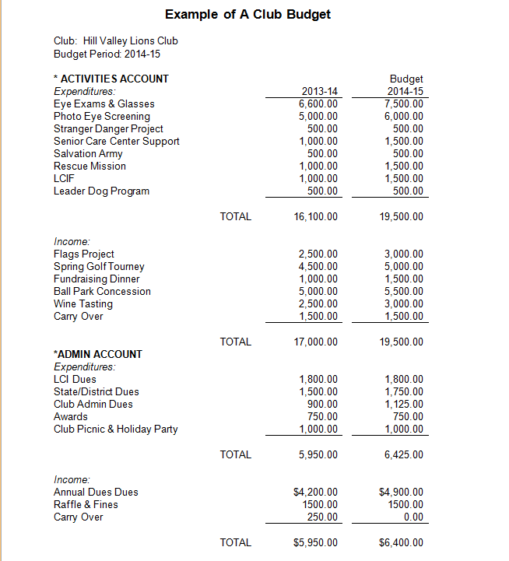
Responsibilities of the Club Treasurer
It is important to choose a report format that is clear, easy to follow, and accurate.
Financial Reports
Your current club treasurer is a great resource.
All club budgets and financial reports should be retained in a permanent file for club history.

Slide 23

501c(3) vs. Lions Club Organization
501c(3)
Separate organization
Contributions are deductible
More appealing to contributors
Lions Club
Contributions to club not deductible
Donations by club should be to 501 c(3) charities

Slide 24

Responsibilities of the Club Treasurer
The last topic to cover under responsibilities is:
NOV
  FILING CLUB TAXES

Slide 25
Responsibilities of the Club Treasurer
Which form to file?
GROSS RECEIPTS | FORM TO FILE
<$50K | 990-N (e-postcard)
>$50K, <$200K | 990-EZ
>$200K or >$500K in assets | FORM 990
Form 990-EZ and Form 990 can no longer be filed on paper. They MUST be filed electronically.

Slide 26
Responsibilities of the Club Treasurer
  *Filing date for the current year Nov. 15
  NO EXTENSION for filing a 990N!
NOV

Slide 27
Responsibilities of the Club Treasurer
NOV
**NOTE: An organization failing to file 990 form for three consecutive years will automatically lose its tax-exempt status.

Slide 28
Responsibilities of the Club Treasurer
ANNUAL AUDIT
ANNUAL AUDIT
PURPOSE: Assure financial accountability & compliance with LCI requirements
Appoint audit committee:
Past President, Secretary, or Treasurer
Two additional members

Slide 29
Responsibilities of the Club Treasurer
GATHER FOR AUDIT COMMITTEE:
ANNUAL AUDIT
Approved budgets
Bank Statements and Cancelled Checks
Check Register & bank reconciliations
Financial Statement for Year End
Paid Bills File
Summary of Receipts
List of Uncollected Dues
List of Unpaid Bills
Club members’ dues invoices

Slide 30
Responsibilities of the Club Treasurer
AUDIT COMMITTEE SHOULD:
ANNUAL AUDIT
Review Financial Statements for accuracy and to be sure it totals
Review deposits – supported by deposit slips
Disbursements – test checks and supporting documents
Reporting – write letter to club and Board of Directors with findings

Slide 31
Responsibilities of the Club Treasurer
YEAR END
Year End
Final report to club.
Pay the bills for installation of officers
Complete the Audit with Audit Committee
FILE IRS FORM 990
Prepare to transition to next treasurer

Slide 32
Planning Your Term
Before you officially take office, there are a several steps you can take to better prepare yourself.
Preparing for your Term
Attend Club Officer Training
Meet with the current treasurer, Audit Committee -determine status and balances of all club accounts
Help incoming president select Finance Committee
Review the club’s current budget to better understand the club’s monetary needs
Confirm location of bank accounts and obtain necessary signatures

Slide 33
Planning Your Term
Meeting with Previous Treasurer
Preparing for your Term
Verify administrative and project account balance
Determine dues owed and outstanding revenue
Verify amounts owed for scholarships and other expenses

Slide 34
Planning Your Term
Before you officially take office, there are a several steps you can take to better prepare yourself.
Preparing for your Term
Select a format for your financial reports to the board of directors
Set up the filing system for maintaining an audit trail of paid items and deposit records
Create your account and review training materials in my MyLCI
Work with club secretary to confirm membership information for billing purposes
Work with club secretary to help prepare dues invoices for members

Slide 35
Odds and Ends
ODDS AND ENDS
Sales Tax Exemption Certificate
Register with the State to be tax exempt
Surety Bonds
Liability Insurance

Slide 36
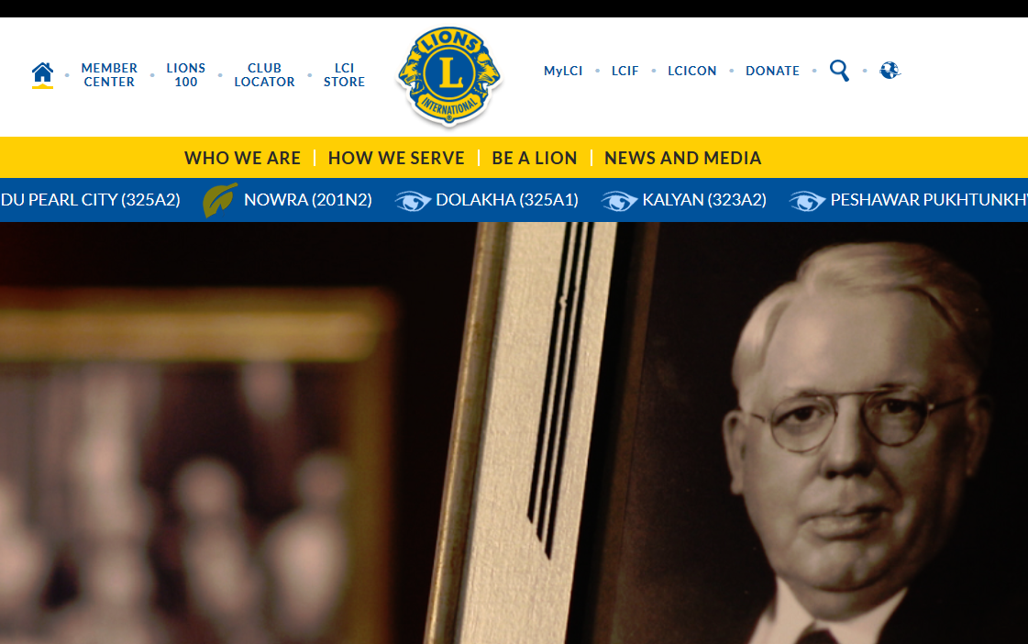
Responsibilities of the Club Treasurer
My LCI
https://www.lionsclubs.org/en
Reporting website
LCI is introducing a new website in July.

Slide 37
Responsibilities of the Club Treasurer
Once new club officers are reported to LCI headquarters, an email will be sent, providing information on how to access the system and select your password.
More information on submitting reports can also be found in the Club Officer Team Manual.

Slide 38

Responsibilities of the Club Treasurer
My LCI
On My LCI You Can…
View membership
Access and download club statements and per capita invoices
Opt-out of paper copies
Make online payments
Make reports
Online training
Notes:
The new “MyLCI” provides some key features that will greatly benefit you.
“MyLCI” allows you to:
* view your membership, which helps in preventing billing errors. You can also confirm if new members were entered correctly, especially if they are student or family members as billing is issued according to membership types.
* Another key benefit you will see from using “MyLCI” is the ability to access and download club statements. Now you can view statements dating back as far as December 2010.
* You can also opt out of receiving paper statements. This feature helps the environment, alleviates the potential of the late arrival of mailed statements, allows per capita errors to be identified and corrected in a timely manner, and lowers the postage cost for the association!
* Lastly, “MyLCI” provides enhanced payment options. As I mentioned briefly earlier, club treasurers now have the option to make payments online. This allows for next business day payment posting and promotes “Active” status for the club.
With these great benefits, we hope to see a drastic increase in the number of club treasurers that are registered with and using the site.

Slide 39
Online Statements
My LCI
Statements:
  You may view them the day they are generated
  View them from several years back
  Can be viewed by club and district officers
Notes:
Before we continue with our preview I want to point out a few things about club statements within “MyLCI.”
* One great benefit of “MyLCI” is that you can view your club’s statements online the day they are generated. You will no longer have to wait to receive it in the mail.
* You will be able to view past statements and semi-annual per capita invoices from as far back as December 2010.
* The club’s statements can be viewed by club, district, and multiple district officers.

Slide 40

Electronic Payments
Payments are processed via the Chase payment website.
Partial payments are allowed.
Payments can be made with a credit card or with an electronic check.
    VISA, MasterCard, Discover Card or American Express
Notes:
There are a few things I want to mention about making online payments.
When making payments, you will be directed to our Chase payment website. At this time, the Chase payment website is only available in English and Spanish.
You will be able to make full or partial payments. When making partial payments, the amount paid will be applied to your oldest balance first.
Lastly, payments can be made via a credit card or, for clubs that have a US bank, a withdrawal can be made directly from your account via an electronic check, also know as eCheck.

Slide 41



Support Center
mylci@lionsclubs.org
630-468-6900
Accounts Receivables and Club Account Services
membershipbilling@lionsclubs.org
Notes:
If you have questions about “MyLCI”, please contact the support center at LCI Headquarters, which is open from 8:30 AM – 4:30 PM Chicago time, Monday thru Friday.
For other billing and treasurer specific questions, please contact the Account Receivables and Club Account Services department.

Slide 42
Responsibilities of the Club Treasurer
A link to your Itemized statement of charges and credits will be sent from International Headquarters.
(Any month transactions occurred or club maintains balance)
These charges and credits may include:
  Semi-annual international member dues (July & Jan)
  New member fees
  Charter fees
  Prorated dues for new members
  Fees from reinstated members
  Dues for transfer and life members
  Club supplies
Notes:
You will get an email from LCI with a link to the website so you can log in and view your statement.

Slide 43
Resources
You can gain additional insight and information by familiarizing yourself with the documents and training material on the following webpages:
MyLCI
Club Officer Orientation
The Leadership Resource Center
The Lions Learning Center
Lions Clubs Member Resources
Managing a Club

Slide 44
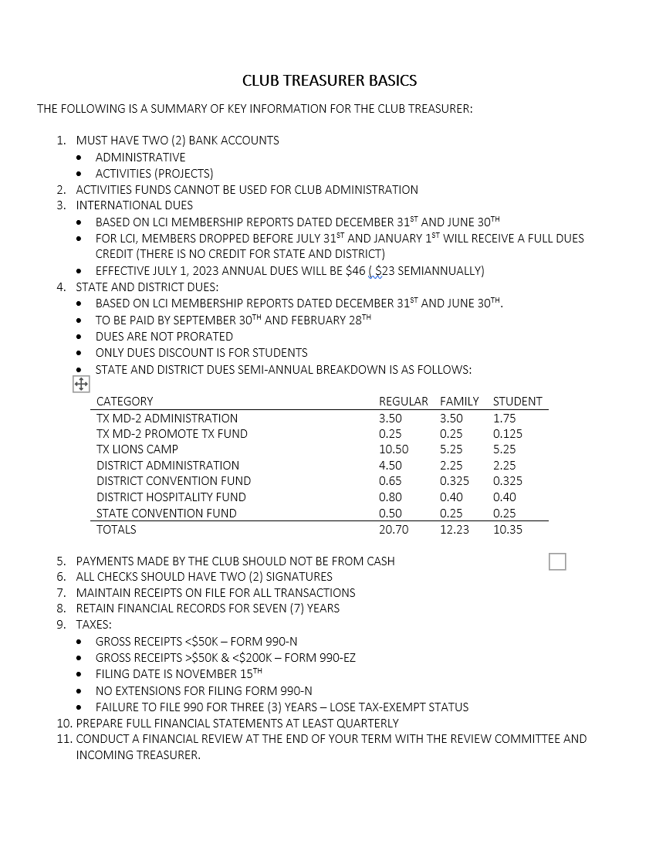
Resources

Slide 45

Questions?

Slide 46
Congratulations!
Congratulations on completing Club Treasurer Training!

