Slide 1
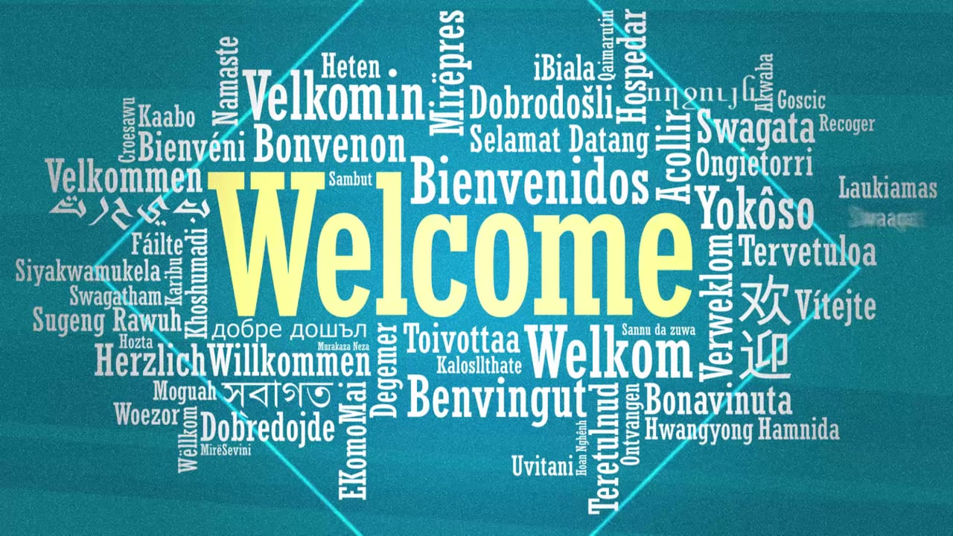

Slide 2

2x1Lions - Membership Chair Training
Facilitated by:
Esmeralda Rodriguez, 2x1-IPDG
Saturday, June 24, 2023
11 am to noon

Slide 3


Global Membership Approach District Team
2x1 Needs You to step up to be a leader or help us identify leaders for focus areas!
Notes:
Presenter notes:
Edit this slide to enter the names of your district governor, Global Membership Approach Support Lead and any other leaders already identified prior to the start of the meeting.
The chart itself can also be modified as needed to suit your district. For example, you could remove the team leaders and just list the members who will work in each focus area. It also does not need to be complete, as it will be re-examined during the Build Success step.
_____________________________________________________
Script for GAT Area Leader to prepare district leaders to lead a Build a Plan workshop:
This is the moment to review and possibly revise the team structure you established during the Build a Team workshop. Revisiting this after-action planning is important to ensure that each task has the appropriate person assigned to it.
Script for district leaders when leading a Build a Plan workshop:
These are our Global membership Approach team members. We have several Lion leaders already identified, but would anyone like to volunteer their name for any of the remaining areas or suggest another way we could organize ourselves to implement the actions we have identified?
Are there others we can ask to join us, for example Past District Governors or other Lion leaders in our district? (Pause for input)

Slide 4
Icebreaker-Stand Up Raise Your Hand Activity (2- minutes)
Raise Your Hand up if you are passionate about helping others.
Raise Your Hand if your club is known for helping to feed people in need.
Raise Your Hand up if you or your club helps recycle eyeglasses.
Raise Your Hand up if you or your club helps with food distributions.
Raise Your Hand up if you or your club added a new member(s) this year.
Raise Your Hand up if you or your club did a service project this year.
Raise Your Hand up if you or your club helped with our 2x1 picnic this year.
Raise Your Hand up if your club sponsored a new club this year.
Raise Your Hand up if you or your club has a signature project(s).
Raise Your Hand up if you or your club donated to 2x1 charities.

Slide 5
Membership
Service
WE SERVE
Global
Membership
Approach
Process
Leadership

Slide 6
Overview Club Membership Chairperson Guide

Slide 7
Membership Chairperson Guide
Preparing Your Club:
Creating Your Club’s Growth Plan
Implementing Your Club’s Growth Plan
Welcoming Your New Members
Preparing For Your Term
Support and Guidance
Membership Satisfaction
Membership Recruitment
Awards & Recognition

Slide 8
LCI Resources
Membership Chairperson Guide
New Club Extenstion Powerpoint
Global Membership Team (GMT) District Coordinator
Global Extention Team (GET) District Coordinator
Global Membership Approach
Membership Reports Toolbox
Membership Development Grants
Just Ask Guide
Global Membership Kit
New Member Orientation Guide:
https://cdn2.webdamdb.com/md_waKhcTuv1wD9.jpg.pdf?v=1
New Member Orientation Powerpoint:
https://www.lionsclubs.org/resources/95669737
New Member Welcome Booklet
Lions Club International Facts sheet (PR-799)

Slide 9
Plan for success. Our 2023-2024 Priorities
Membership growth and engagement
The growth of our association means we’re always ready to serve. To grow, we must not only bring in new members, we must also keep our current Lions engaged and active.
Support our Foundation
We are in the final year of our most ambitious giving campaign ever, Campaign 100. The generosity and support of LCIF is empowering our service around the world, and bringing hope. Let’s put our hearts into action by supporting our global foundation. We reached and exceeded raising US$300M.
Compassionate Service
As communities around the world seek to find a sense
of normalcy once again, Lions have a new and great
opportunity to lead by example. We can help the world
recover in this time when so many are still struggling. We
must keep up our innovative service efforts of the past
year and expand on them to address the needs of our
current situation, with the knowledge that things can
change at any moment
Communication
Transparency and open lines of communication are
essential to great service, and therefore have always
been key to Lions clubs. We must continue to focus on
our connections to one another, those we serve, and
the organizations that support us. As Lions, we have a
powerful and global community of peers we can learn
from and assist.

Slide 10

Individual-
Just Ask/Invite one
Clubs-
Keep all your Members & Get 5 new Members
Increase Service Opportunities
Increase Reporting of Service
Increase Leadership Opportunities
Increase Sharing our lions stories of service
Regions/Zones-
Increase number of members and clubs;
Rebuild clubs with 20 or less members;
Increase attendance of leadership to cabinet meetings, zone chair meetings, executive council and district convention.
District-
Increase fellowships and engaging service; Increase membership-retention/recruitment; service,and leadership; Increase recognition; Increase sharing success stories of service

Slide 11
Traveling Trophies sponsored by PDGs presented at 1st, 2nd, 3rd and 4th Cabinet Meetings for increase in membership; service reporting; LCIF donations
Individual-
Just Ask/Invite one
Clubs-
Keep all your Members & Get 5 new Members
Increase Service Opportunities
Increase Reporting of Service
Increase Leadership Opportunities
Increase Sharing our lions stories of service
Regions/Zones-
Increase number of members and clubs;
Rebuild clubs with 20 or less members;
Increase attendance of leadership to cabinet meetings, zone chair meetings, executive council and district convention.
District-
Increase fellowships and engaging service; Increase membership-retention/recruitment; service,and leadership; Increase recognition; Increase sharing success stories of service

Slide 12

7 C’s
1.Connecting with each other and our community by sharing our Why and our stories!
2.Committing to be our best, do our best and try our best!
3.Caring for one another in words and actions!
4.Celebrating the good things we accomplish!
5.Communicating effectively the strengths, weaknesses, opportunities and threats to our members, clubs and district and brainstorming solutions.
6.Creating engaging service opportunities for current and new prospective lion members!
7.Collaborating with each to other at district, club, zone and also community partners is important!
We must remember that Connecting, Committing, Caring, Celebrating, Communicating, Creating Engaging Service and Collaborating are key to Increasing Retention and Growth in membership, Leadership and Service in our district and clubs. We need to take a close look at where we are, what is working and what we need to add or change to increase the strong foundation in our district and clubs. We need to be willing to each individually take a risk and commit to dare to get out of our comfort zone and together face the challenges, obstacles and struggles with a positive attitude and respect.

Slide 13

Feedback/Comments/Questions? Thanks for attending training today!
Notes:
Presenter notes:
____________________________________________________________
Thank you for participating today. All the work we have done will help Lions clubs grow in our district and eventually around the world.
Would anyone like to provide feedback on this process? How did this meeting work for you?
Thank you again for all your contributions to the Global Action Team and Global Membership Approach and all you do for Lions clubs.

